Slide 1
Control Statements: Part 2
Chapter 6 of Visual C# How to Program, 6/e

Slide 2
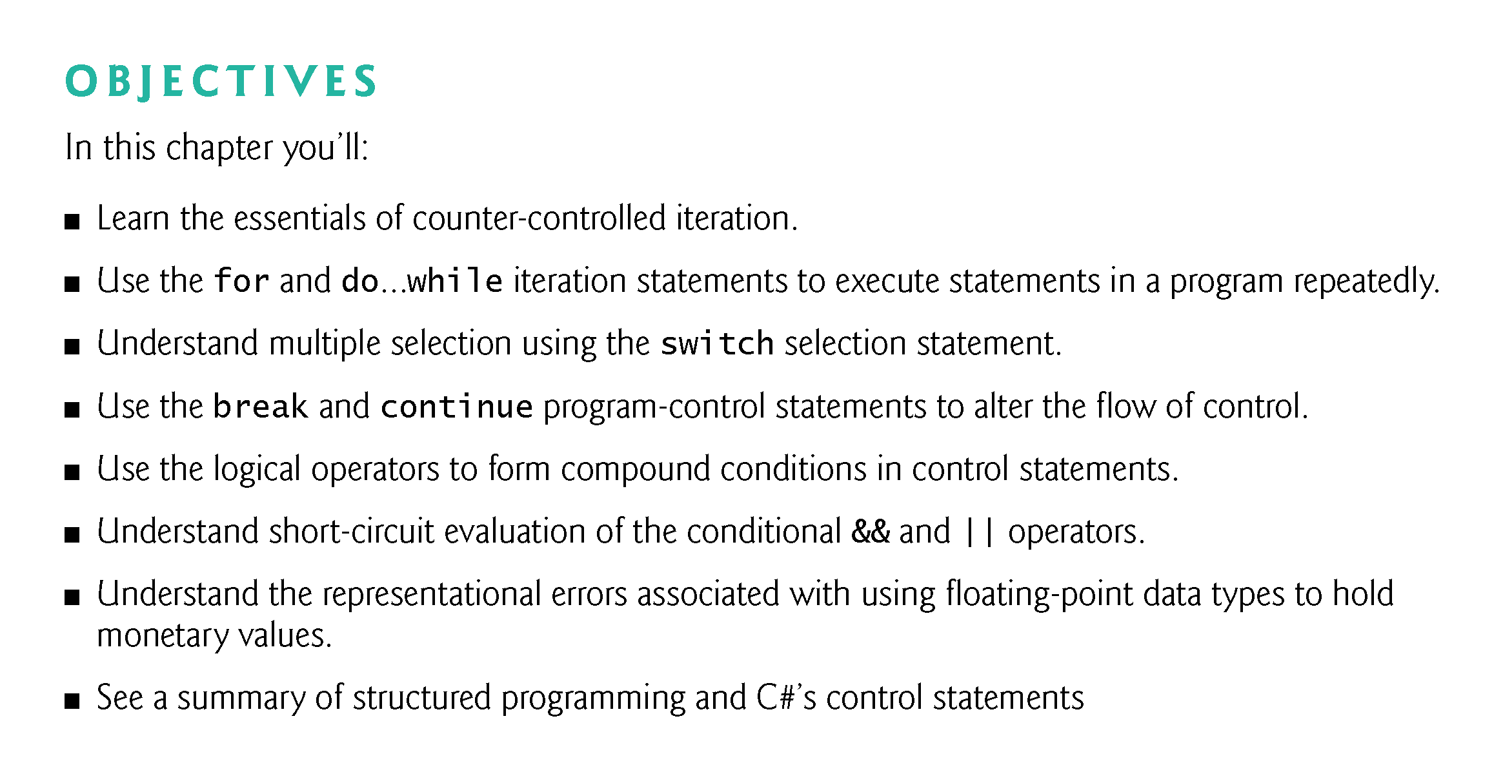

Slide 3
6.2 Essentials of Counter-Controlled Iteration
Counter-controlled iteration requires
  a control variable (or loop counter)
  the initial value of the control variable
  the increment (or decrement) by which the control variable
  is modified each iteration of the loop
  the loop-continuation condition
Fig. 6.1 uses a loop to display the numbers from 1 through 10.

Slide 4
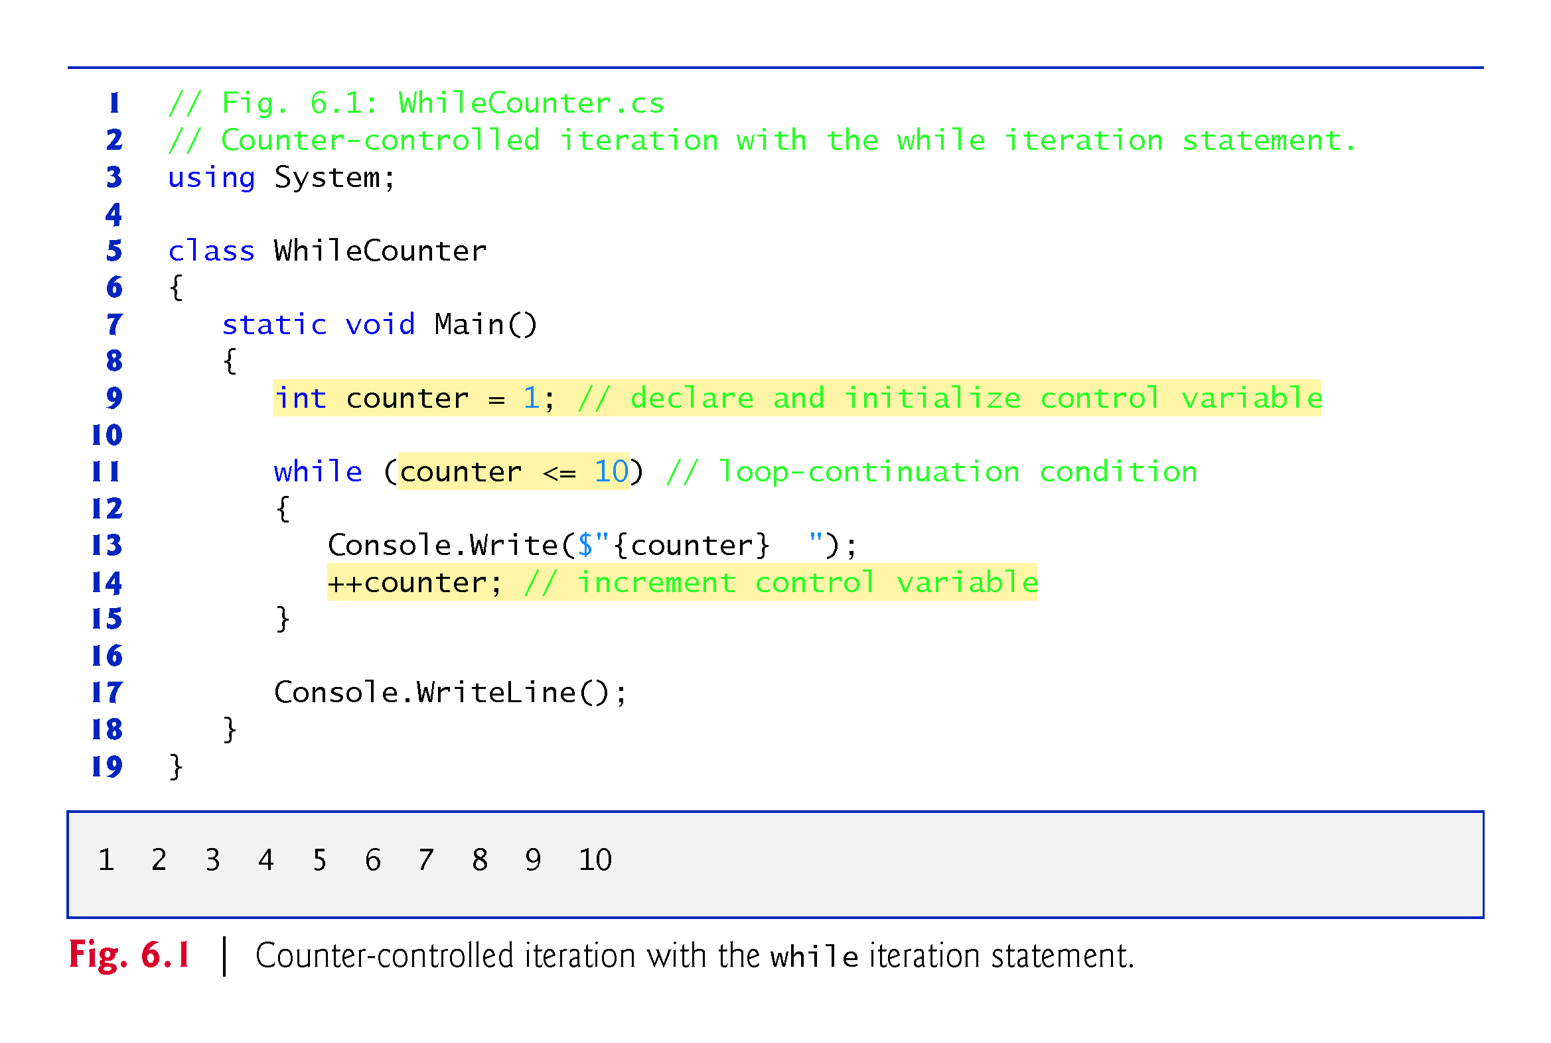

Slide 5
6.3 for Iteration Statement
The for iteration statement specifies the elements of counter-controlled-iteration in a single line of code.
Figure 6.2 reimplements the app using the for statement.

Slide 6
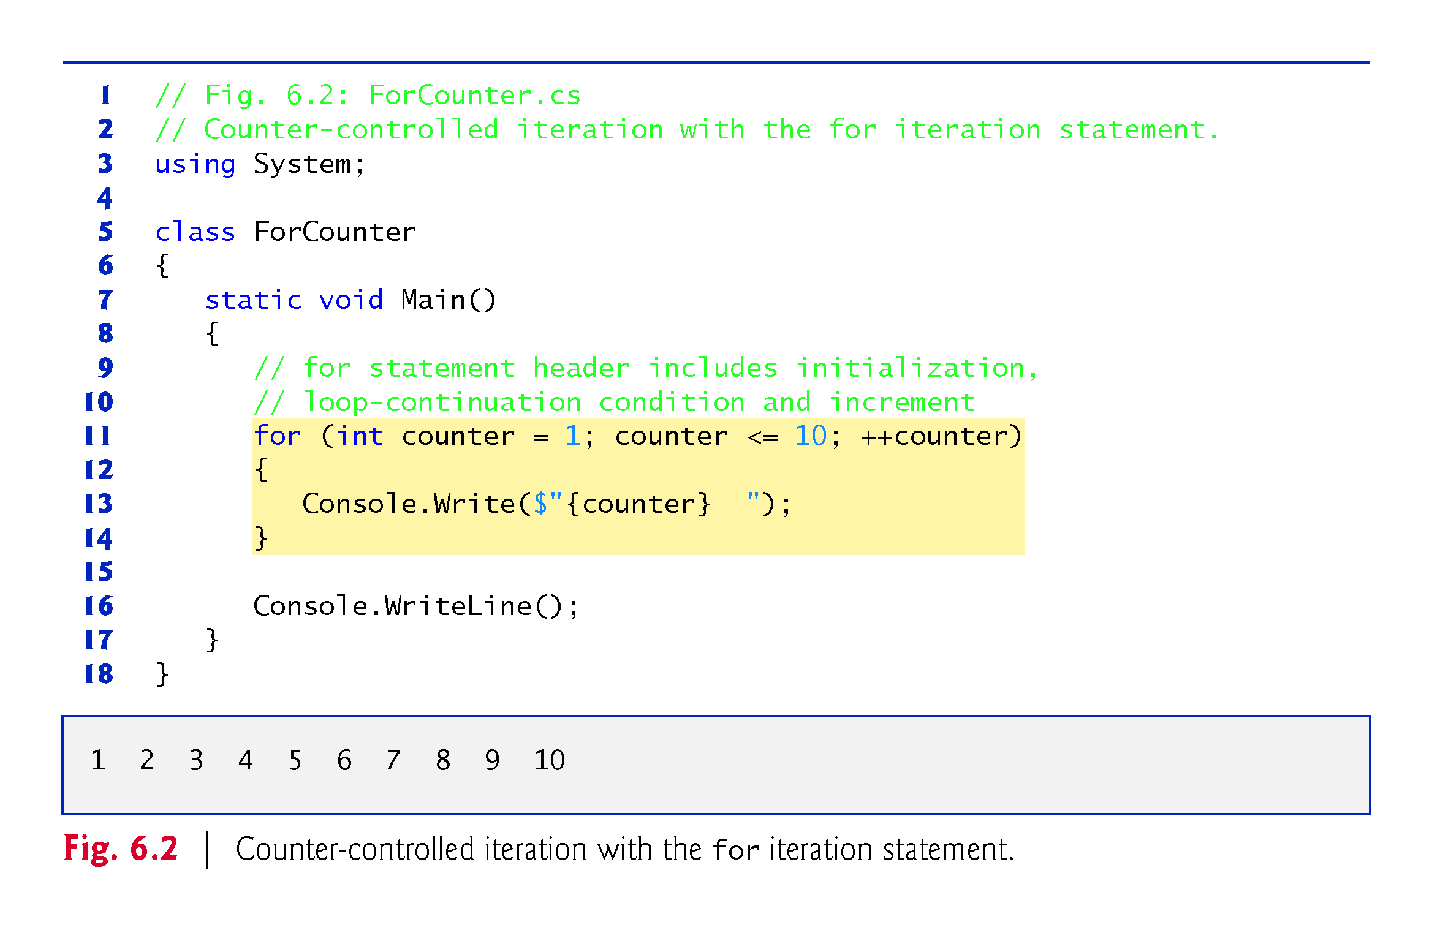

Slide 7
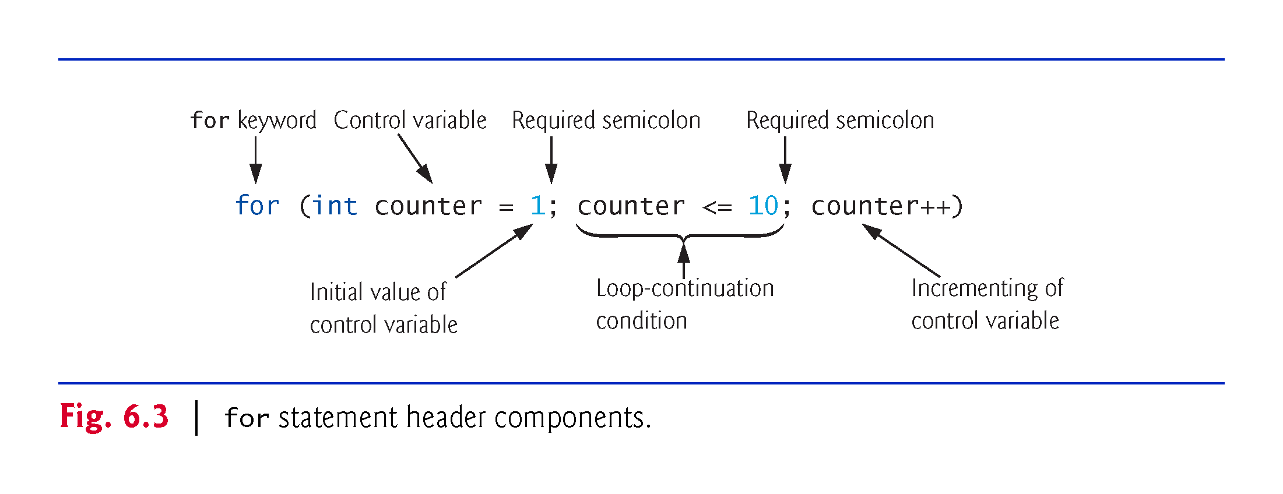

Slide 8
6.3 for Iteration Statement (Cont.)
If the initialization expression declares the control variable, the control variable will not exist outside the for statement.
This restriction is known as the variable’s scope.
Similarly, a local variable can be used only in the method that declares the variable and only from the point of declaration.

Slide 9
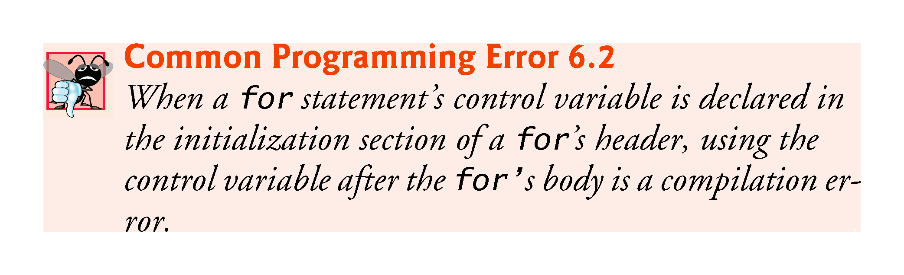

Slide 10
6.3 for Iteration Statement (Cont.)
All three expressions in a for header are optional.
  Omitting the loopContinuationCondition creates an infinite loop.
  You can omit the initialization expression if the control variable is initialized before the loop.
  You can omit the increment expression if the app calculates the increment with statements in the loop’s body or if no increment is needed.

Slide 11
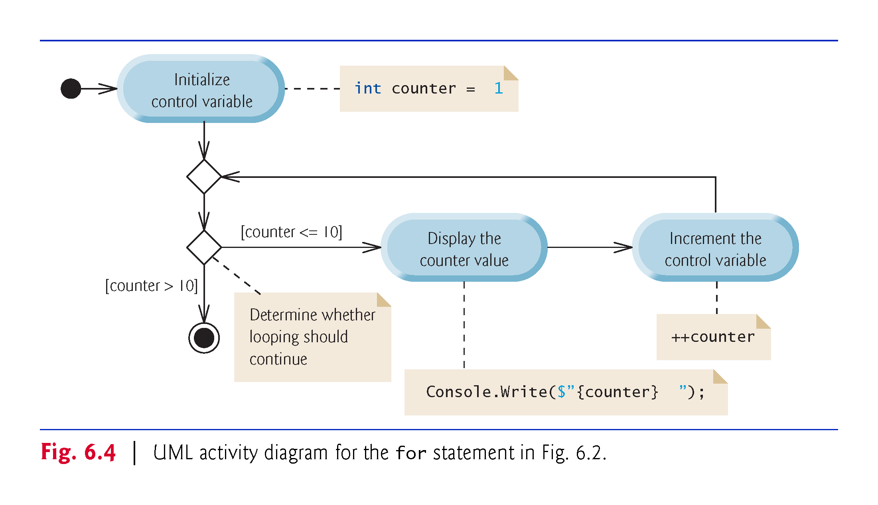

Slide 12
6.5 App: Summing Even Integers
The app in Fig. 6.5 uses a for statement to sum the even integers from 2 to 20 and store the result in an int variable called total.

Slide 13
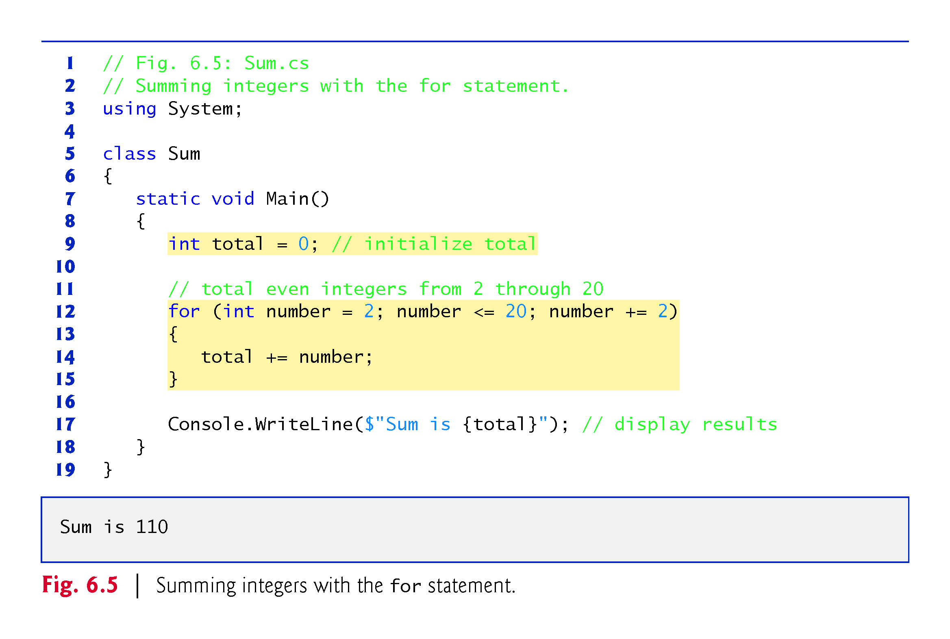

Slide 14
6.6 App: Compound-Interest Calculations
A person invests $1,000 in a savings account yielding 5% interest, compounded yearly. Calculate and display the amount of money in the account at the end of each year for 10 years.
a = p (1 + r )^{n}
p is the original amount invested (i.e., the principal)
r is the annual interest rate (use 0.05 for 5%)
n is the number of years
a is the amount on deposit at the end of the nth year.
Fig. 6.6 uses a loop that performs the calculation for each of the 10 years the money remains on deposit.

Slide 15
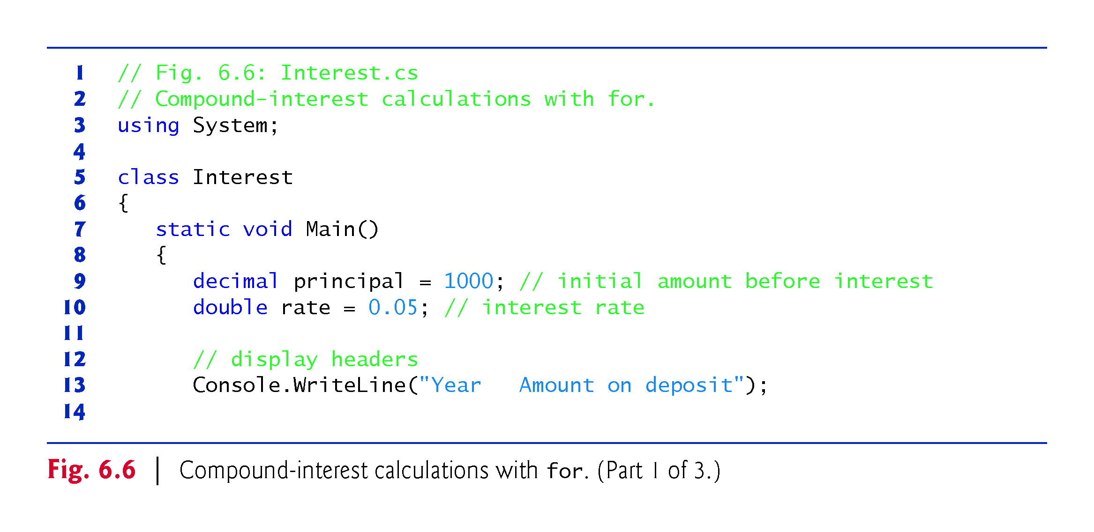

Slide 16
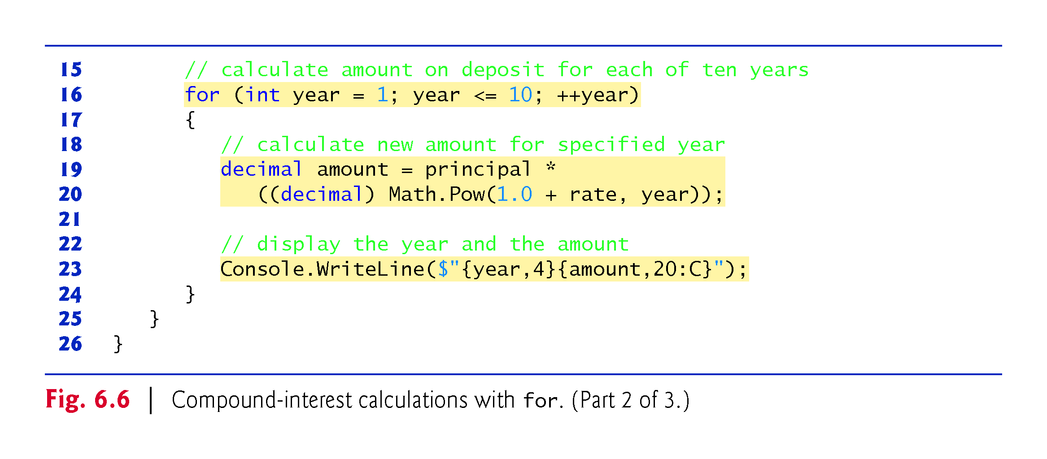

Slide 17
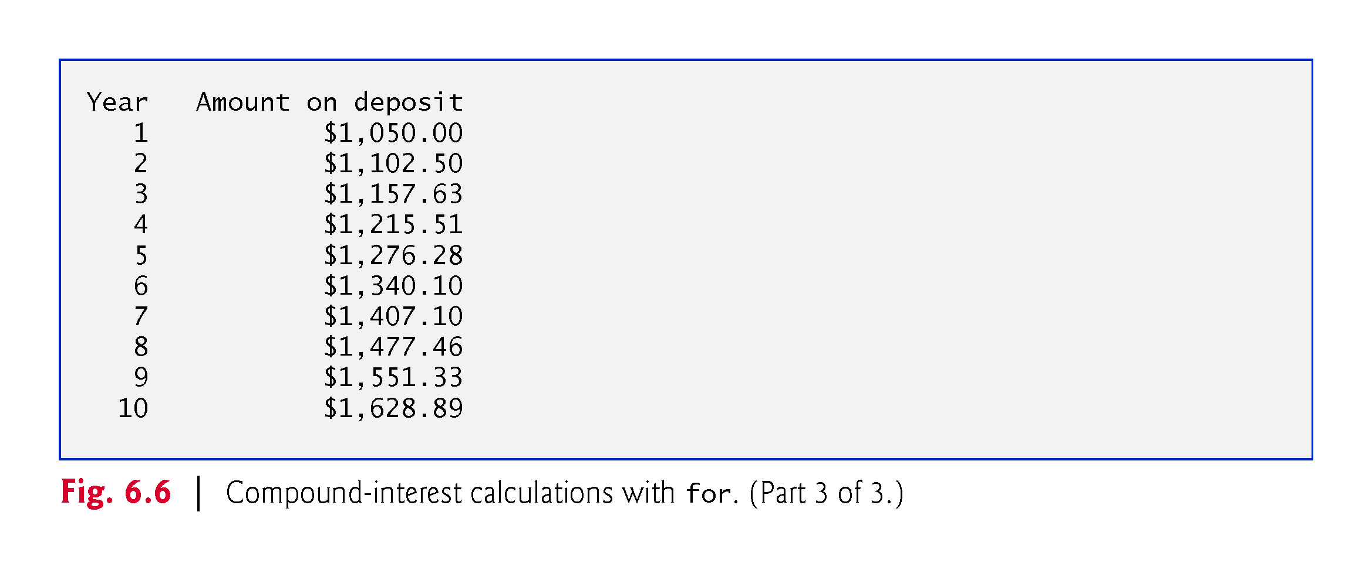

Slide 18
6.6.1 Performing the Interest Calculations with Math Method pow
Many classes provide static methods that cannot be called on objects—they must be called using a class name.
You can call a static method by specifying the class name followed by the member access (.) operator and the method name:
ClassName.methodName(arguments)
Math.Pow(x, y) calculates the value of x raised to the yth power.

Slide 19
6.6.3 Caution: Do Not Use float or double for Monetary Amounts
Section 4.9 introduced the simple type decimal for precise monetary representation and calculations.
For certain values types float and double suffer from what we call representational error.
  Floating-point numbers often arise as a result of calculations—when we divide 10 by 3, the result is 3.3333333…, with the sequence of 3s repeating infinitely.
  The computer allocates only a fixed amount of space to hold such a value, so clearly the stored floating-point value can be only an approximation.

Slide 20
6.7 do...while Iteration Statement
The do…while iteration statement (Fig. 6.7) is similar to the while statement.

Slide 21
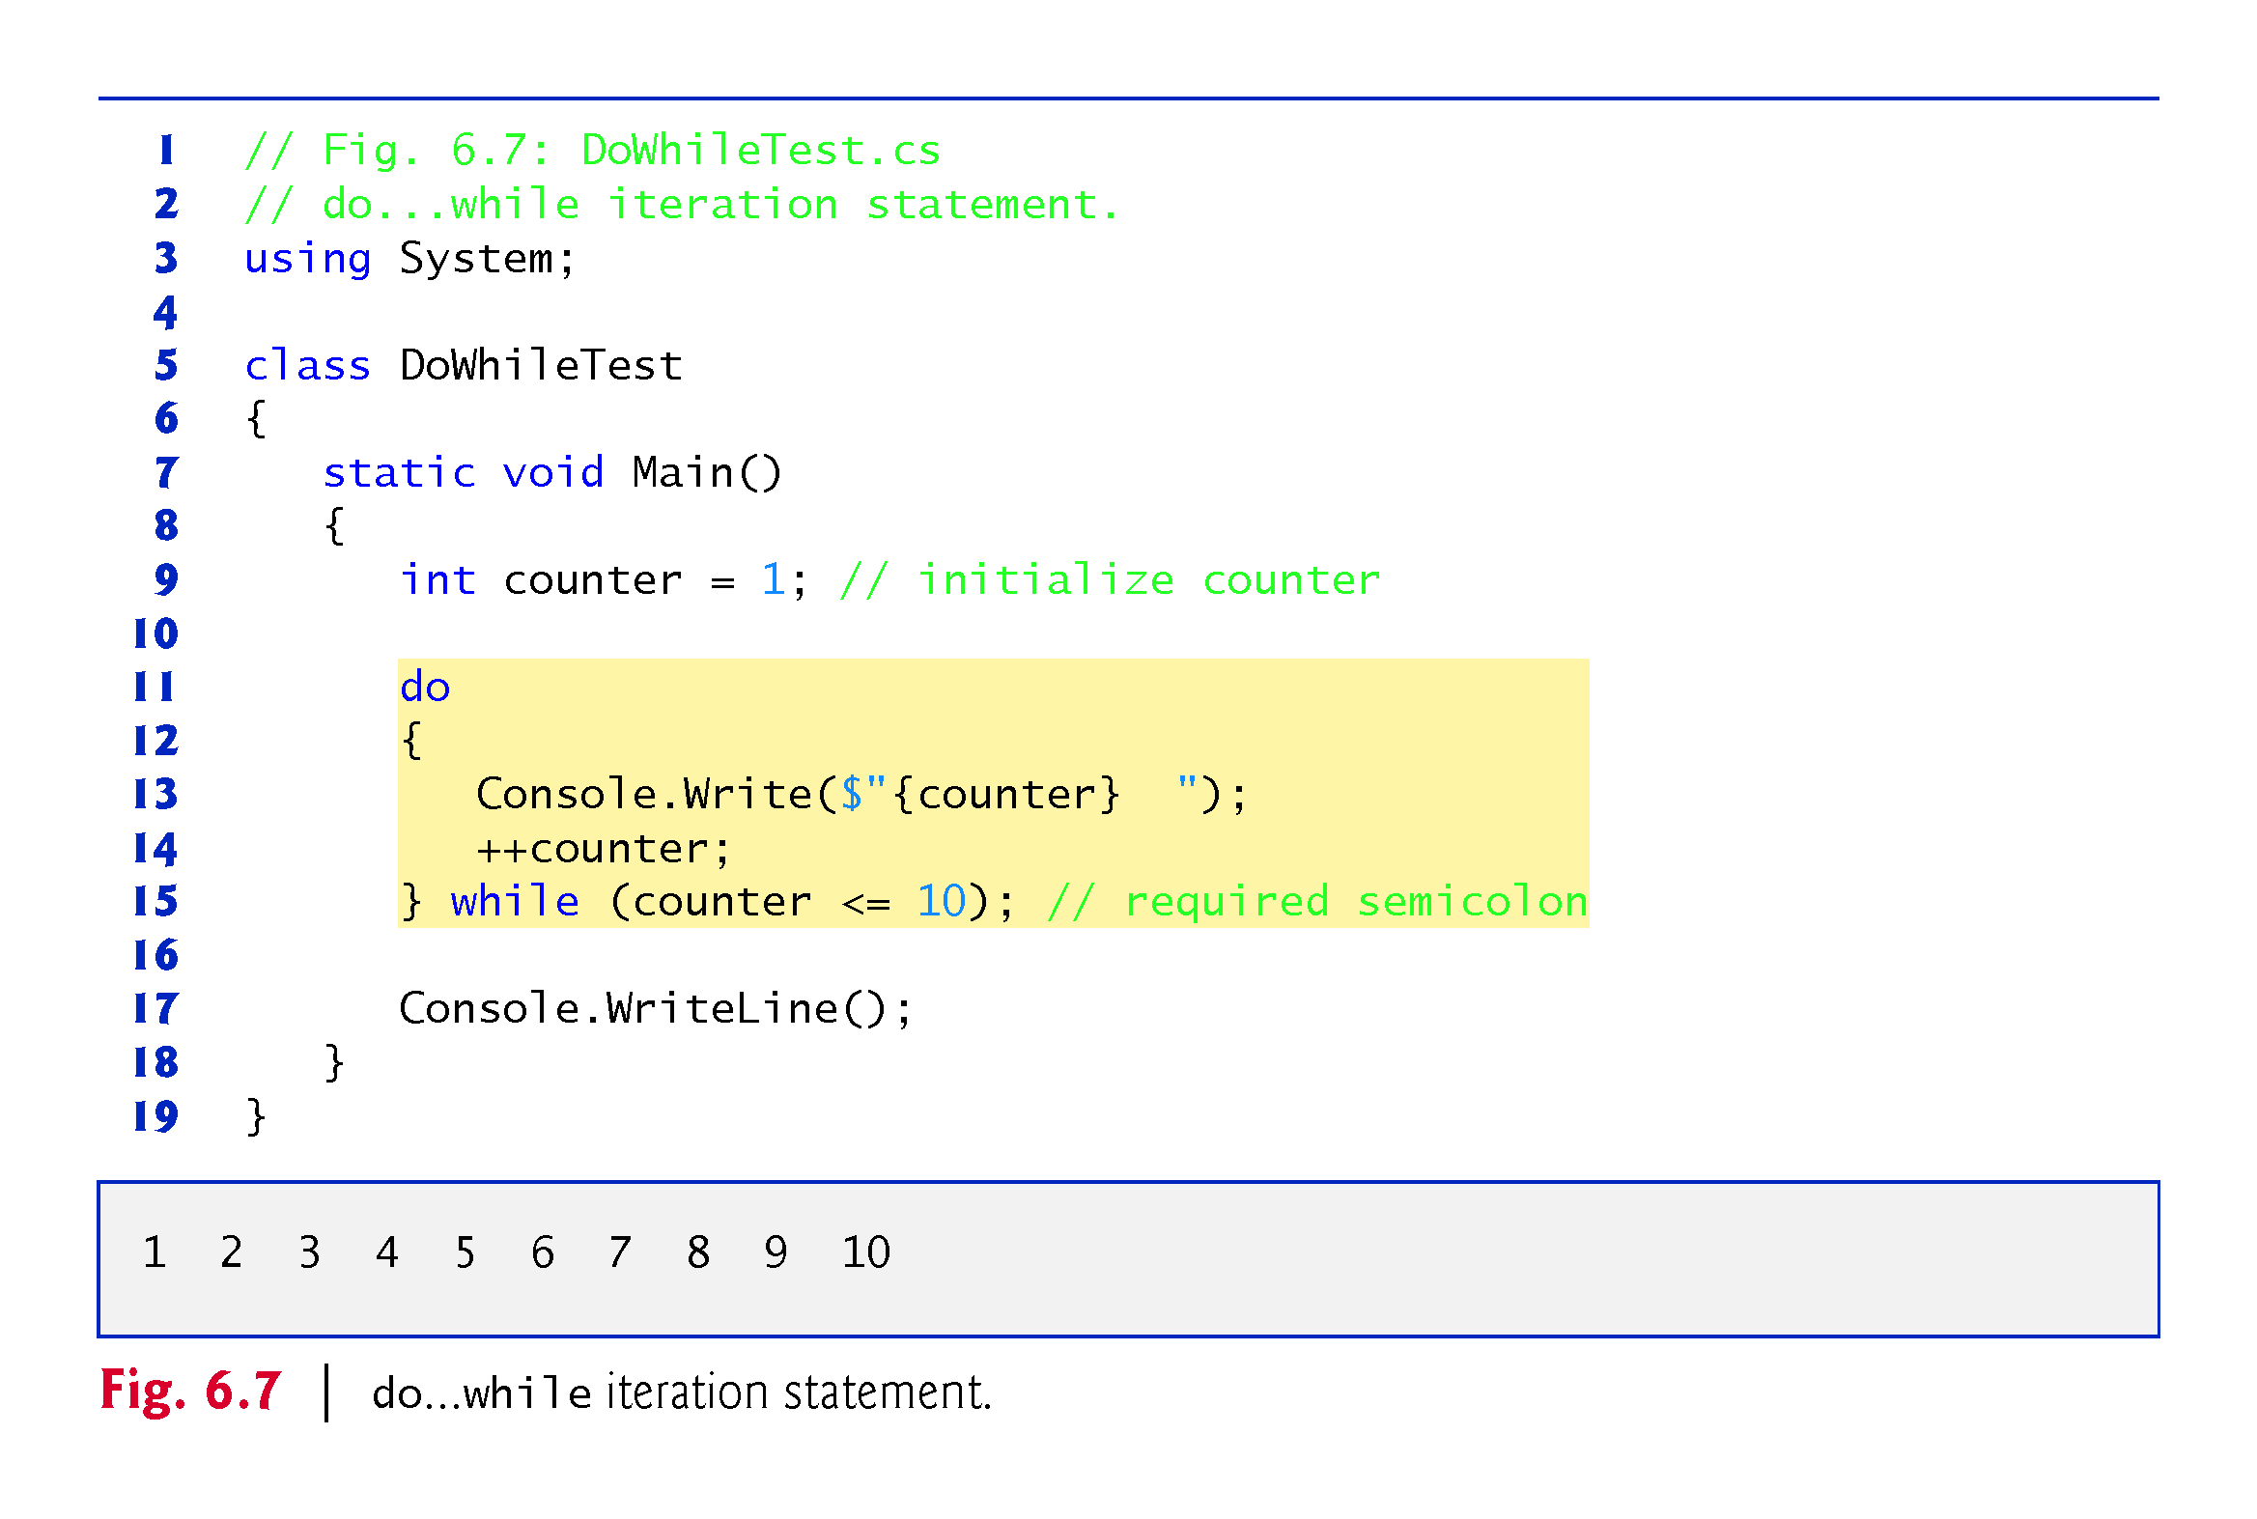

Slide 22
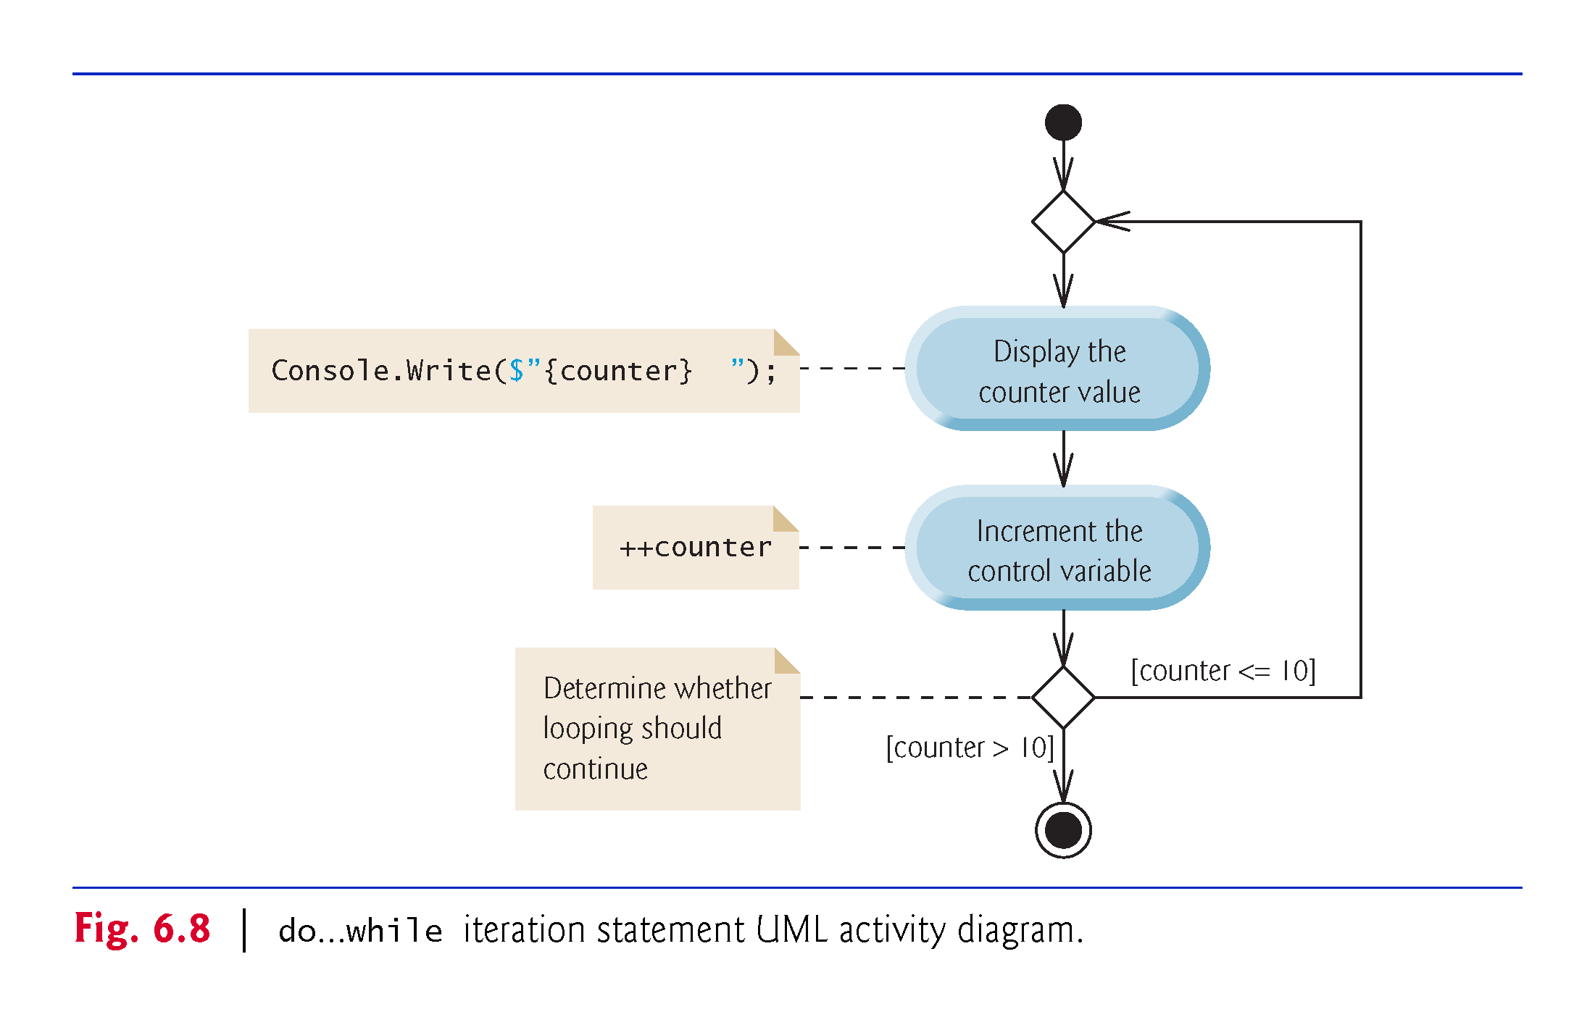

Slide 23
6.8 switch Multiple-Selection Statement
The switch multiple-selection statement performs different actions based on the value of an expression.
Each action is associated with the value of a constant integral expression or a constant string expression that the expression may assume.

Slide 24
6.8.1 Using a switch Statement to Count A, B, C, D and F Grades
Figure 6.9 calculates the class average of a set of numeric grades entered by the user, and uses a switch statement to determine whether each grade is the equivalent of an A, B, C, D or F and to increment the appropriate grade counter.
The program also displays a summary of the number of students who received each grade.

Slide 25
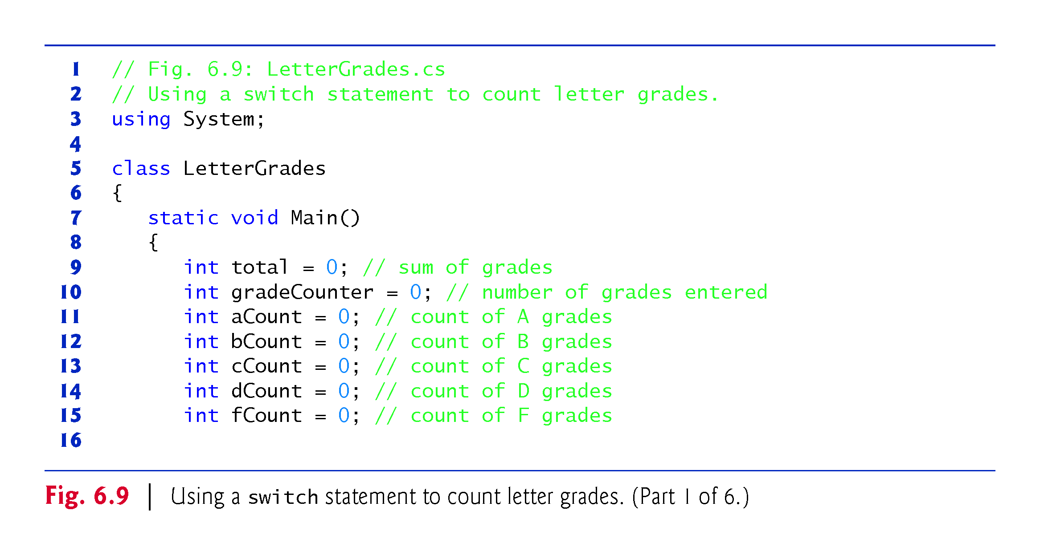

Slide 26
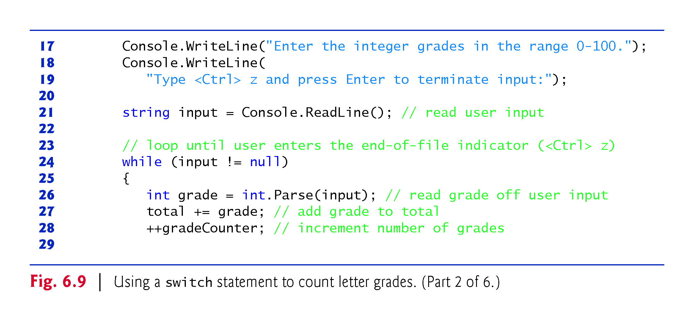

Slide 27
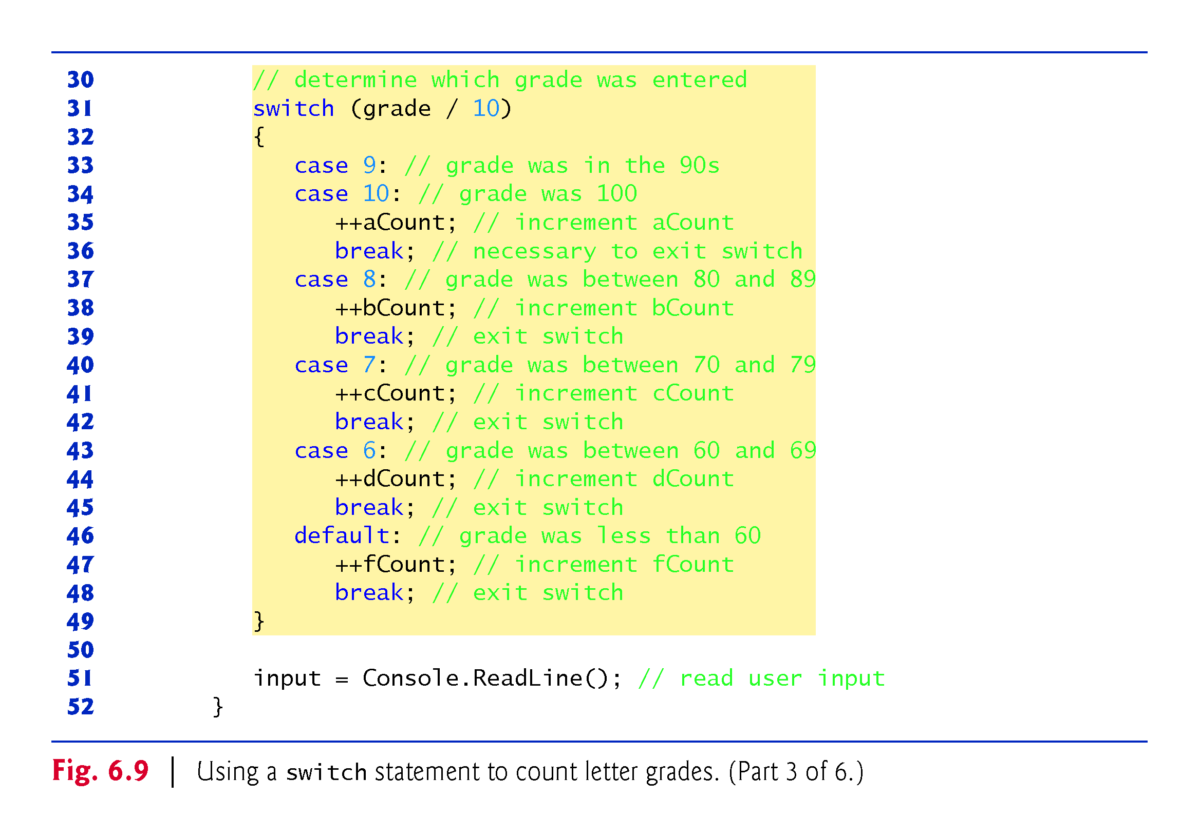

Slide 28
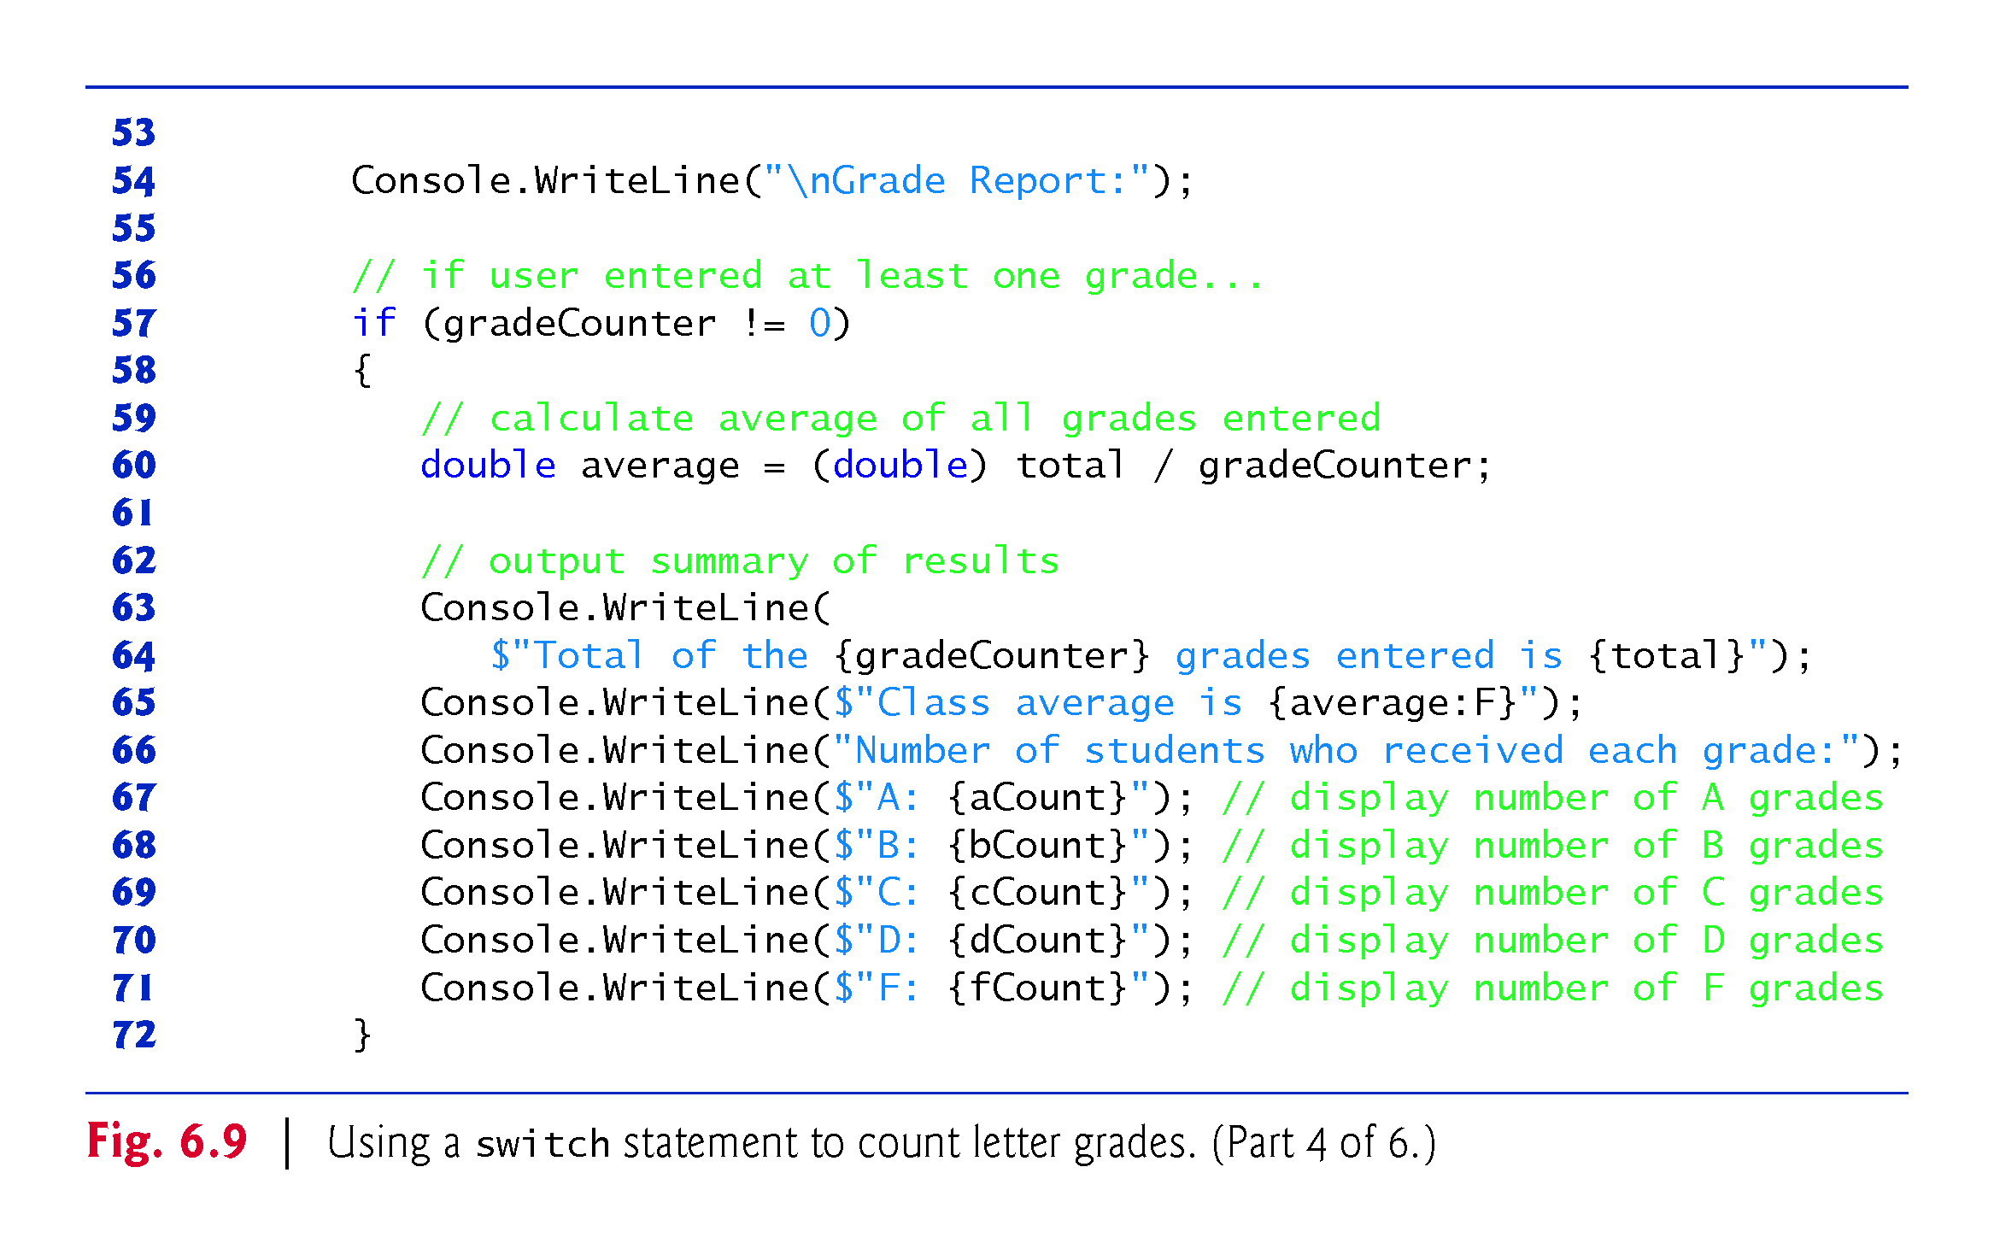

Slide 29
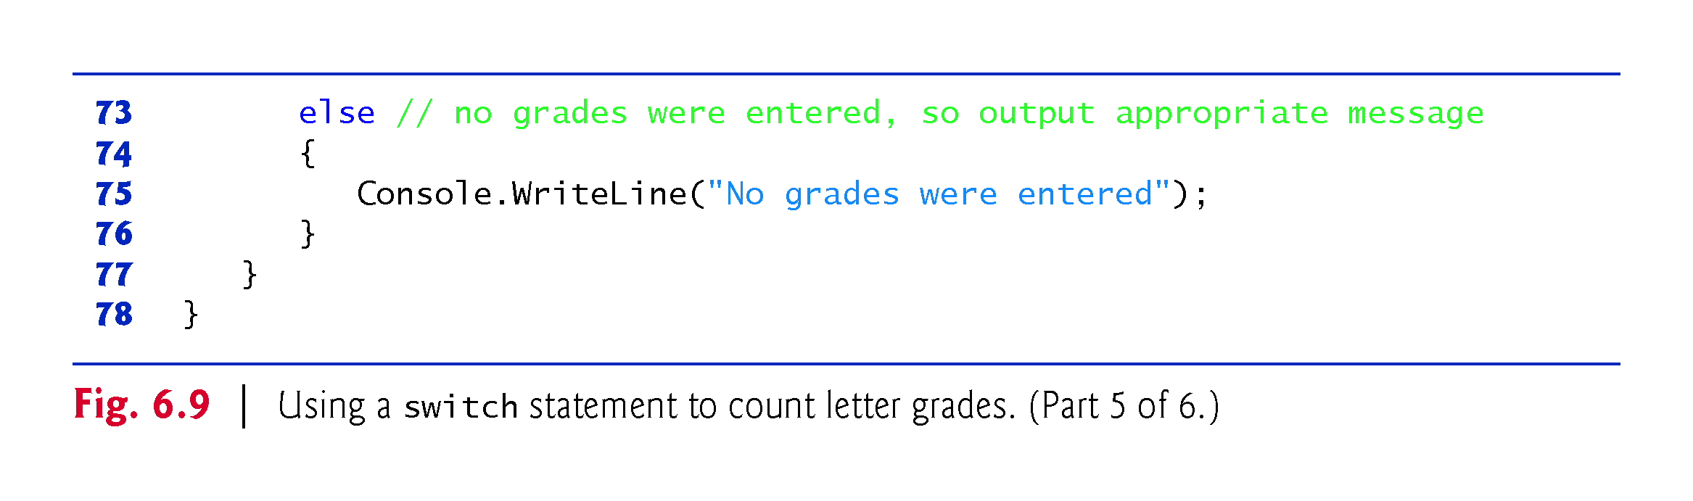

Slide 30
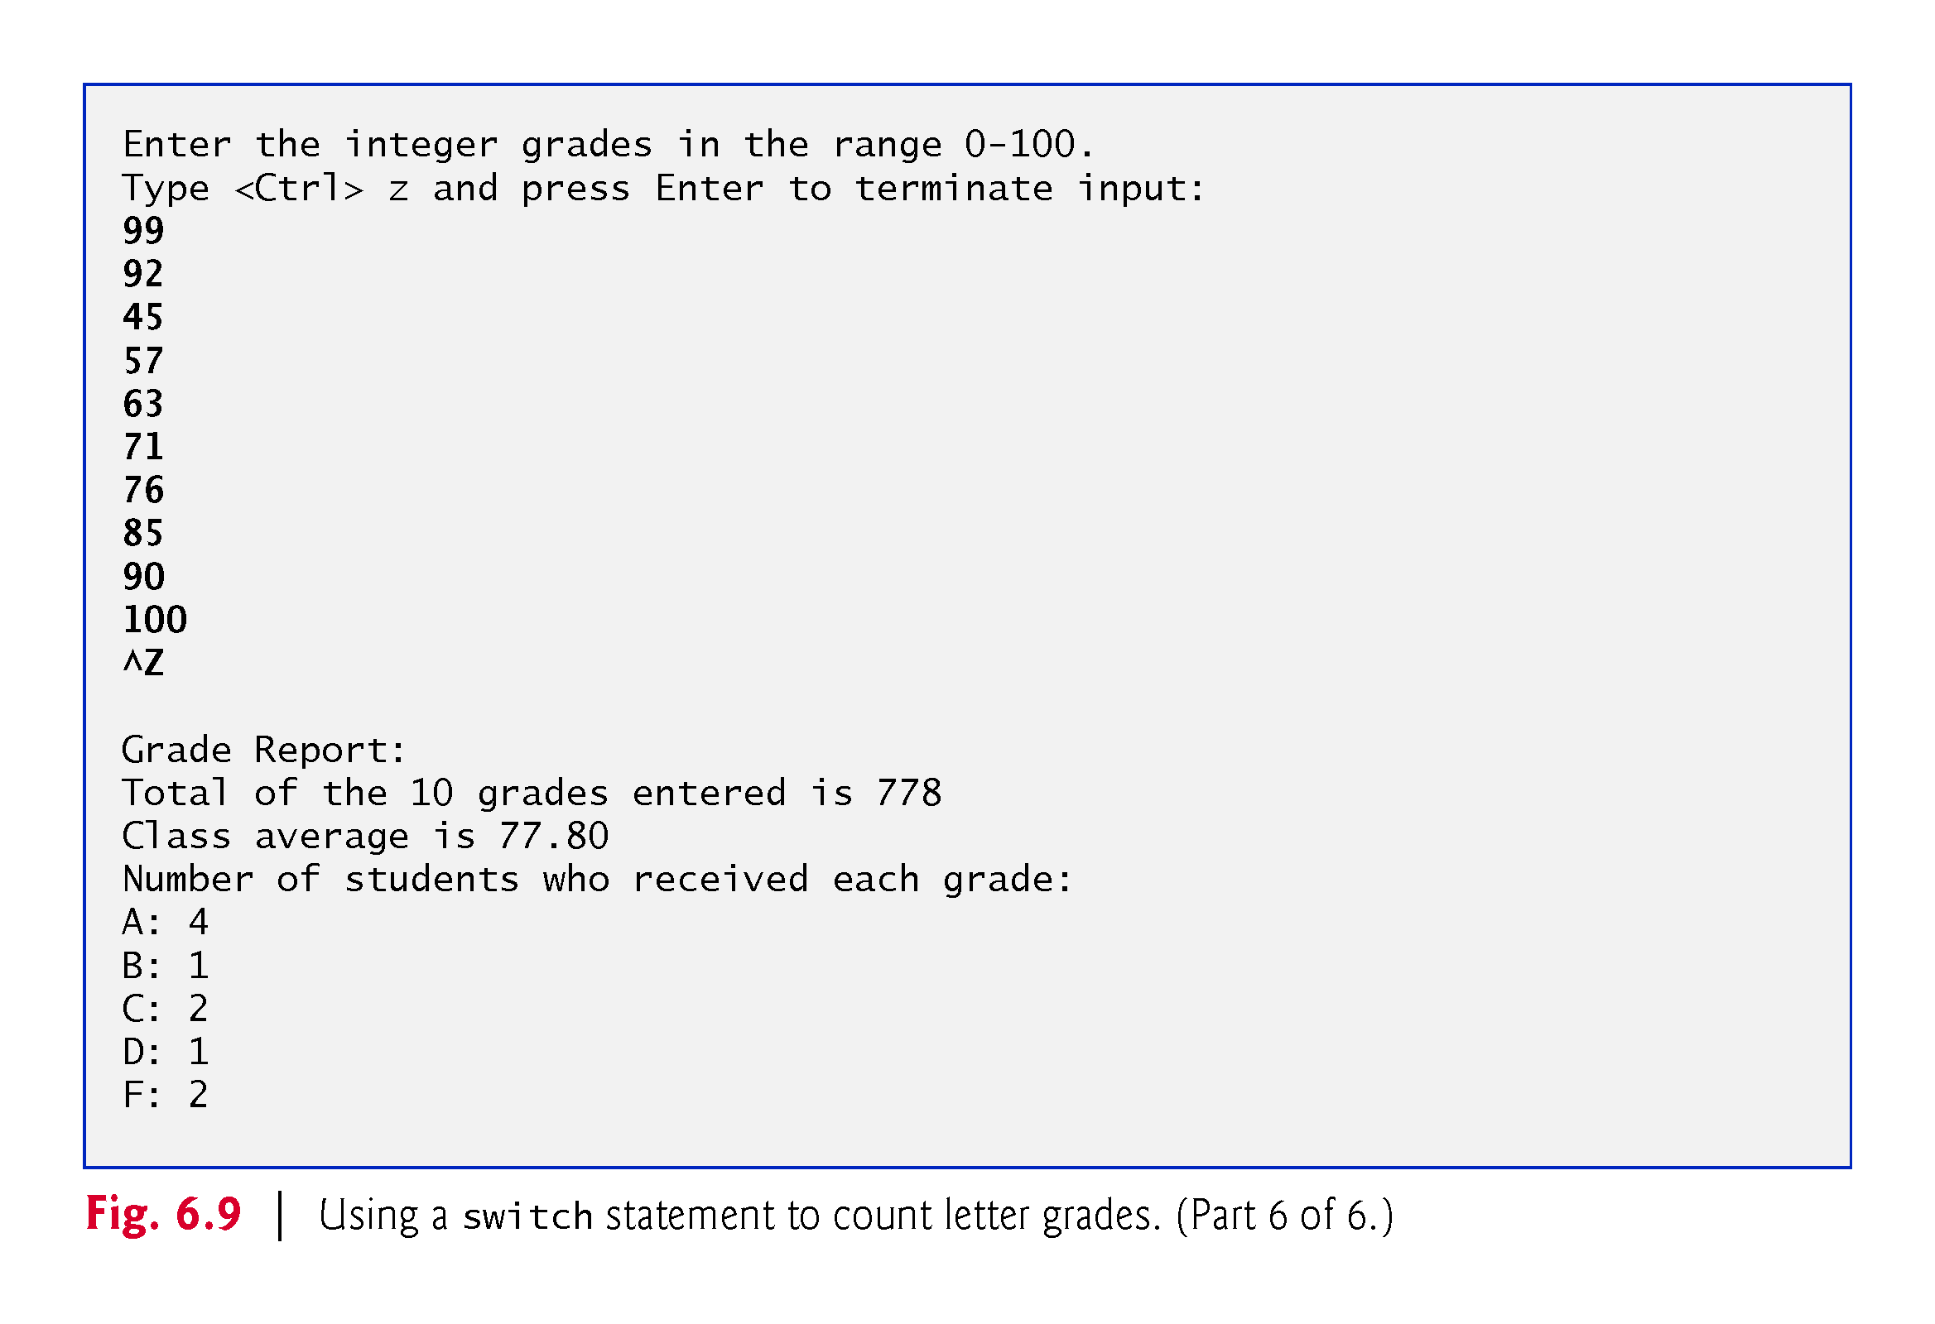

Slide 31
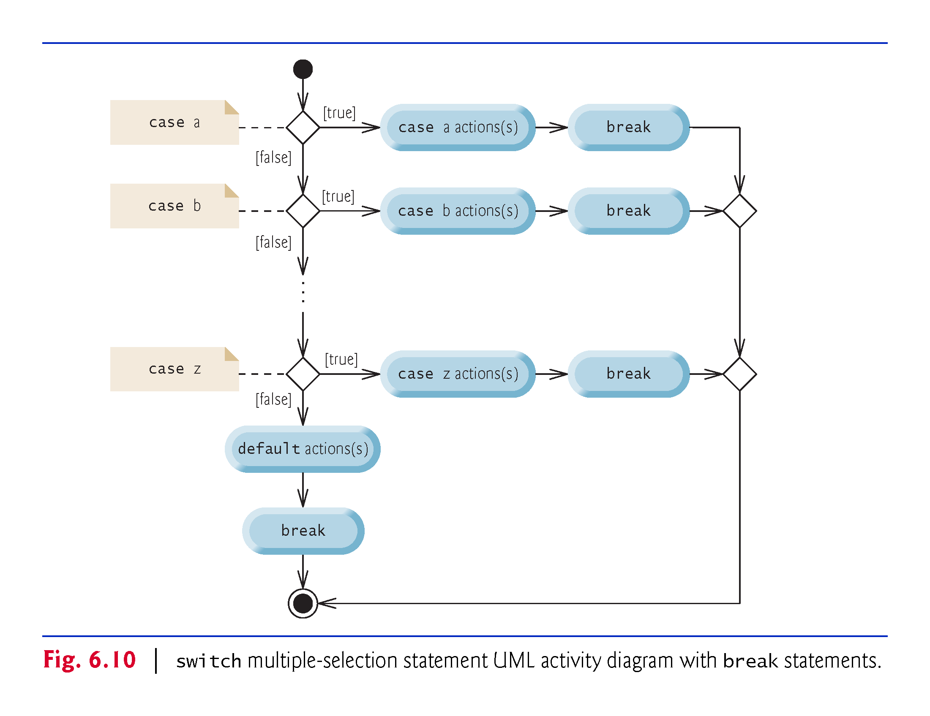

Slide 32
6.10.1 break Statement
The break statement causes immediate exit from a statement.
Figure 6.13 demonstrates a break statement exiting a for.

Slide 33
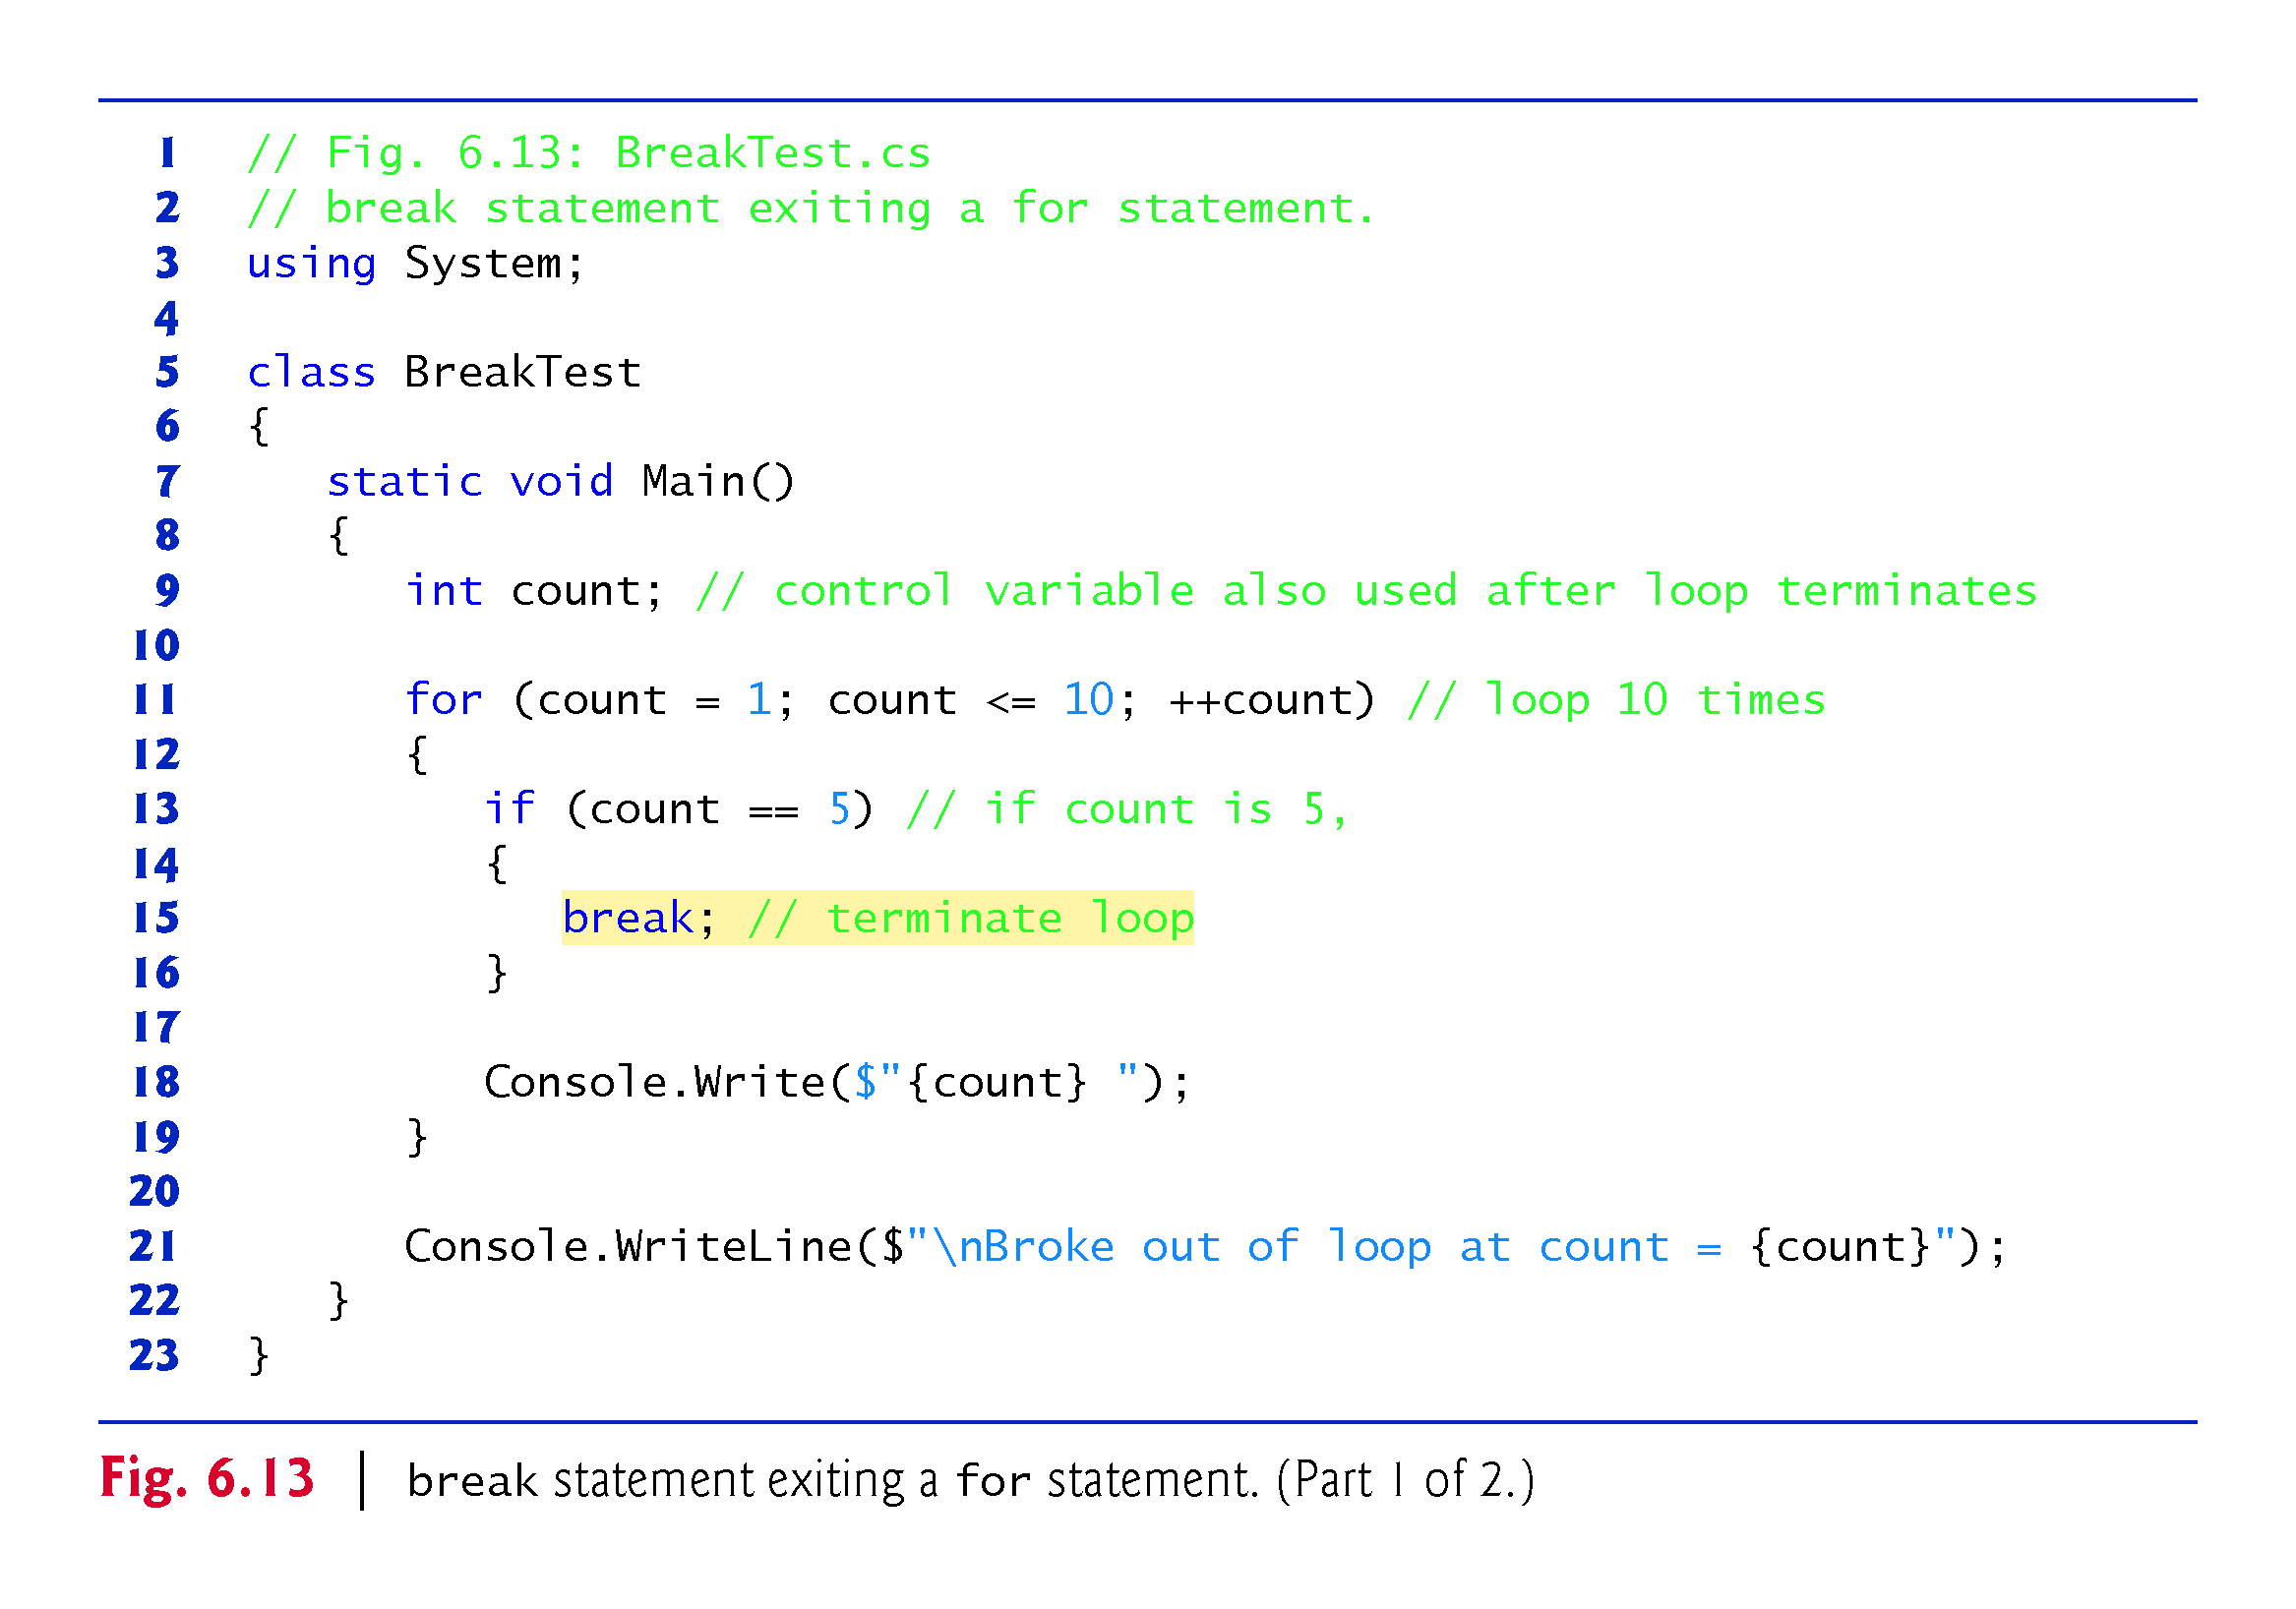

Slide 34
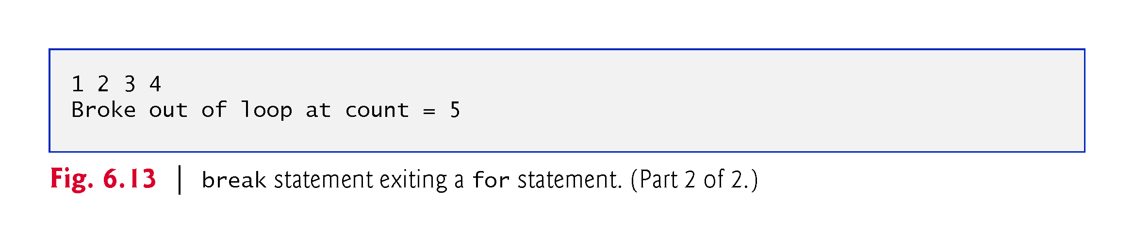

Slide 35
6.10.2 break Statement
The continue statement skips the remaining statements in the loop body and tests whether to proceed with the next iteration of the loop.
In a for statement, the increment expression executes, then the app evaluates the loop-continuation test.
Figure 6.14 uses continue in a for statement.

Slide 36
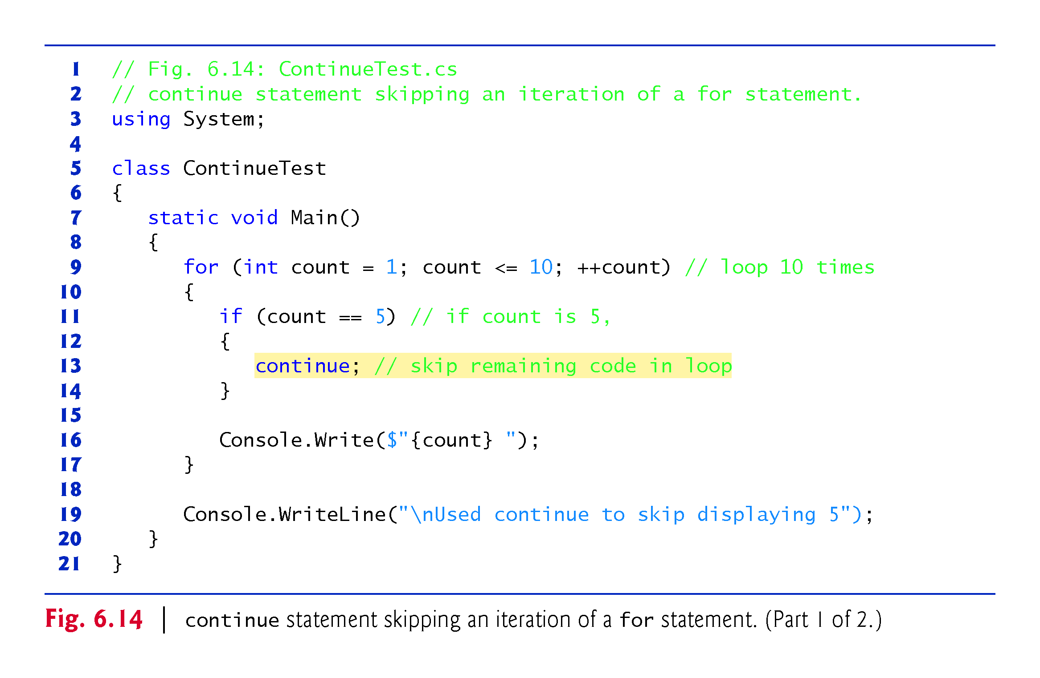

Slide 37
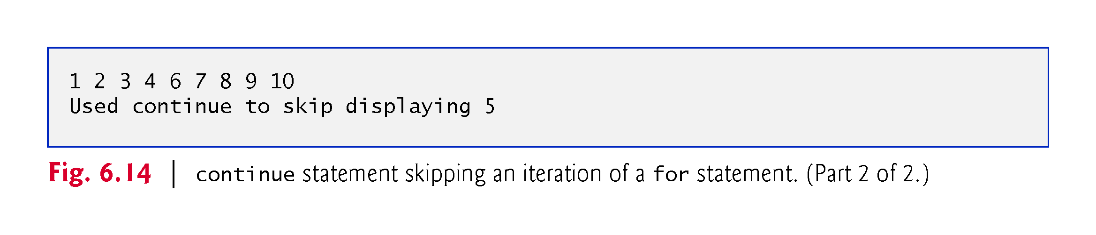

Slide 38
6.11 Logical Operators
Simple conditions are expressed in terms of the relational operators >, <, >= and <=, and the equality operators == and !=.
  Each expression tests only one condition.
C# provides logical operators to enable you to form more complex conditions by combining simple conditions.
The logical operators are && (conditional AND), || (conditional OR), & (boolean logical AND), | (boolean logical inclusive OR), ^ (boolean logical exclusive OR) and ! (logical negation).

Slide 39
6.11.1 Conditional AND (&&) Operator
• The && (conditional AND) operator works as follows:
if (gender == 'F' && age >= 65)
{
++seniorFemales;
}
• The combined condition is true if and only if both simple conditions are true.
• The combined condition may be more readable with redundant parentheses:
  (gender == 'F') && (age >= 65)

Slide 40
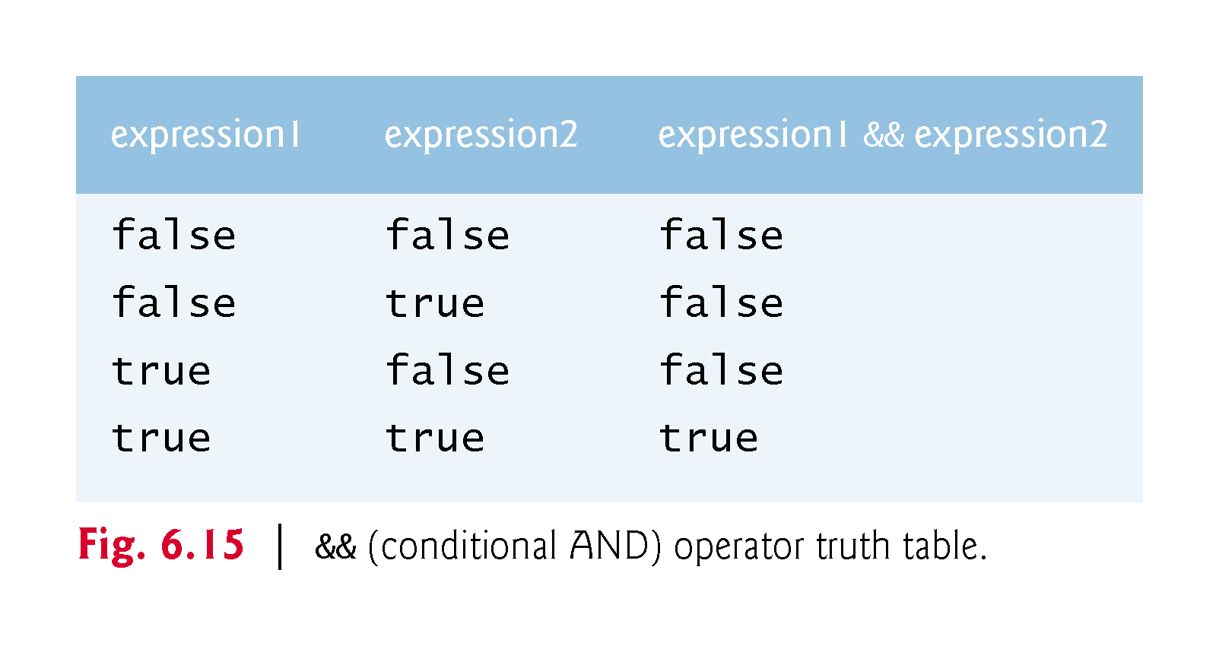

Slide 41
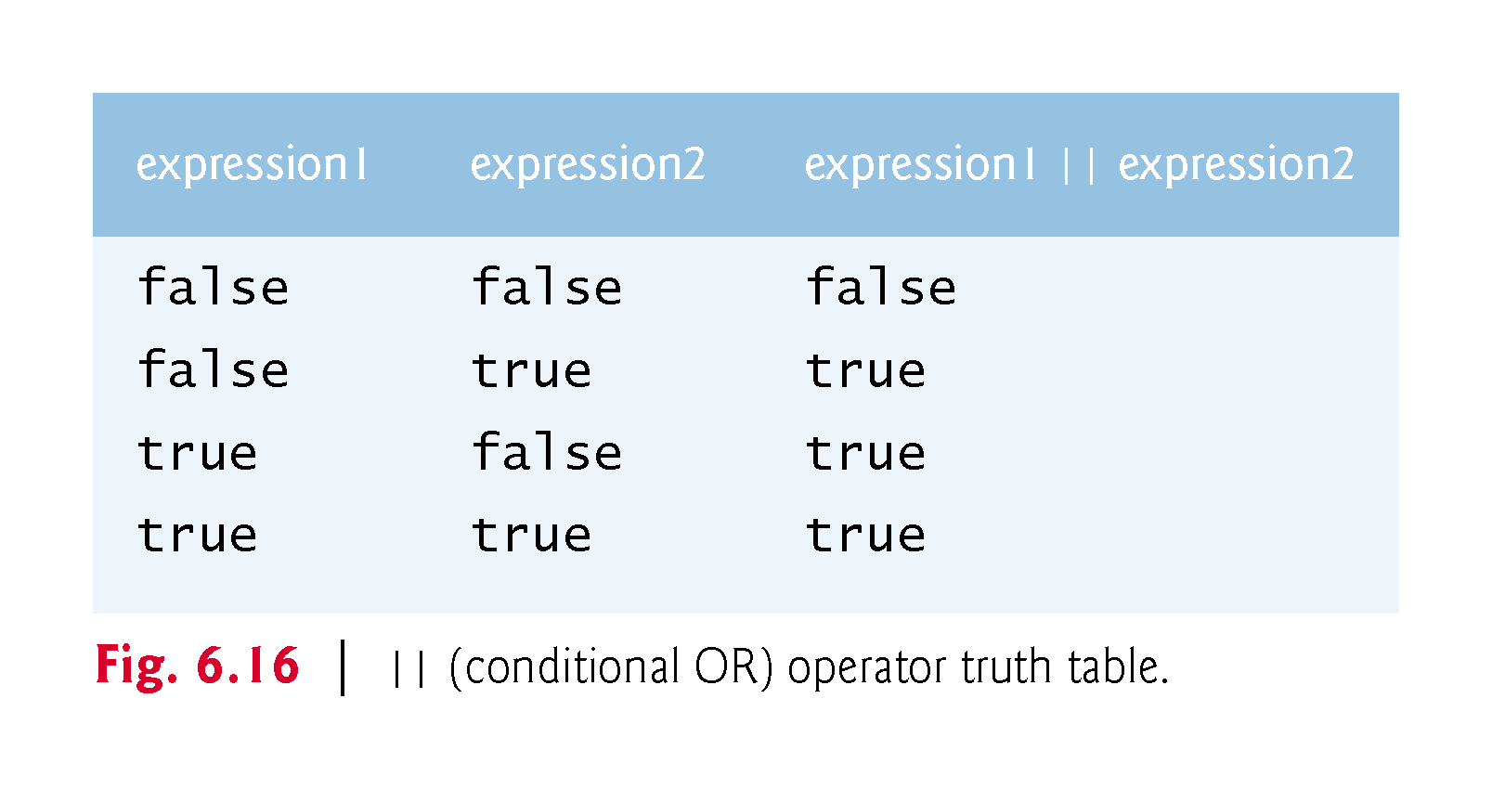

Slide 42
6.11.3 Short-Circuit Evaluation of Complex Conditions
The parts of an expression containing && or || operators are evaluated only until it’s known whether the condition is true or false.
  (gender == 'F’) && (age >= 65)
If gender is not equal to 'F' (i.e., it is certain that the entire expression is false) evaluation stops.
This feature is called short-circuit evaluation.

Slide 43
6.11.5 Boolean Logical Exclusive OR (^)
A complex condition containing the boolean logical exclusive OR (^) operator (also called the logical XOR operator) is true if and only if one of its operands is true and the other is false.
Figure 6.17 is a truth table for the boolean logical exclusive OR operator (^).

Slide 44
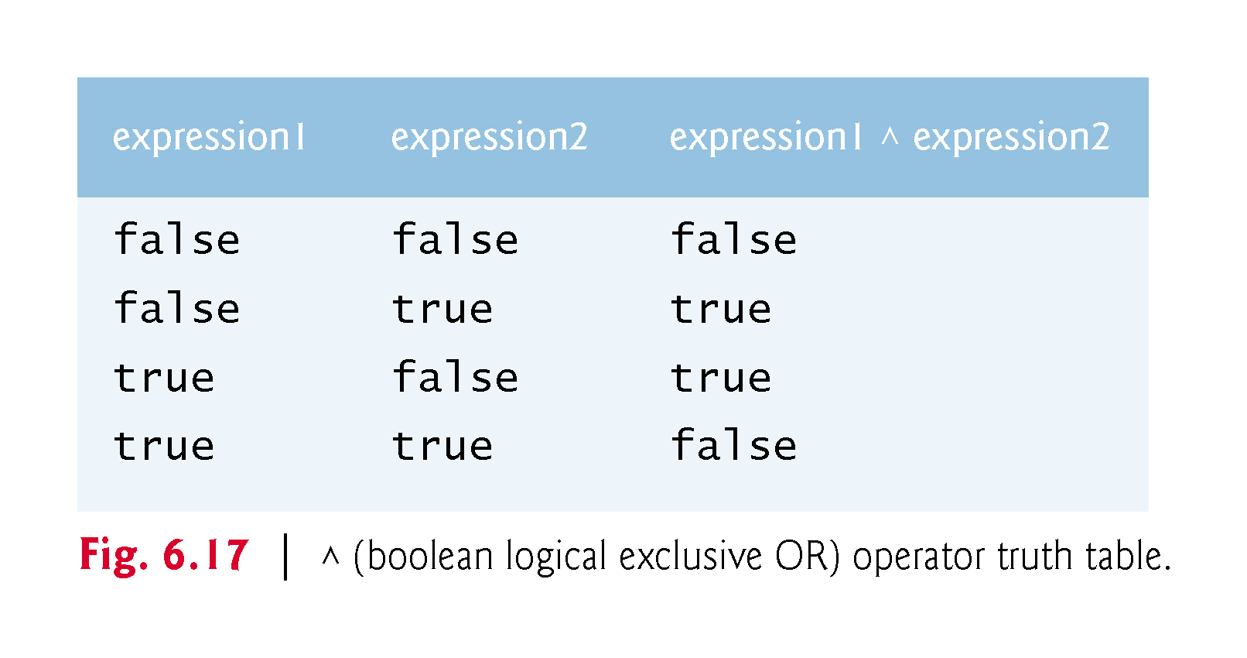

Slide 45
6.11.6 Logical Negation (!) Operator
The ! (logical negation or not) operator enables you to “reverse” the meaning of a condition.
  if (! (grade == sentinelValue))
  {
  Console.WriteLine($"The next grade is {grade}");
  }
In most cases, you can avoid using logical negation by expressing the condition differently:
  if (grade != sentinelValue)
  {
  Console.WriteLine($"The next grade is {grade}");
  }
Figure 6.18 is a truth table for the logical negation operator.

Slide 46
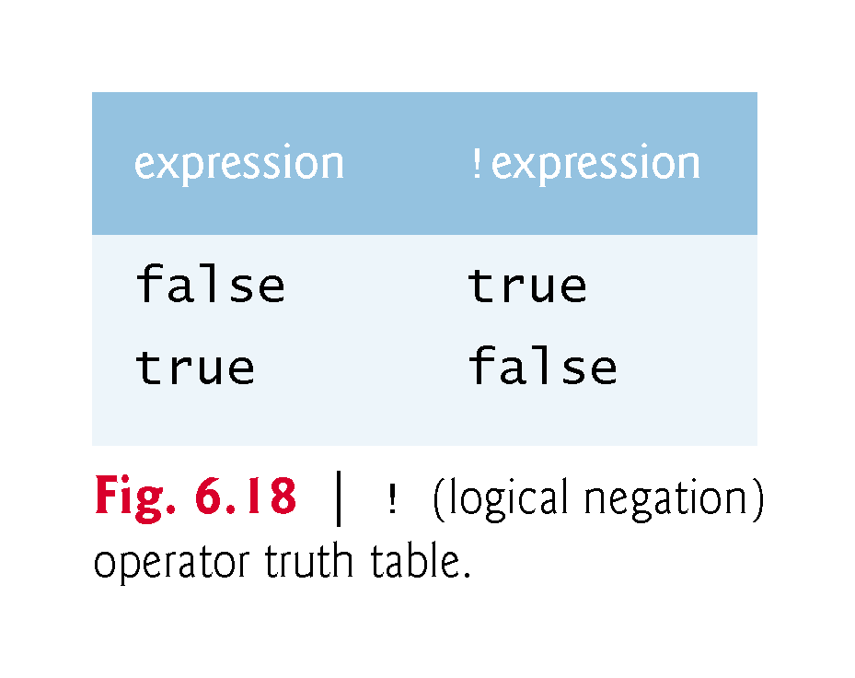

Slide 47
6.11.7 Logical Operators Example
Figure 6.19 demonstrates the logical operators and boolean logical operators.

Slide 48
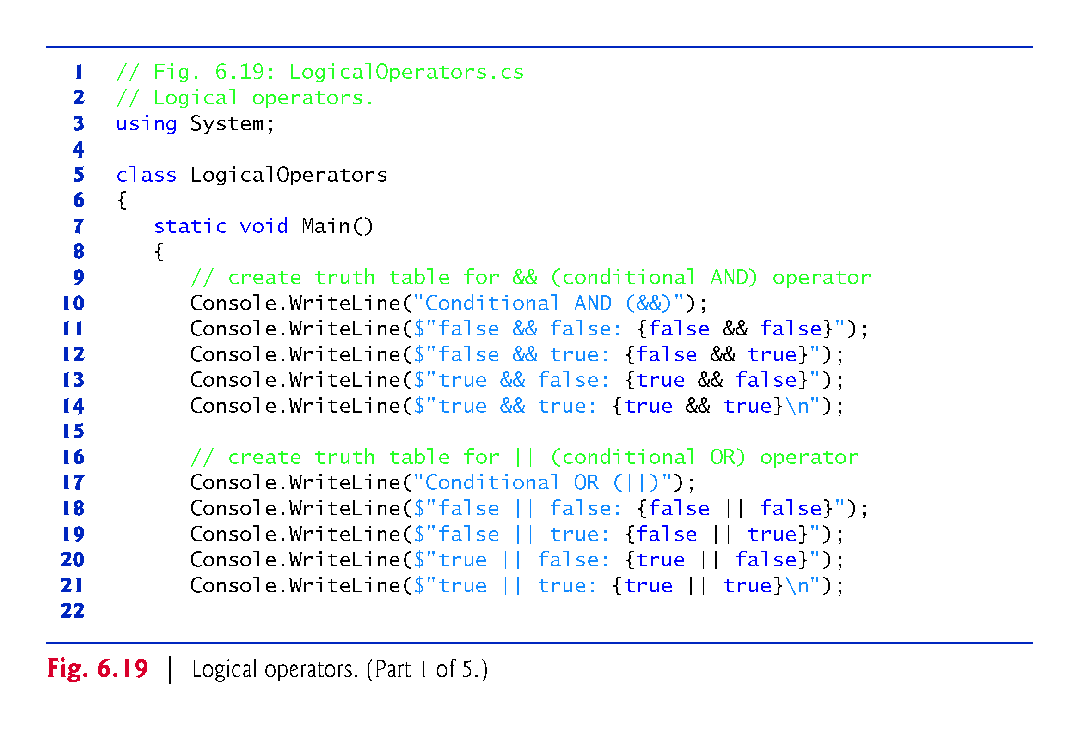

Slide 49
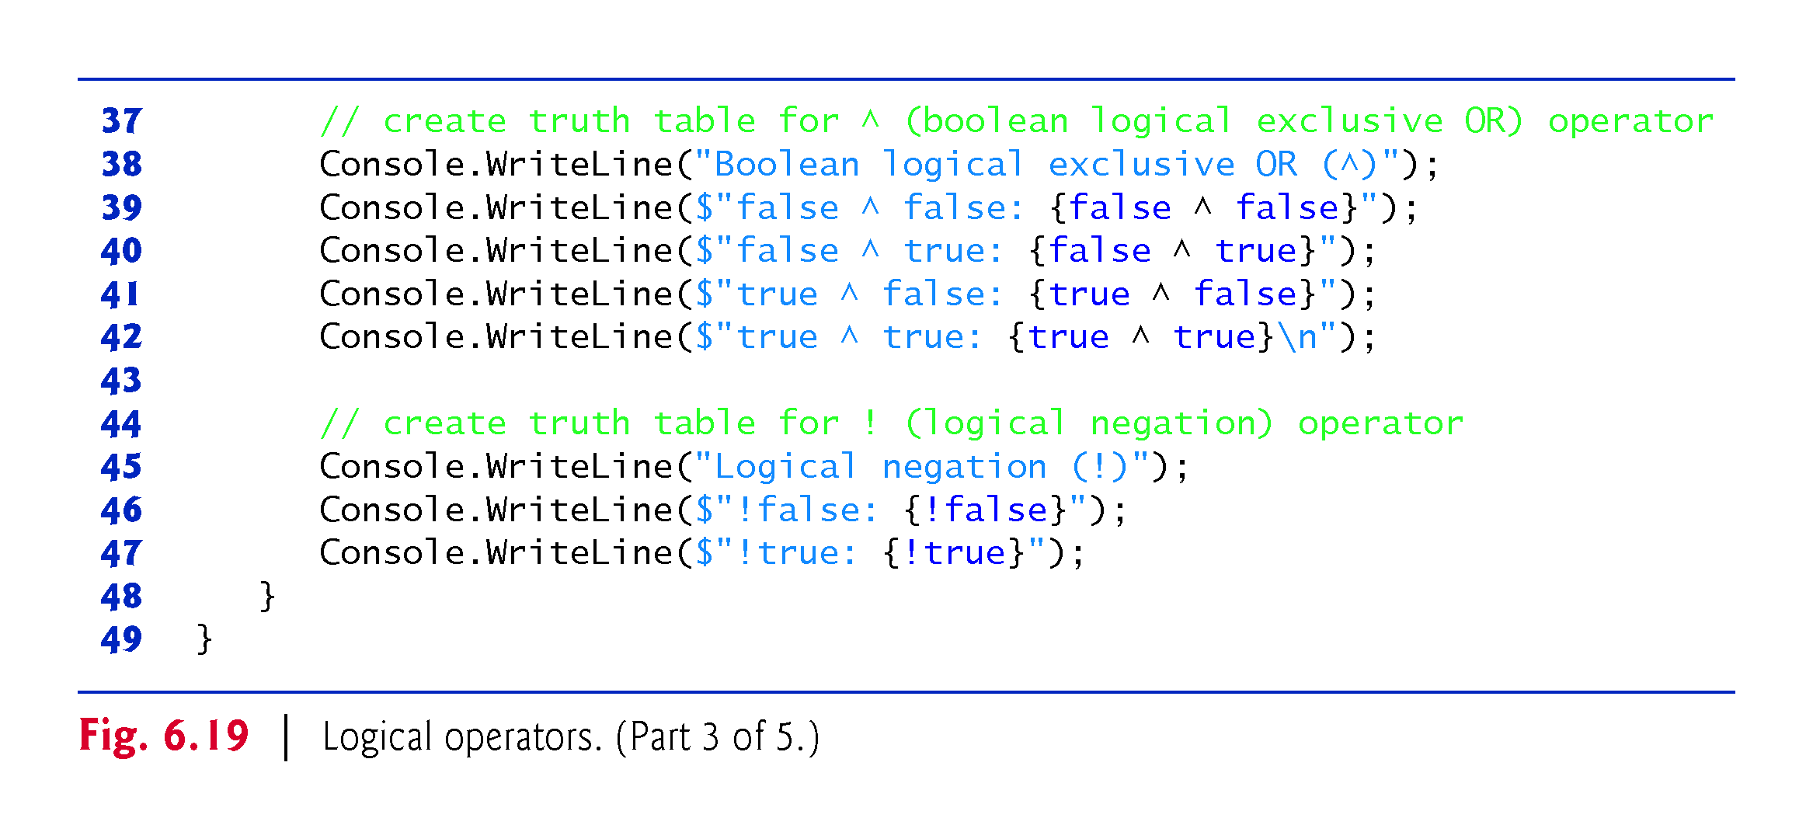

Slide 50
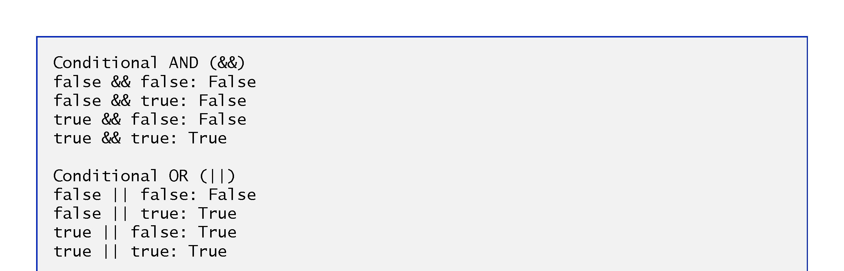

Slide 51
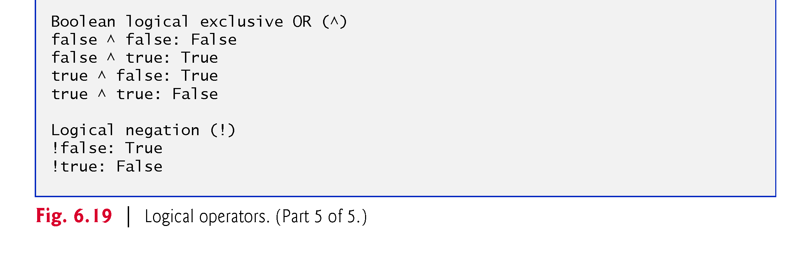

Slide 52
6.11.7 Logical Operators Example
Figure 6.20 shows the C# operators from highest precedence to lowest.

Slide 53
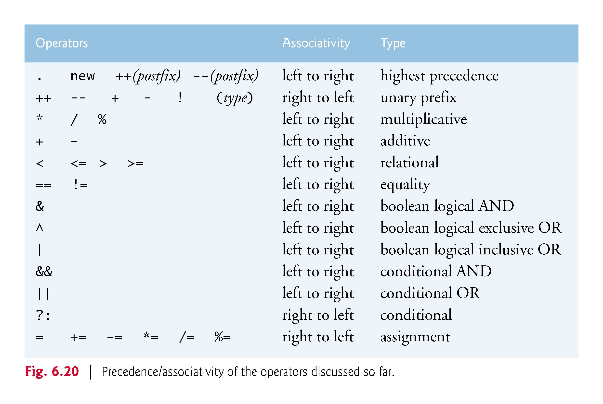

Slide 54
شكرا جزيلا

