Slide 1
Algorithm Development and Control Statements: Part 1
Chapter 5 of Visual C# How to Program, 6/e

Slide 2
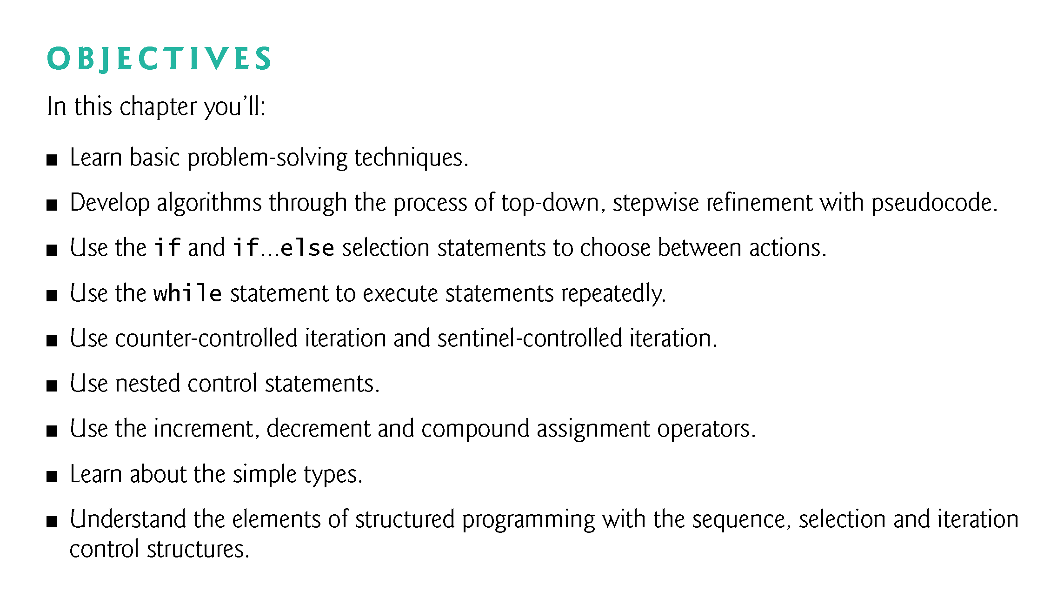

Slide 3
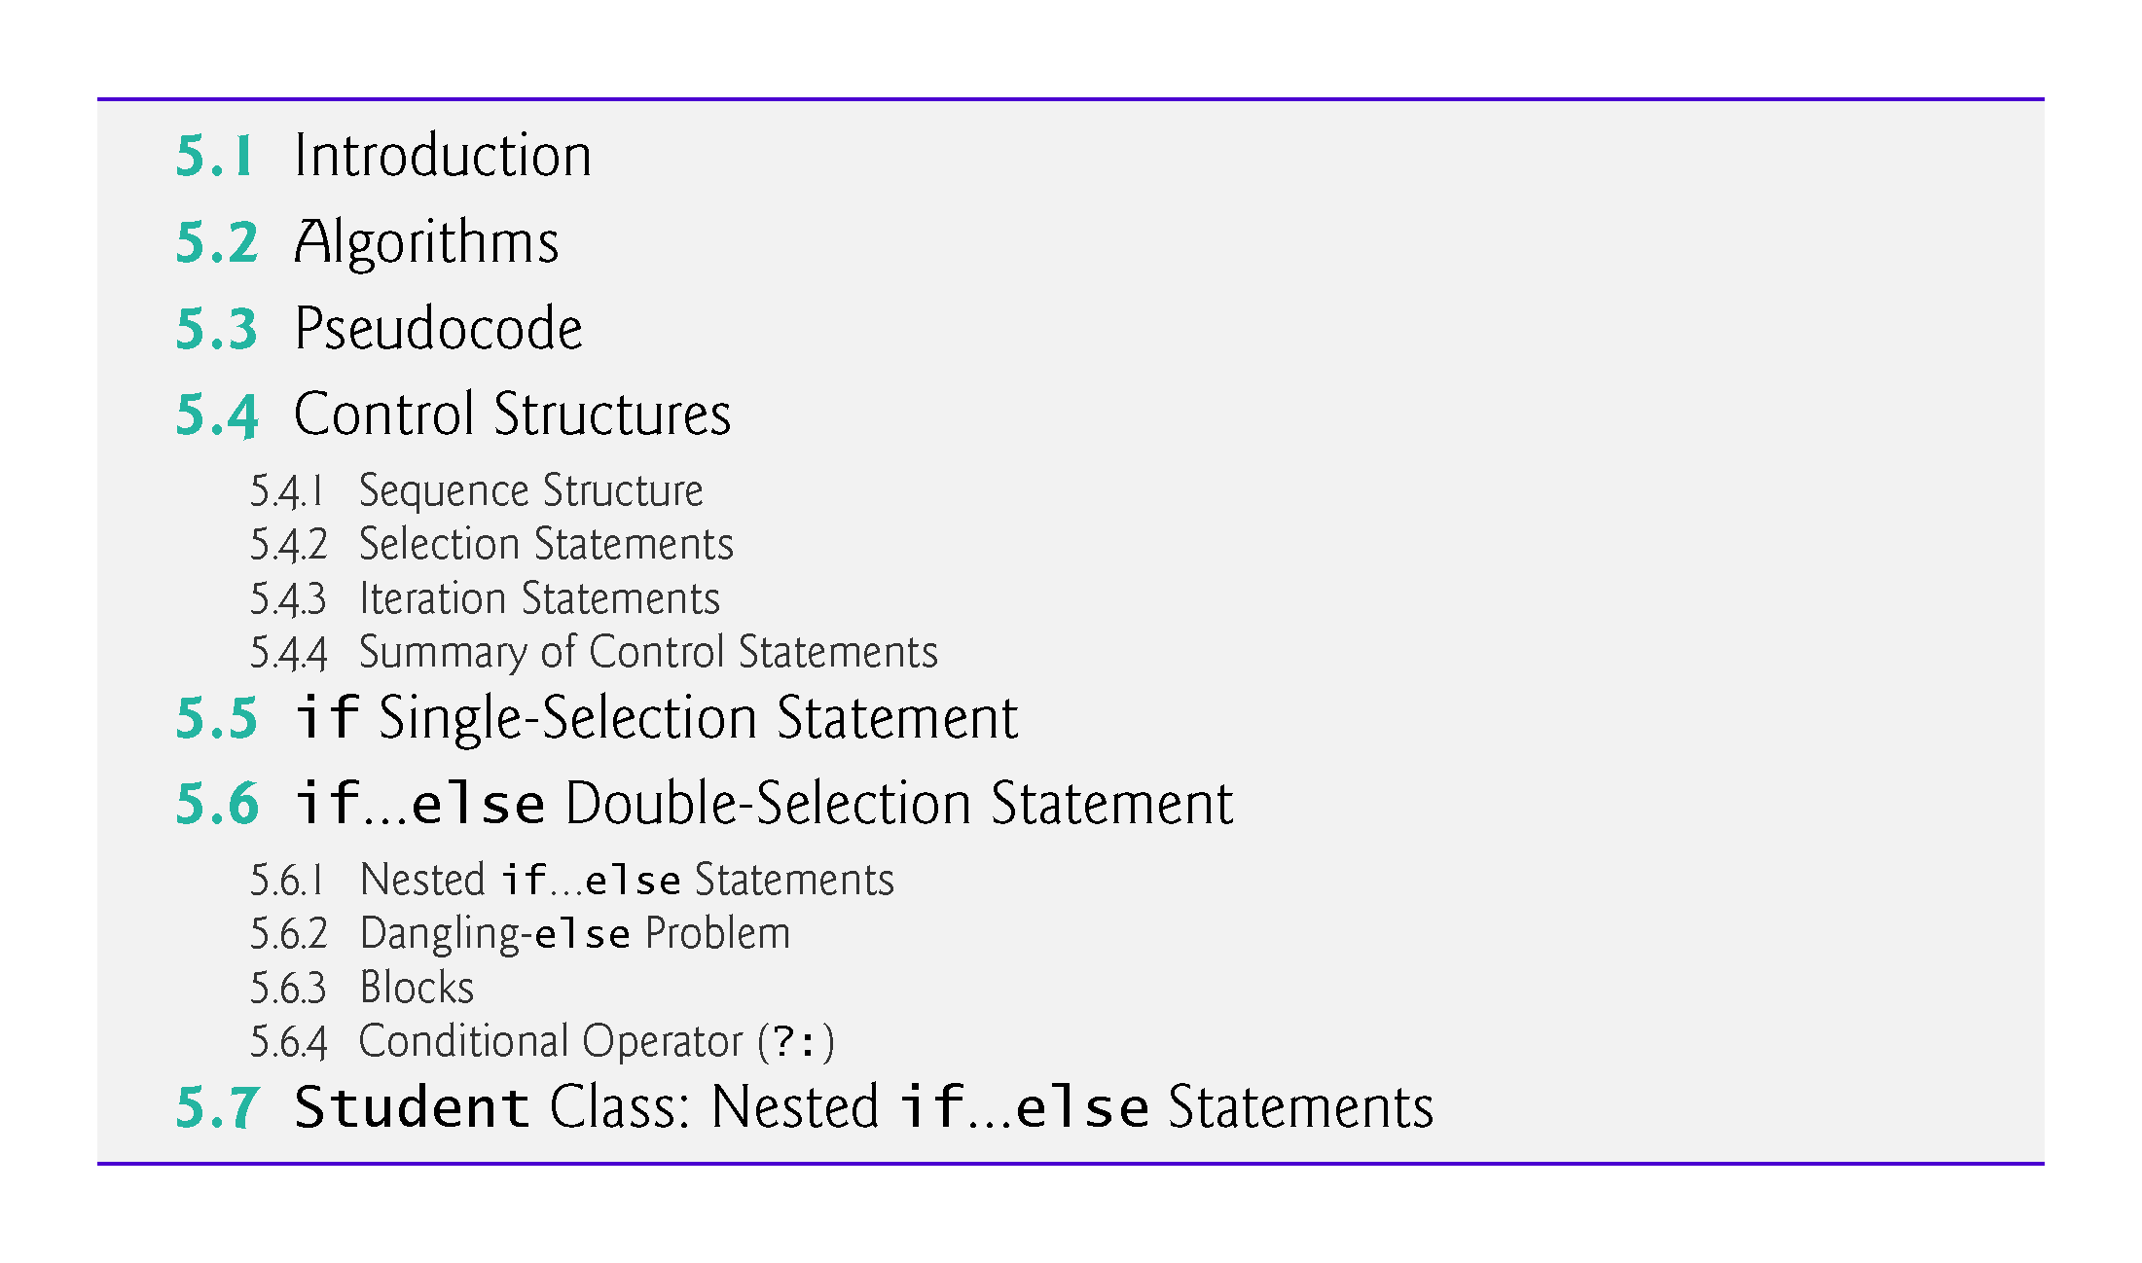

Slide 4
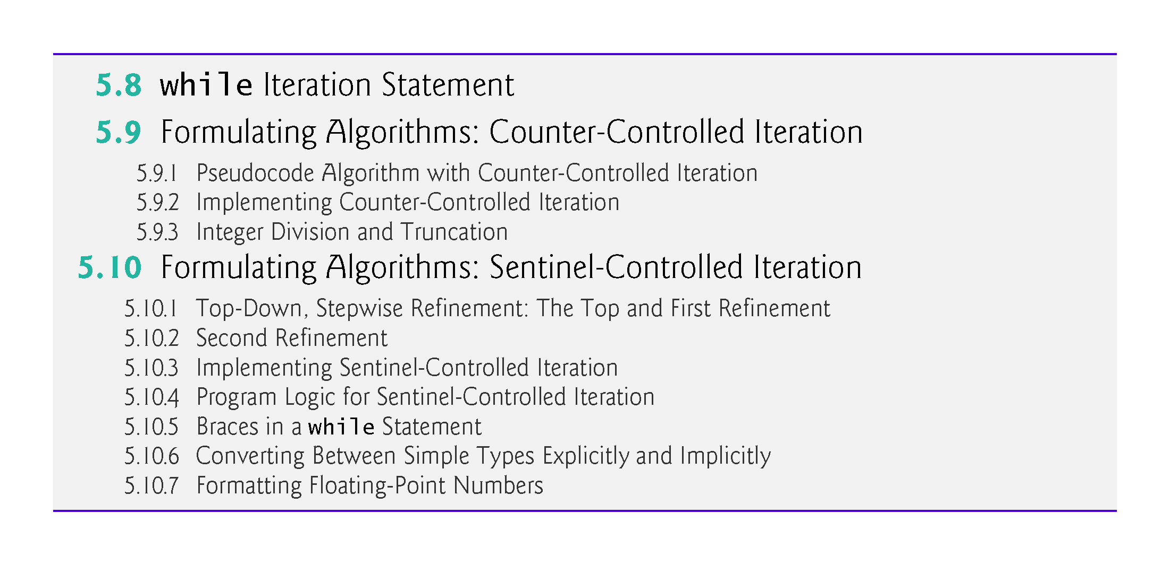

Slide 5
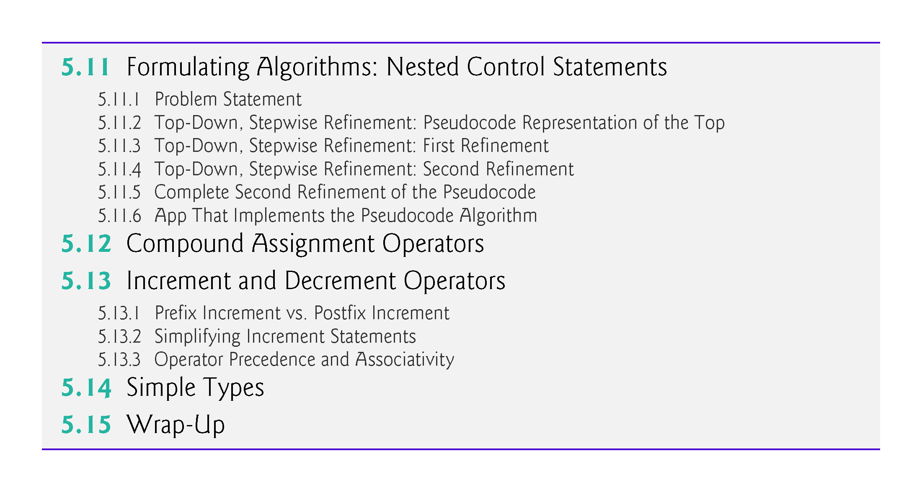

Slide 6
5.2 Algorithms
Computers solve problems by executing a series of actions in a specific order.
An algorithm is a procedure for solving a problem, in terms of:
  the actions to be executed and
  the order in which these actions are executed

Slide 7
5.2 Algorithms (Cont..)
Consider the “rise-and-shine algorithm” followed by one junior executive for getting out of bed and going to work:
  (1) get out of bed,
  (2) take off pajamas,
  (3) take a shower,
  (4) get dressed,
  (5) eat breakfast and
  (6) carpool to work.

Slide 8
5.2 Algorithms (Cont.)
Suppose that the same steps are performed in a different order:
  (1) get out of bed,
  (2) take off pajamas,
  (3) get dressed,
  (4) take a shower,
  (5) eat breakfast,
  (6) carpool to work.
In this case, the junior executive shows up for work soaking wet.
The order in which statements execute is called program control.

Slide 9
5.3 Pseudocode
Pseudocode is similar to English—it’s not a programming language.
It helps you “think out” an app before attempting to write it.
A carefully prepared pseudocode app can easily be converted to a corresponding C# app.

Slide 10
5.3 Pseudocode
The pseudocode of Fig. 5.1 corresponds to the algorithm that inputs two integers from the user, adds these integers and displays their sum.
The pseudocode statements are simply English statements that convey what task is to be performed in C#.

Slide 11
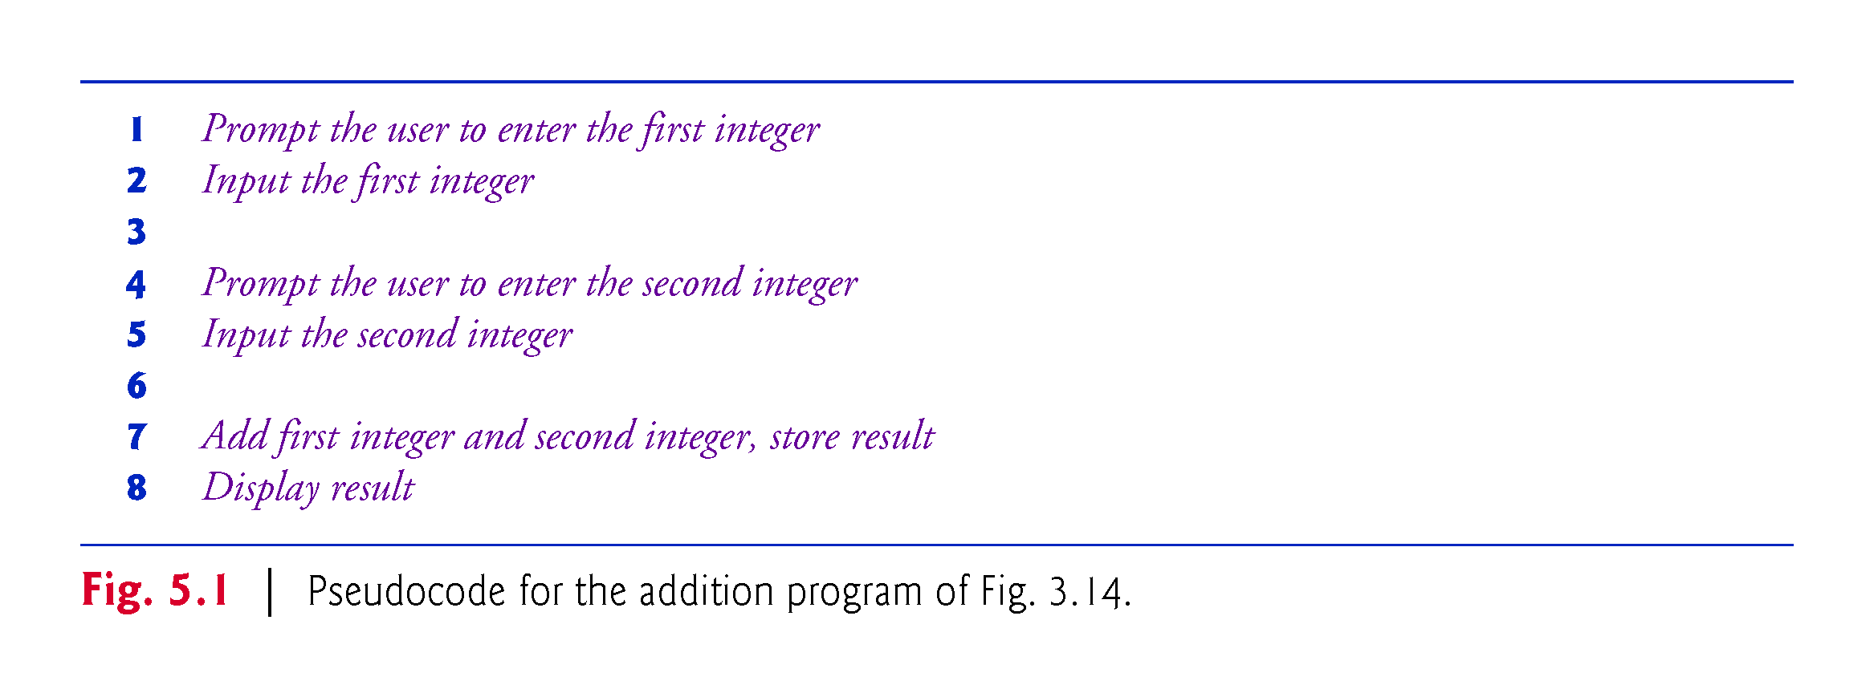

Slide 12
5.4 Control Structures
Normally, statements execute one after the other in sequential execution.
Various C# statements enable you to specify the next statement to execute. This is called transfer of control.
Structured apps are clearer, easier to debug and modify, and more likely to be bug free.

Slide 13
5.4.1 Sequence Structure
The sequence structure is built into C#.
  Unless directed otherwise, the computer executes C# statements one after the other in the order in which they’re written—that is, in sequence.
An activity diagram models the workflow of a software system (Fig. 5.1).
Activity diagrams are composed of symbols such as action-state symbols, diamonds, small circles and notes.
Transition arrows represent the flow of the activity.
The solid circle represents the activity’s initial state.
The solid circle surrounded by a hollow circle represents the final state.

Slide 14
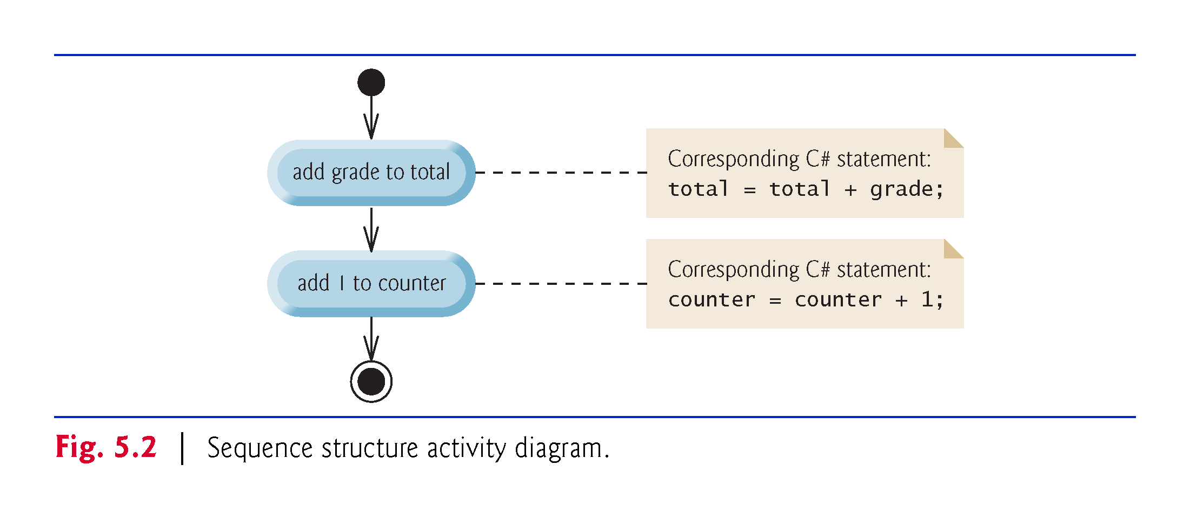

Slide 15
5.4.1 Sequence Structure
Single-entry/single-exit control statements make it easy to build apps.
Control statements are “attached” to one another by connecting the exit point of one to the entry point of the next.
This procedure is called control-statement stacking.
Control-statement nesting allows a control statement to appear inside another control statement.

Slide 16
5.4.2 Selection Statements
C# has three types of selection structures, which from this point forward we shall refer to as selection statements.
  The if statement performs (selects) an action if a condition is true or skips the action if the condition is false.
  The if…else statement performs an action if a condition is true or performs a different action if the condition is false.
  The switch statement (Chapter 6) performs one of many different actions, depending on the value of an expression.

Slide 17
5.4.3 Iteration Statements
C# provides four iteration statements (sometimes called repetition statements or looping statements) that enable programs to perform statements repeatedly as long as a condition (called the loop-continuation condition) remains true.
  while, do…while, for and foreach statements.
The while, for and foreach statements perform the action (or group of actions) in their bodies zero or more times.
The do…while statement performs the action (or group of actions) in its body one or more times.

Slide 18
5.4.4 Summary of Control Statements
Every app is formed by combining as many of these statements as is appropriate for the algorithm the app implements.
Each activity diagram contains an initial state and a final state that represent a control statement’s entry point and exit point, respectively.
Single-entry/single-exit control statements make it easy to build programs—we simply connect the exit point of one to the entry point of the next.
We call this control-statement stacking.
There’s only one other way in which control statements- may be connected—control-statement nesting—in which one control statement appears inside another.

Slide 19
5.5 if Single-Selection Statement
if grade is greater than or equal to 60
display “Passed”
The preceding pseudocode if statement may be written
in C# as:
  if (grade >= 60)
  {
  Console.WriteLine("Passed");
  }
The C# code corresponds closely to the pseudocode.

Slide 20
5.5 if Single-Selection Statement (Cont..)
bool Simple Type
You saw in Chapter 3 that decisions can be based on conditions containing relational or equality operators.
A decision can be based on any expression that evaluates to true or false.
C# provides the simple type bool for Boolean variables that can hold only the values true and false—each of these is a C# keyword.

Slide 21
5.5 if Single-Selection Statement (Cont..)
Figure 5.2 illustrates the single-selection if statement.
The diamond, or decision symbol indicates that a decision is to be made.
The workflow will continue along a path determined by one of the symbol’s two associated guard conditions.

Slide 22
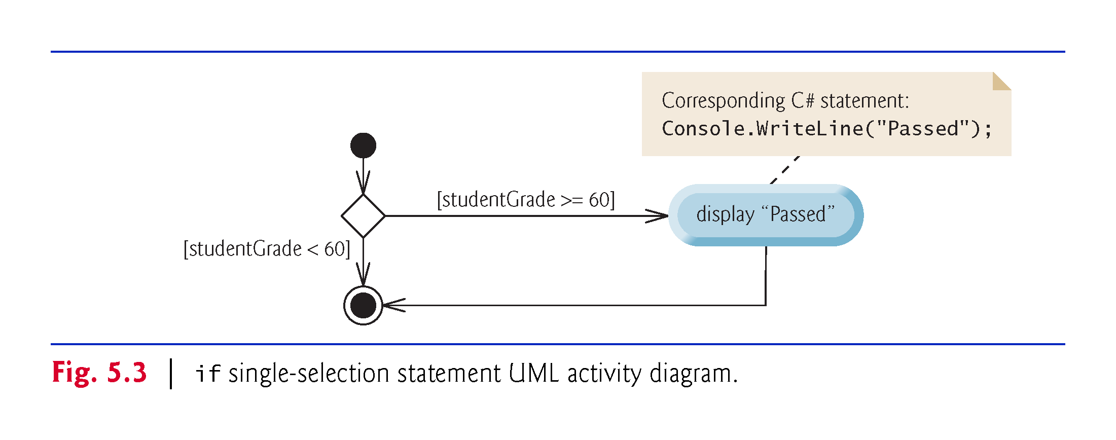

Slide 23
5.6 if…else Double-Selection Statement
The if…else double-selection statement allows you to specify an action to perform when the condition is true and a different action when the condition is false

Slide 24
5.6 if…else Double-Selection Statement
if grade is greater than or equal to 60
display “Passed”
else
display “Failed”
The preceding if…else pseudocode statement can be written in C# as
  if (grade >= 60)
  {
  Console.WriteLine("Passed");
  }
  else
  {
  Console.WriteLine("Failed");
  }

Slide 25
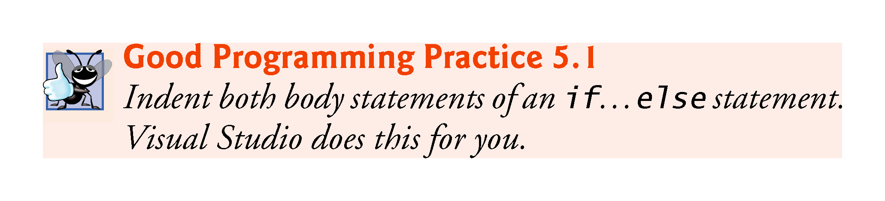

Slide 26
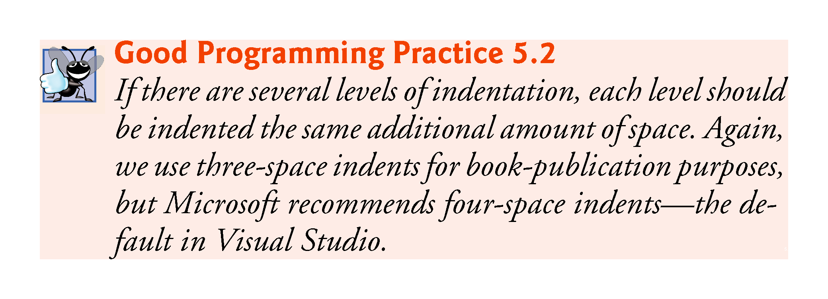

Slide 27
5.6 if…else Double-Selection Statement (Cont.)
Figure 5.4 illustrates the flow of control in the if…else statement.
The symbols in the UML activity diagram represent action states and a decision.

Slide 28
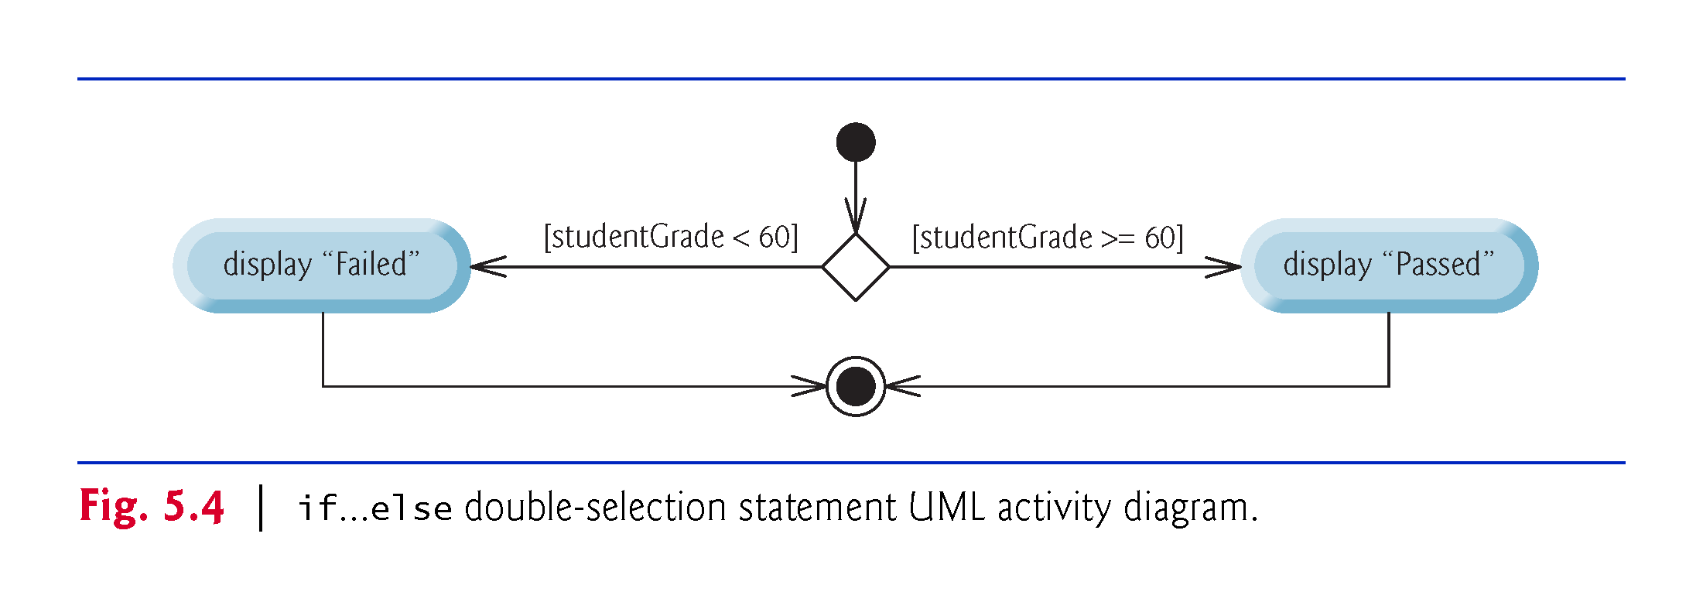

Slide 29
5.6.1 Nested if…else Statements
Nested if…else Statements
An app can test multiple cases with nested if…else statements:
if grade is greater than or equal to 90
display “A”
else
if grade is greater than or equal to 80
display “B”
else
if grade is greater than or equal to 70
display “C”
else
if grade is greater than or equal to 60
display “D”
else
display “F”

Slide 30
5.6.1 Nested if…else Statements
if (studentGrade >= 90)
{
Console.WriteLine("A")
}
else
{
if (studentGrade >= 80)
{
Console.WriteLine("B")
}
else
{
if (studentGrade >= 70)
{
Console.WriteLine("C")
}
else
{
if (studentGrade >= 60)
{
Console.WriteLine("D")
}
else
{
Console.WriteLine("F")
}
}
}
}

Slide 31
5.6.1 Nested if…else Statements
if (studentGrade >= 90)
{
Console.WriteLine("A");
}
else if (studentGrade >= 80)
{
Console.WriteLine("B");
}
else if (studentGrade >= 70)
{
Console.WriteLine("C");
}
else if (studentGrade >= 60)
{
Console.WriteLine("D");
}
else
{
Console.WriteLine("F");
}

Slide 32
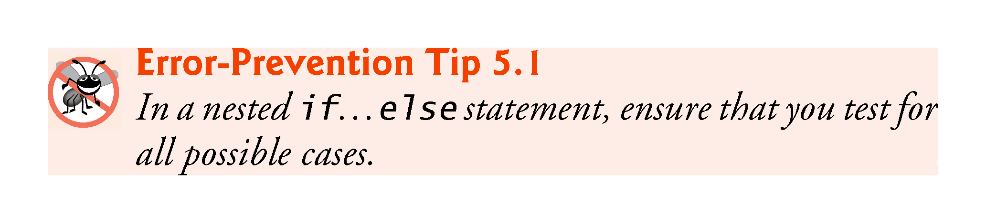

Slide 33
5.6.2 Dangling-else Problem
Throughout the text, we always enclose control statement bodies in braces ({ and }). This avoids a logic error called the “dangling-else” problem.
We investigate this problem in Exercises 5.27-5.29.

Slide 34
5.6.3 Blocks
Statements contained within a pair of braces ({ and }) form a block:
  if (studentGrade >= 60)
  {
  Console.WriteLine("Passed");
  }
  else
  {
  Console.WriteLine("Failed");
  Console.WriteLine("You must take this course again.");
  }
Without the braces, the last statement in the else block would execute regardless of whether the grade was less than 60.

Slide 35
5.6.3 Blocks
A logic error has its effect at execution time.
  A fatal logic error causes an app to fail and terminate prematurely.
  A nonfatal logic error allows an app to continue executing.

Slide 36
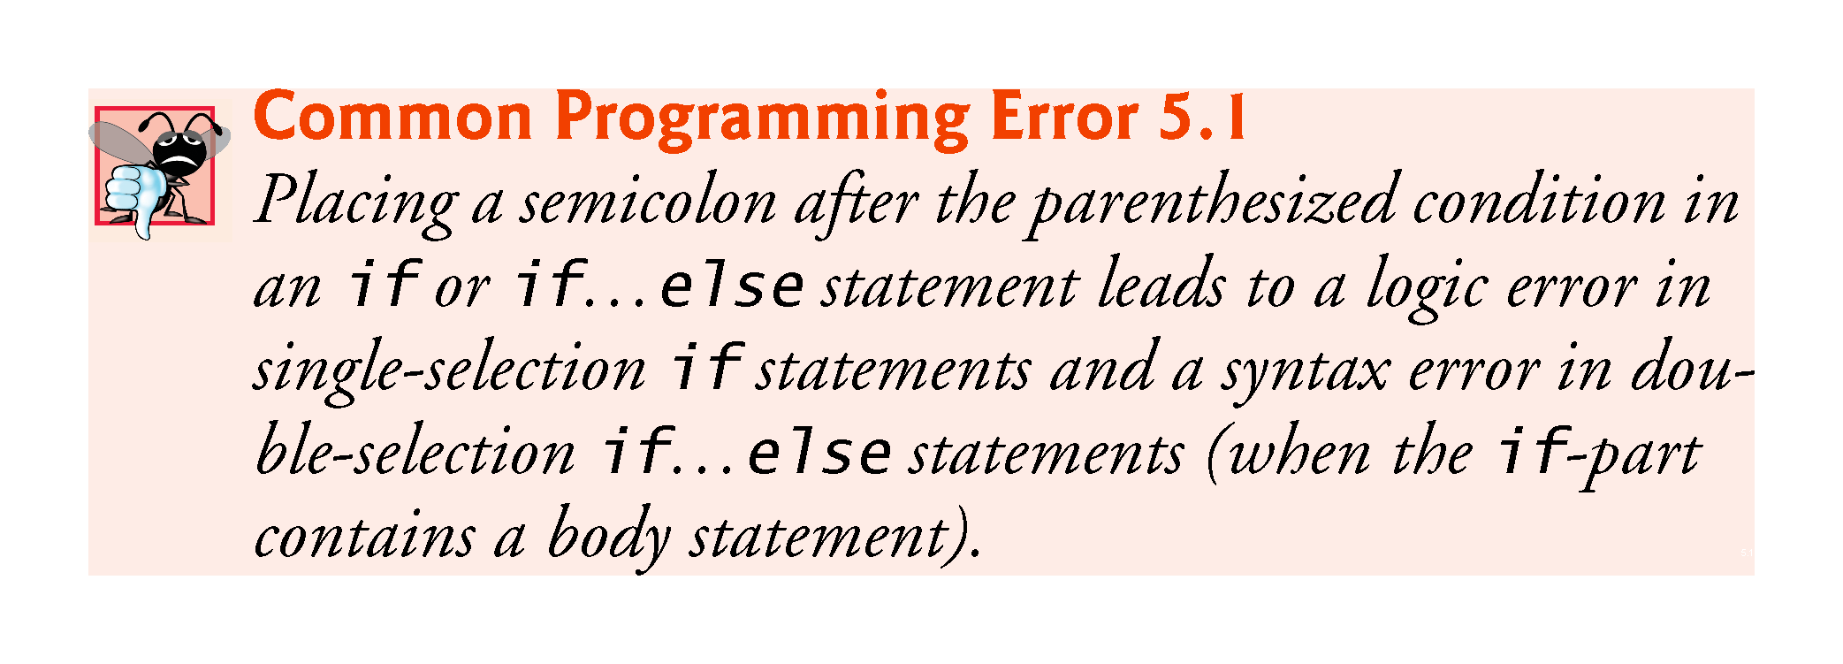

Slide 37
5.6.4 Conditional Operator (?:)
The conditional operator (?:) can be used in place of an if…else statement.
Console.WriteLine(
studentGrade >= 60 ? "Passed" : "Failed");
  The first operand is a boolean expression that evaluates to true or false.
  The second operand is the value if the expression is true
  The third operand is the value if the expression is false.

Slide 38
5.7 Student Class: Nested if…else Statements
The example of Figs. 5.5–5.6 demonstrates a nested if…else statement that determines a student’s letter grade based on the student’s average in a course.
Read-only property LetterGrade (lines 39–68) uses nested if…else statements to determine the Student’s letter grade based on the Student’s average.
A read-only property provides only a get accessor.
Local variable letterGrade is initialized to string.Empty (line 43), which represents the empty string (that is, a string containing no characters).

Slide 39
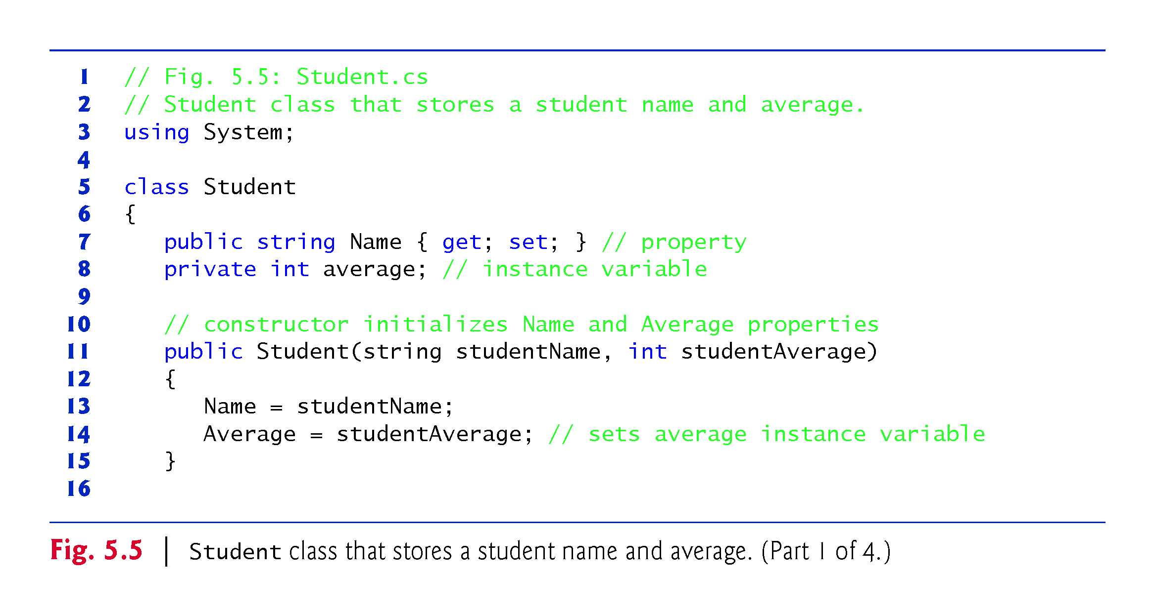

Slide 40
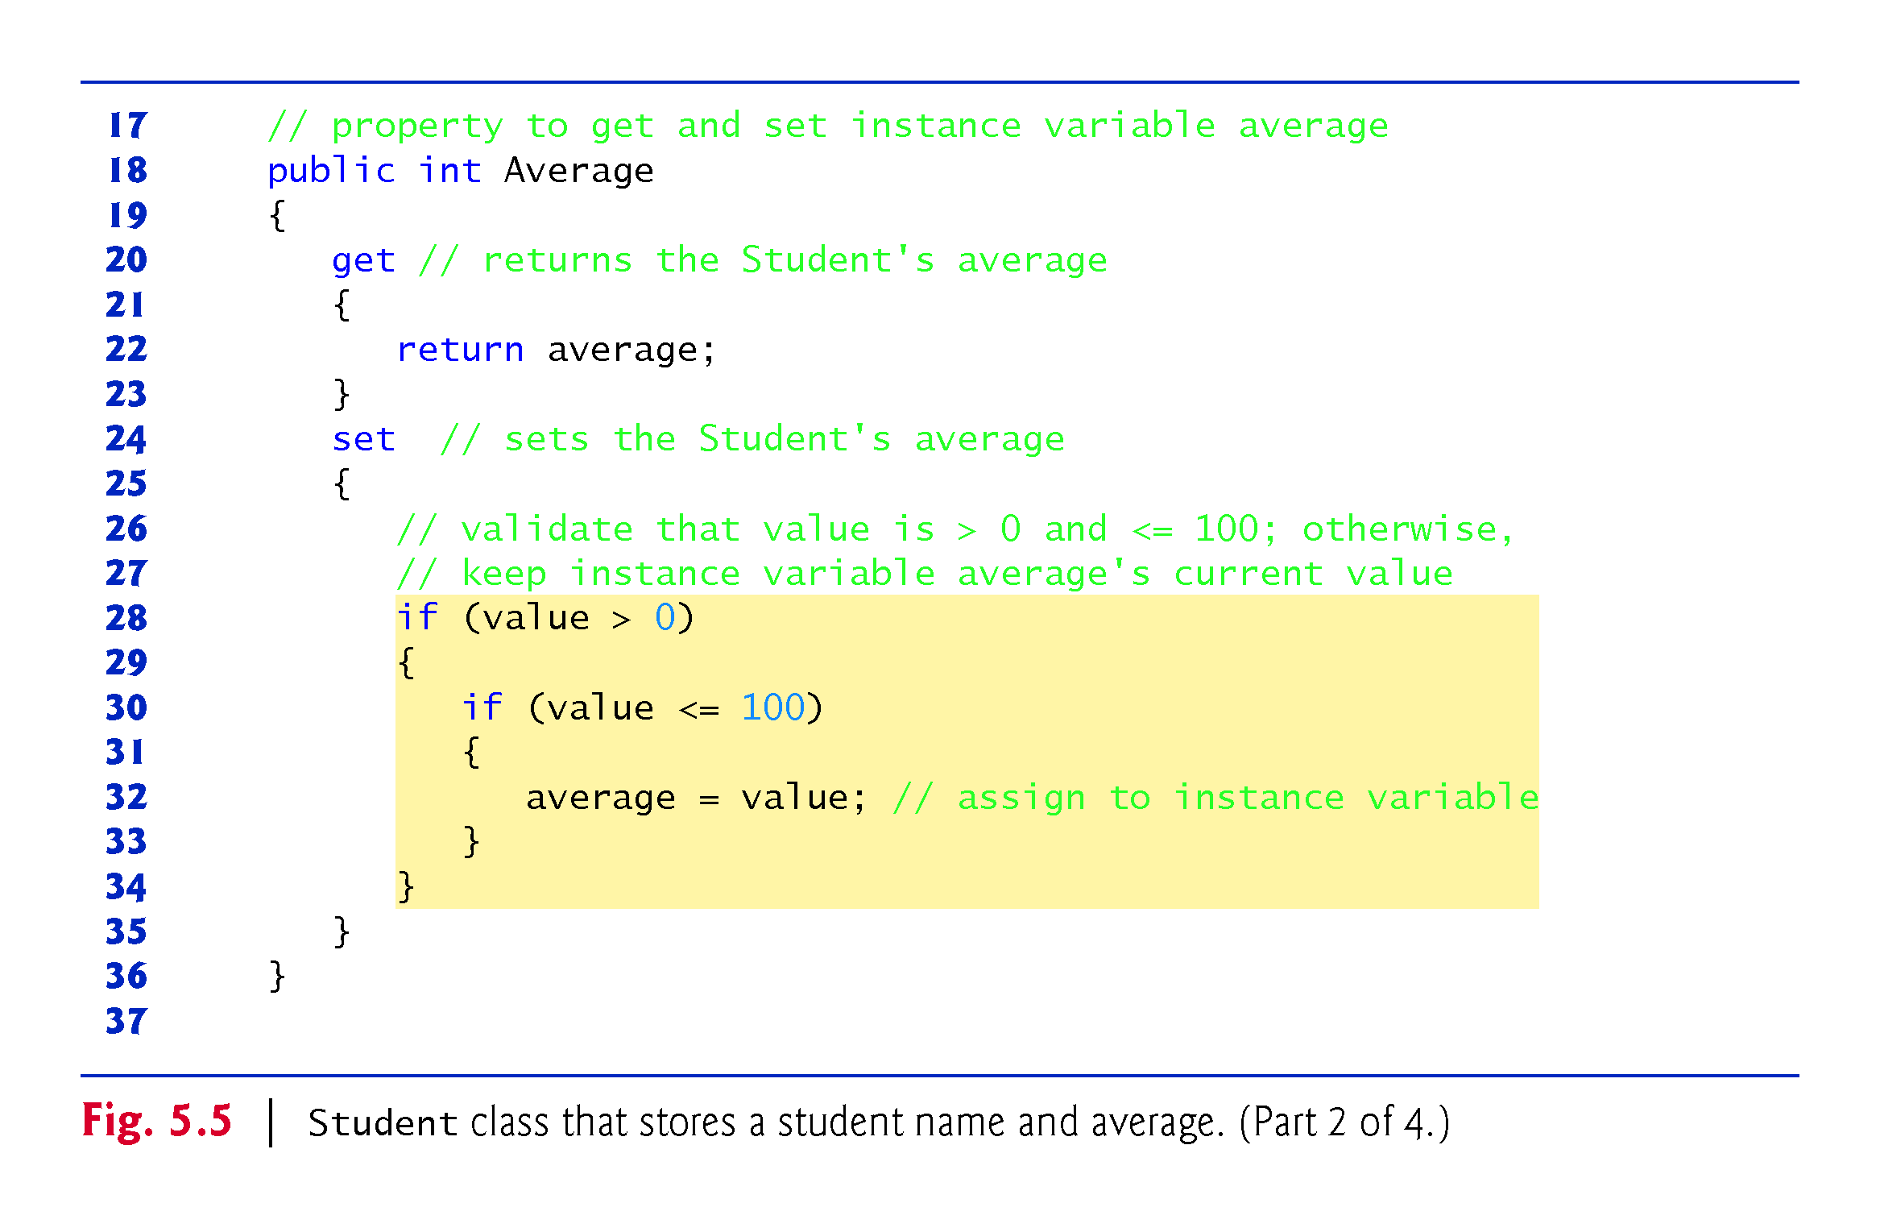

Slide 41
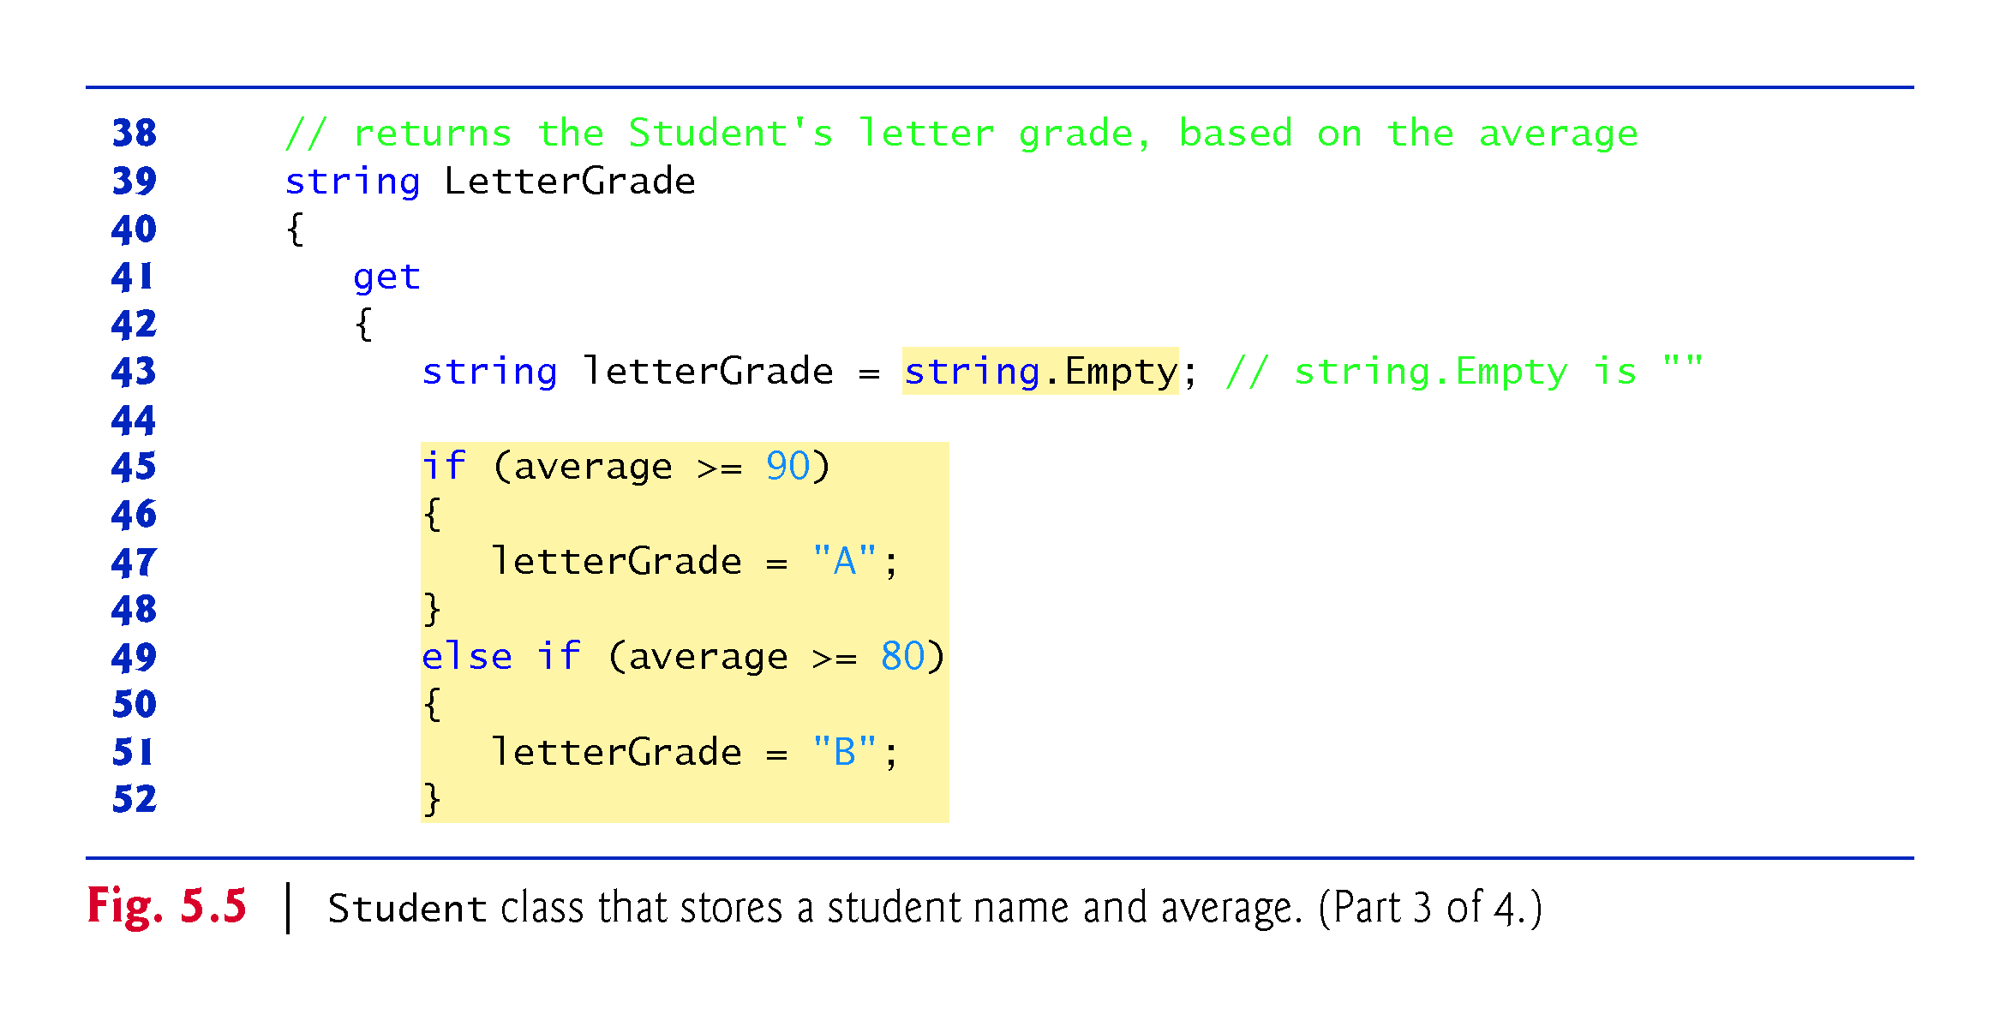

Slide 42
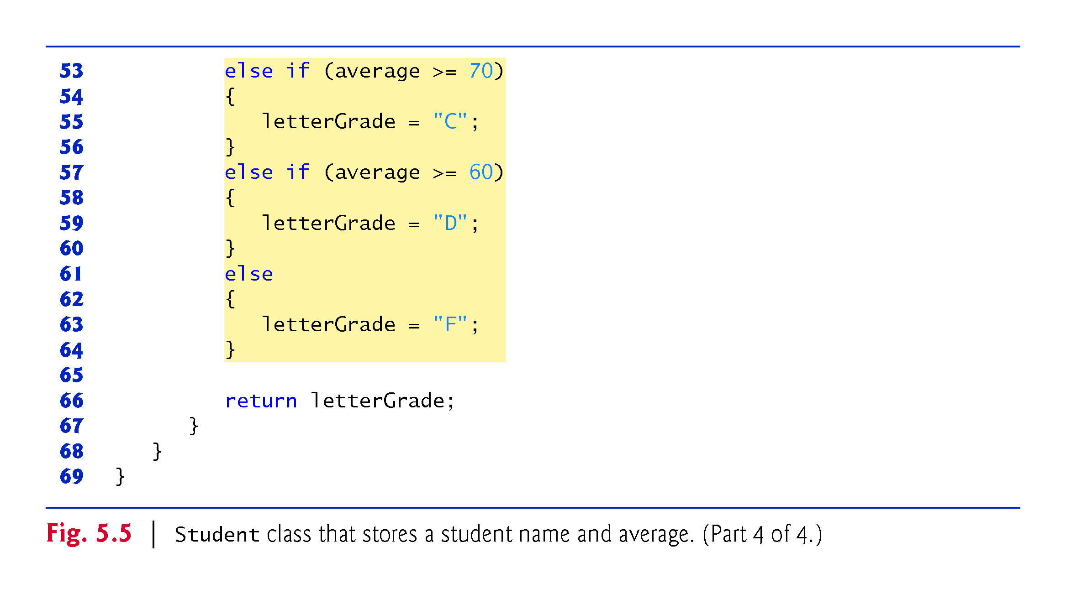

Slide 43
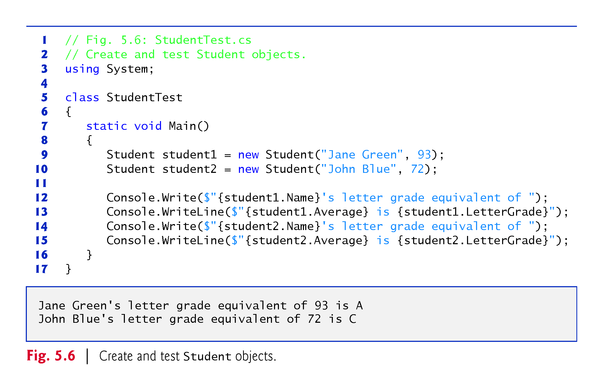

Slide 44
5.8 while Iteration Statement
A iteration statement allows you to specify that an app should repeat an action:
While there are more items on my shopping list
put next item in cart and cross it off my list
As an example of C#’s while iteration statement, consider a code segment designed to find the first power of 3 larger than 100:
int product = 3;
while (product <= 100)
{
product = 3 * product;
}

Slide 45
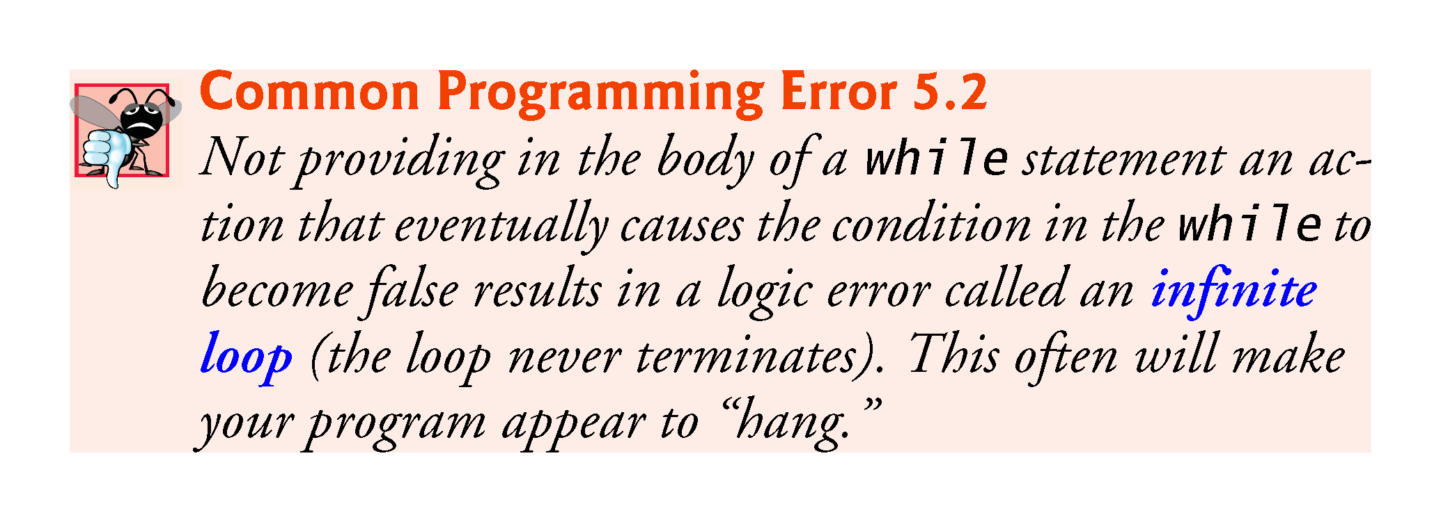

Slide 46
5.8 while Iteration Statement
The UML activity diagram in Fig. 5.7 illustrates the flow of control in the preceding while statement.
This diagram introduces the UML’s merge symbol.
The UML represents both the merge symbol and the decision symbol as diamonds.
The merge symbol joins multiple flows of activity into one.
  In this diagram, the merge symbol joins the transitions from the initial state and from the action state, so they both flow into the decision that determines whether the loop should begin (or continue) executing

Slide 47
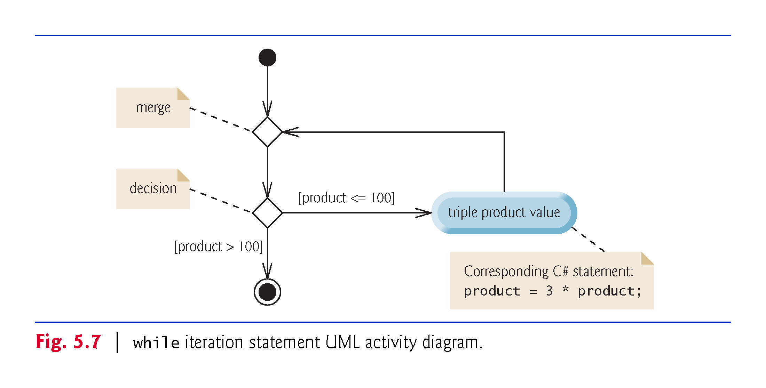

Slide 48
5.9 Formulating Algorithms: Counter-Controlled Iteration
Consider the following problem statement:
A class of 10 students took a quiz. The grades (integers in
the range 0 to 100) for this quiz are available to you.
Determine the class average on the quiz.
The algorithm must input each grade, keep track of the total of all grades input, perform the averaging calculation and display the result.

Slide 49
5.9.1 Pseudocode Algorithm with Counter-Controlled Iteration
Pseudocode Algorithm with Counter-Controlled Iteration
We use counter-controlled iteration to input the grades one at a time.
A variable called a counter controls the number of times a set of statements will execute.
Counter-controlled iteration is often called definite iteration, because the number of iterations is known before the loop begins executing.
Figure 5.8 expresses the algorithm in pseudocode.
A total is a variable used to accumulate the sum of several values.
A counter is a variable used to count.

Slide 50
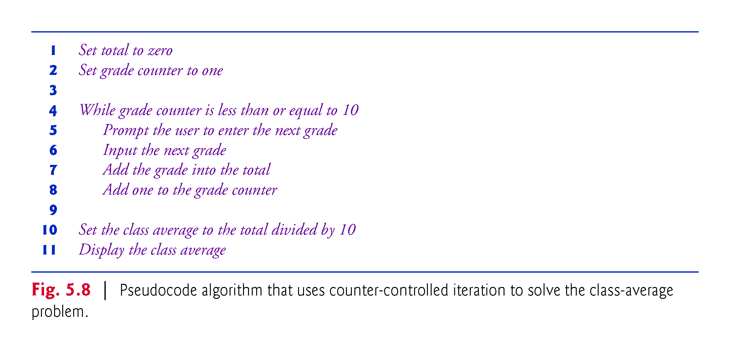

Slide 51
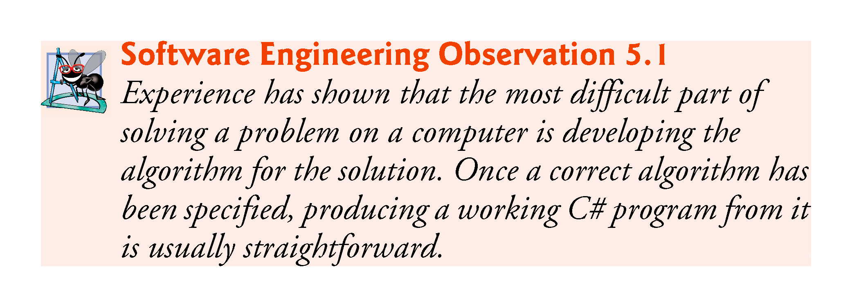

Slide 52
5.9.2 Implementing Counter-Controlled Iteration
In Fig. 5.9, method Main implements the class-averaging algorithm described by the pseudocode in —it allows the user to enter 10 grades, then calculates and displays the average

Slide 53
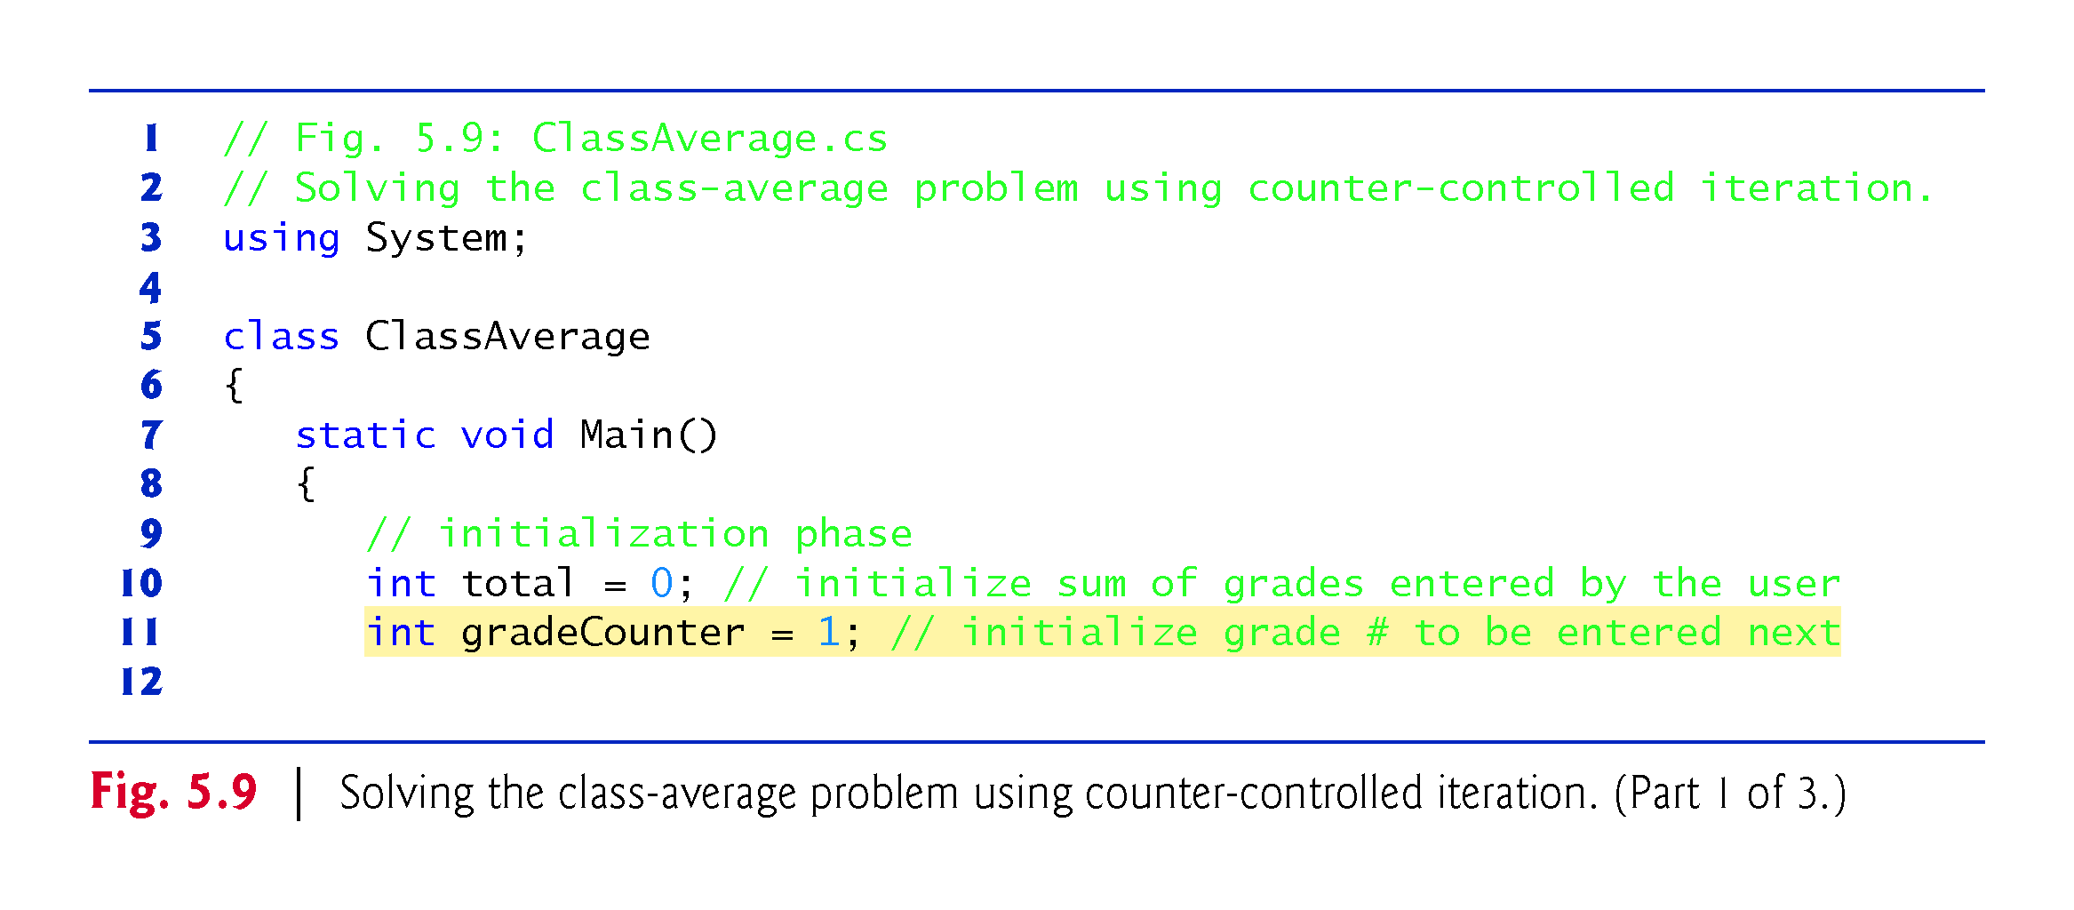

Slide 54
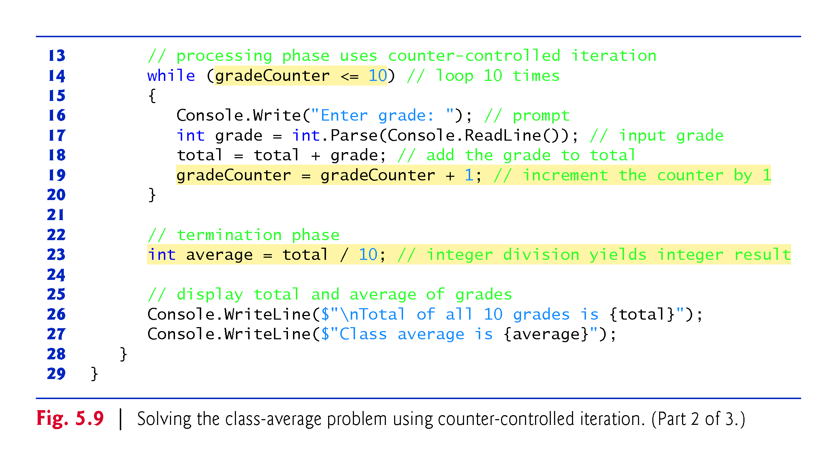

Slide 55
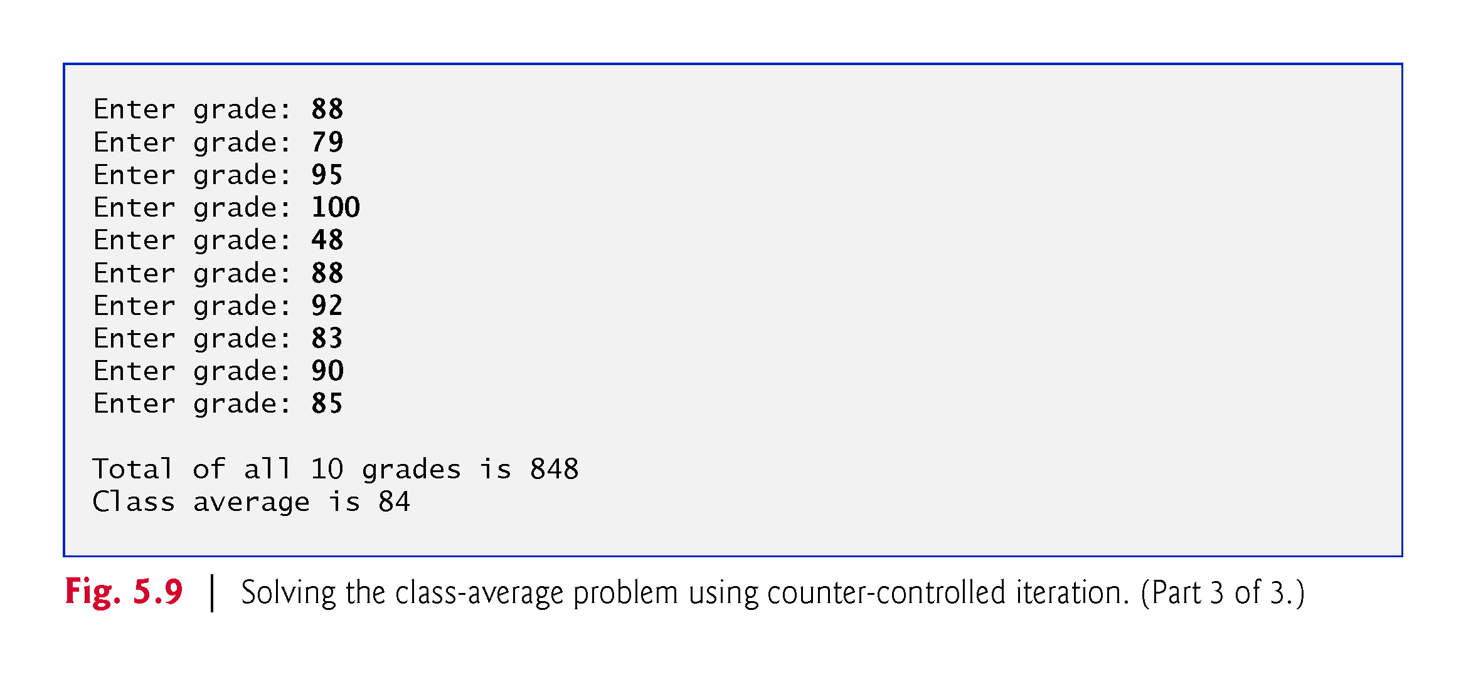

Slide 56
5.9.2 Implementing Counter-Controlled Iteration
C# requires local variables to be definitely assigned—that is, each local variable must be assigned a value before the variable’s value is used.

Slide 57
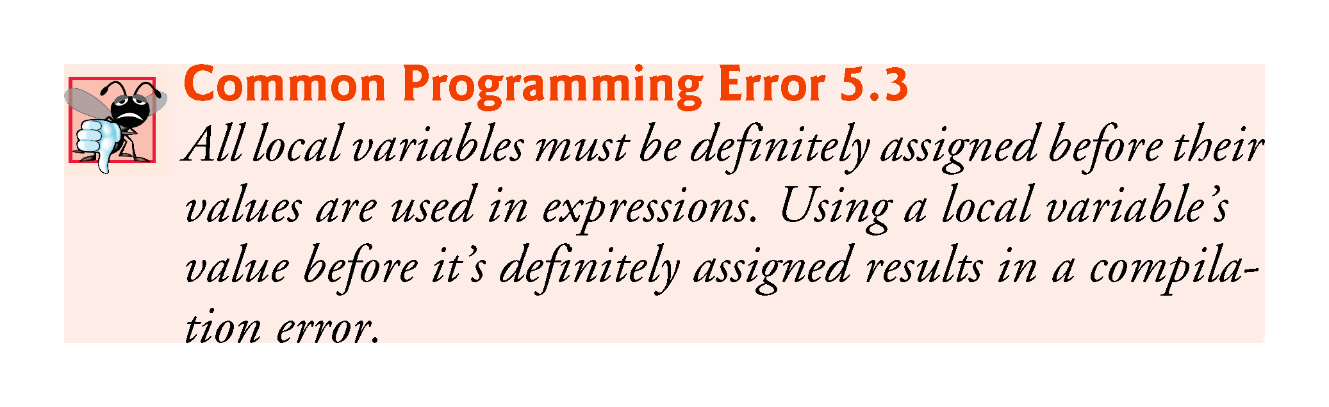

Slide 58
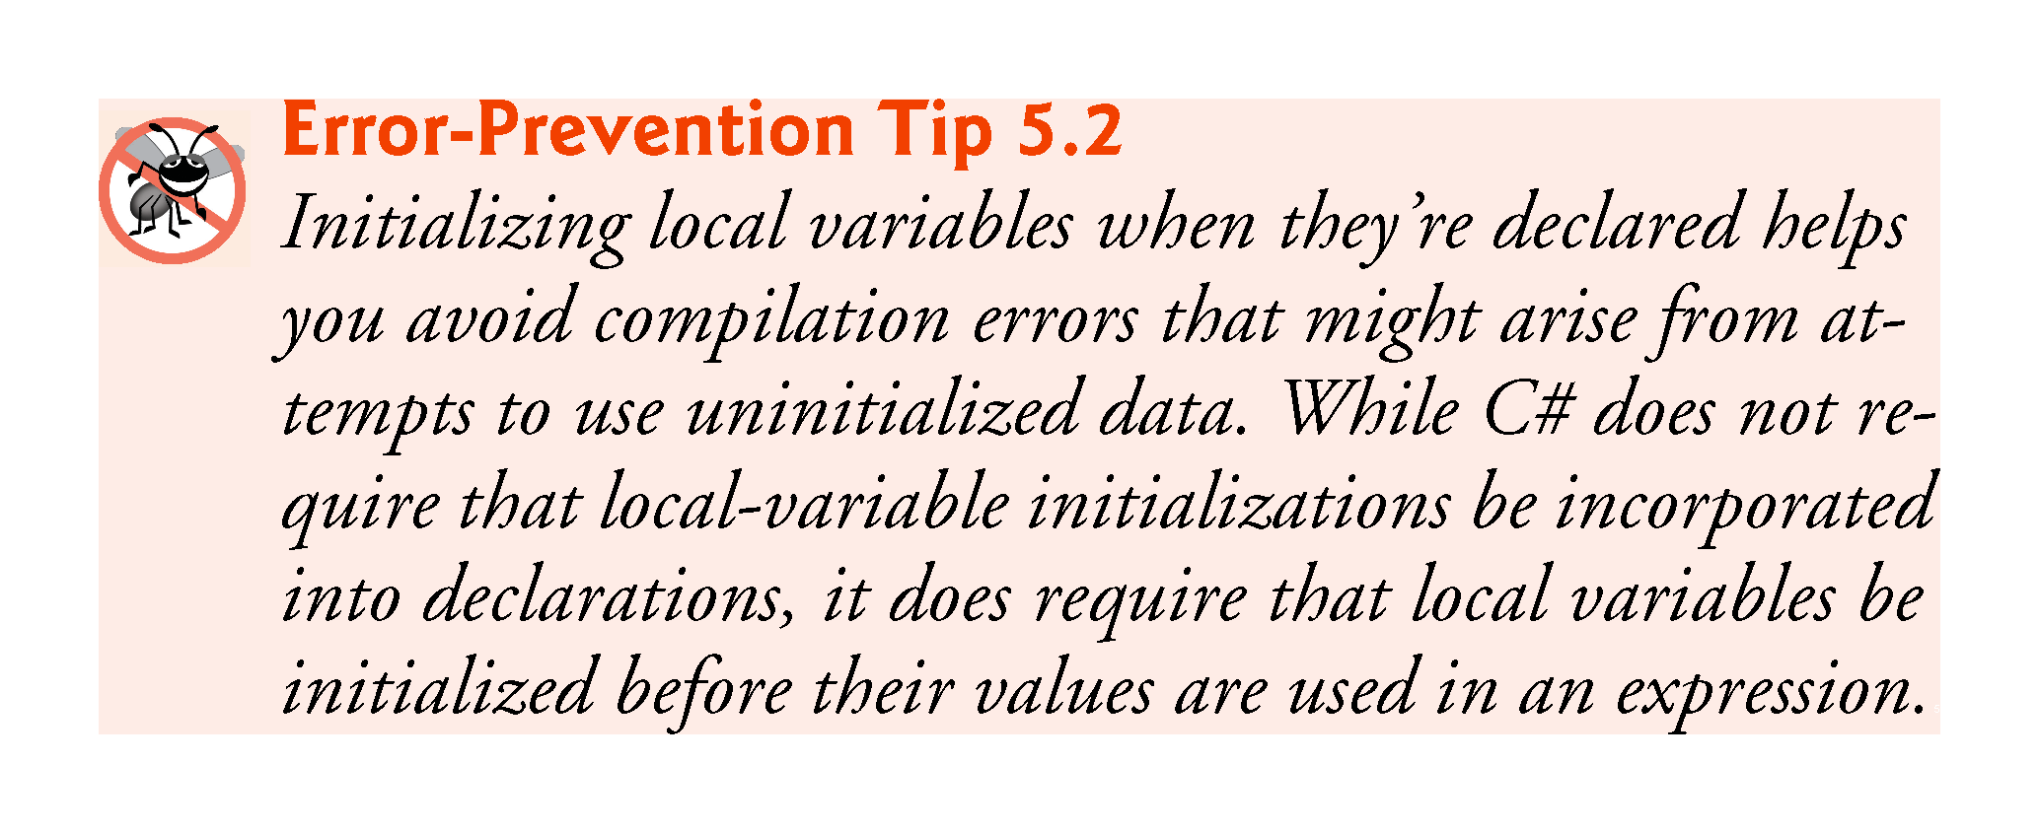

Slide 59
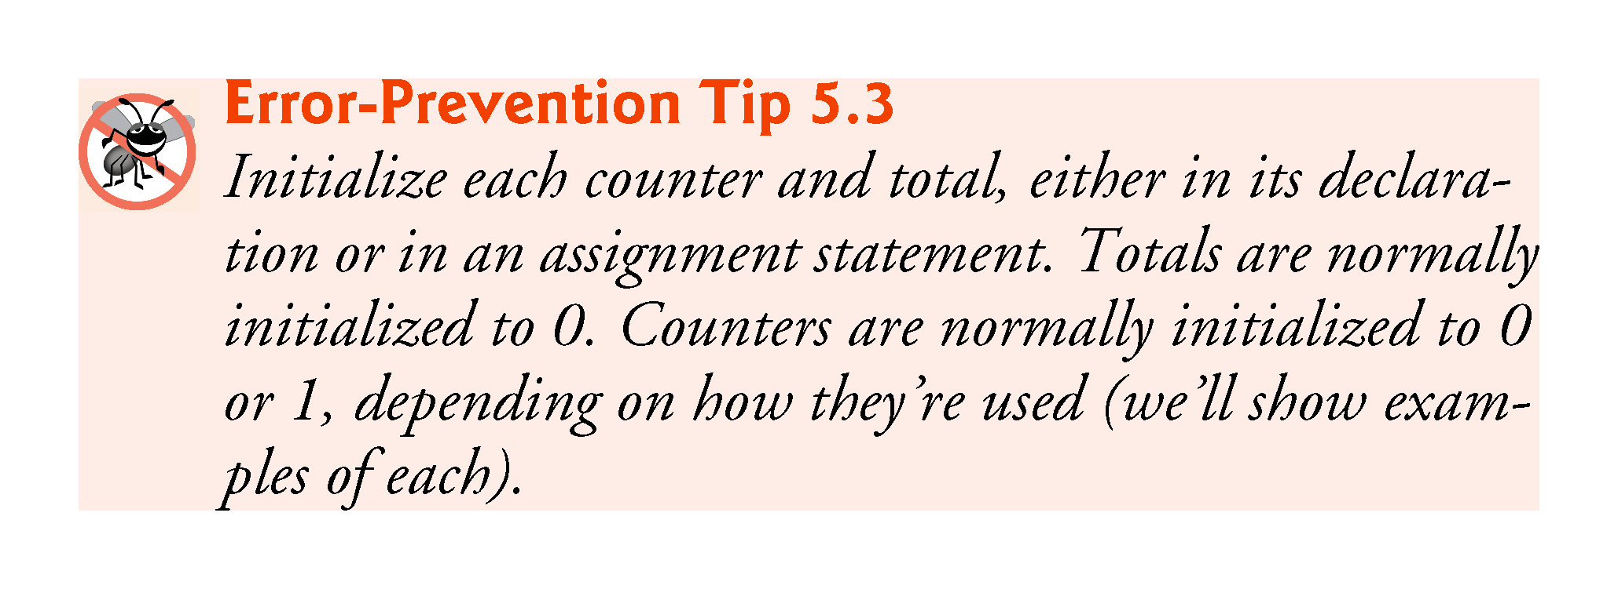

Slide 60
5.9.3 Integer Division and Truncation
Dividing two integers results in integer division.
Any fractional part of the result is lost (i.e., truncated, not rounded).

Slide 61
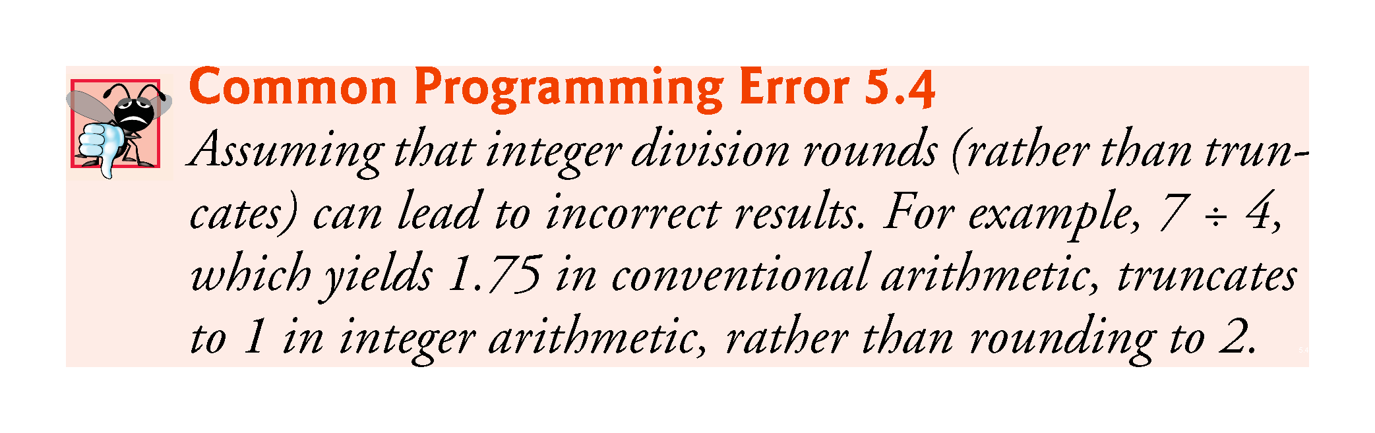

Slide 62
5.10 Formulating Algorithms: Sentinel-Controlled Iteration
Consider the following problem:
  Develop a class-averaging app that processes grades for an arbitrary number of students each time it’s run.
In this example, no indication is given of how many grades the user will enter during the app’s execution.
A sentinel value can be entered to indicate “end of data entry.” This is called sentinel-controlled iteration.
Sentinel-controlled iteration is often called indefinite iteration because the number of iterations is not known before the loop begins.

Slide 63
5.10.1 Top-Down, Stepwise Refinement: The Top and First Refinement
We approach the class averaging program with a technique called top-down, stepwise refinement.
The top conveys the overall function of the app: determine the class average for the quiz
We divide the top into a series of smaller tasks in the first refinement:
  initialize variables
  input, sum and count the quiz grades
  calculate and display the class average

Slide 64
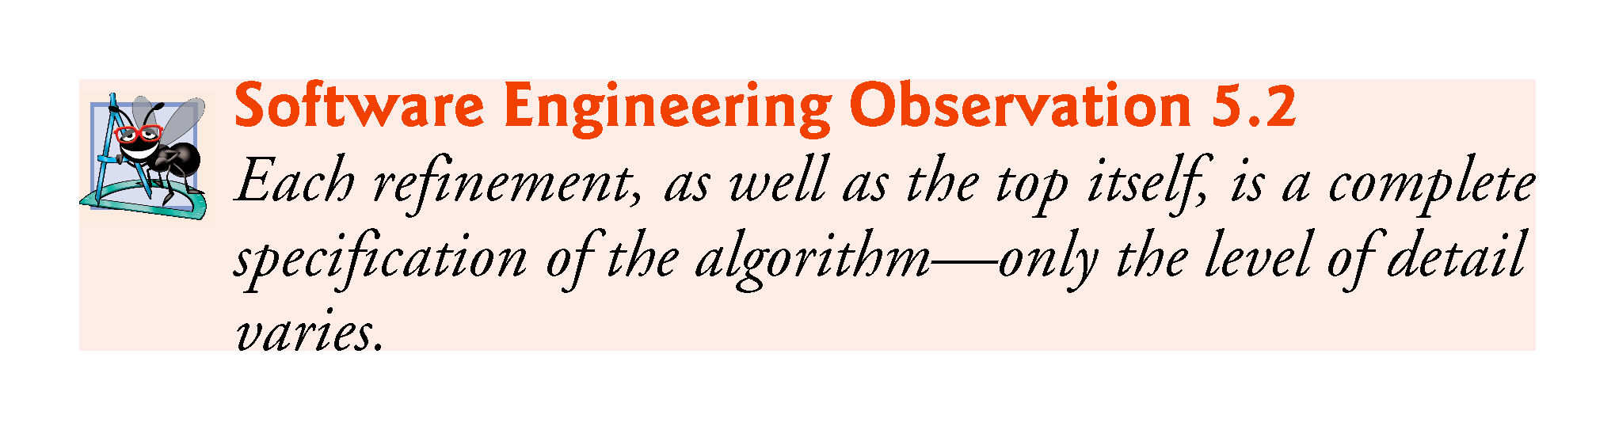

Slide 65
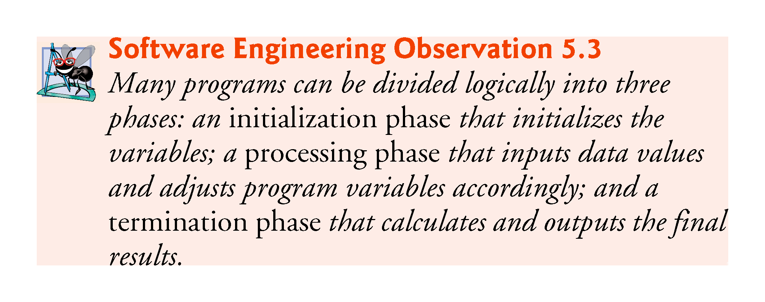

Slide 66
5.10.2 Second Refinement
The second refinement specifies individual variables.
  initialize variables
This can be refined as follows:
  initialize total to zero
  initialize counter to zero

Slide 67
5.10.2 Second Refinement
input, sum and count the quiz grades
The second refinement of the preceding pseudocode state­ment is:
  prompt the user to enter the first grade
  input the first grade (possibly the sentinel)
  while the user has not yet entered the sentinel
  add this grade into the running total
  add one to the grade counter
  prompt the user to enter the next grade
  input the next grade (possibly the sentinel)

Slide 68
5.10.2 Second Refinement
calculate and display the class average
The preceding pseudocode can be refined as follows:
  if the counter is not equal to zero
  set the average to the total divided by the counter
  display the average
  else
  display “No grades were entered”
We are careful here to test for the possibility of division by zero.
The complete second refinement of the pseudocode for the class-average problem is shown in Fig. 5.10.

Slide 69
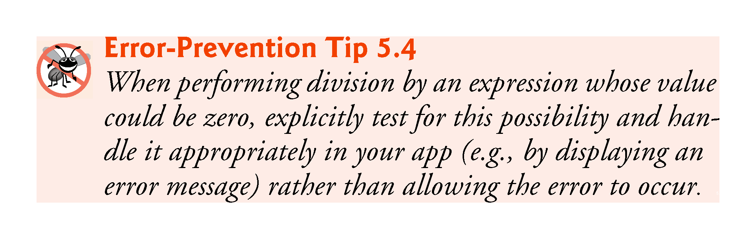

Slide 70
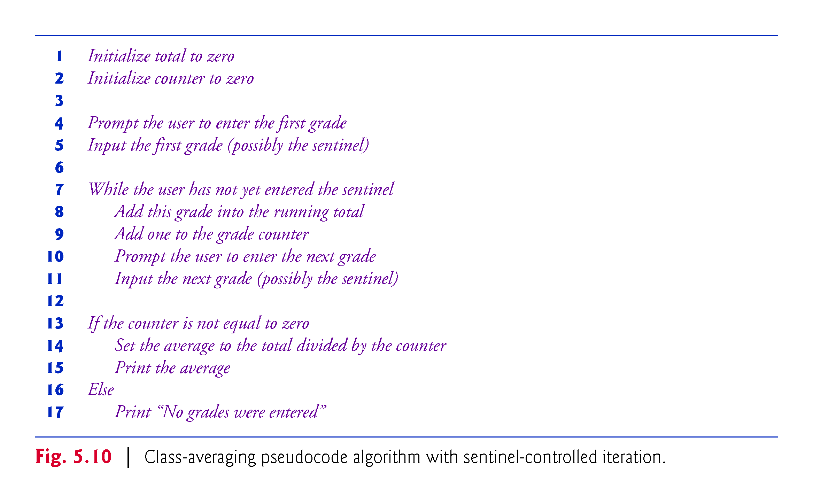

Slide 71
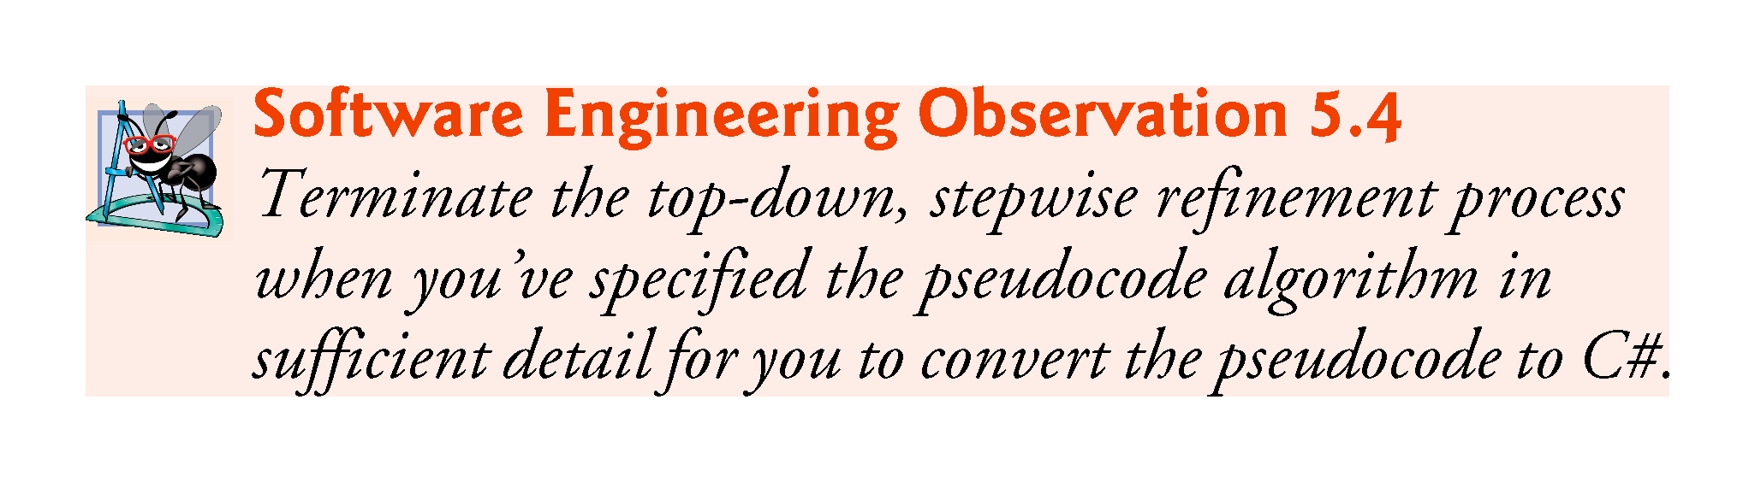

Slide 72
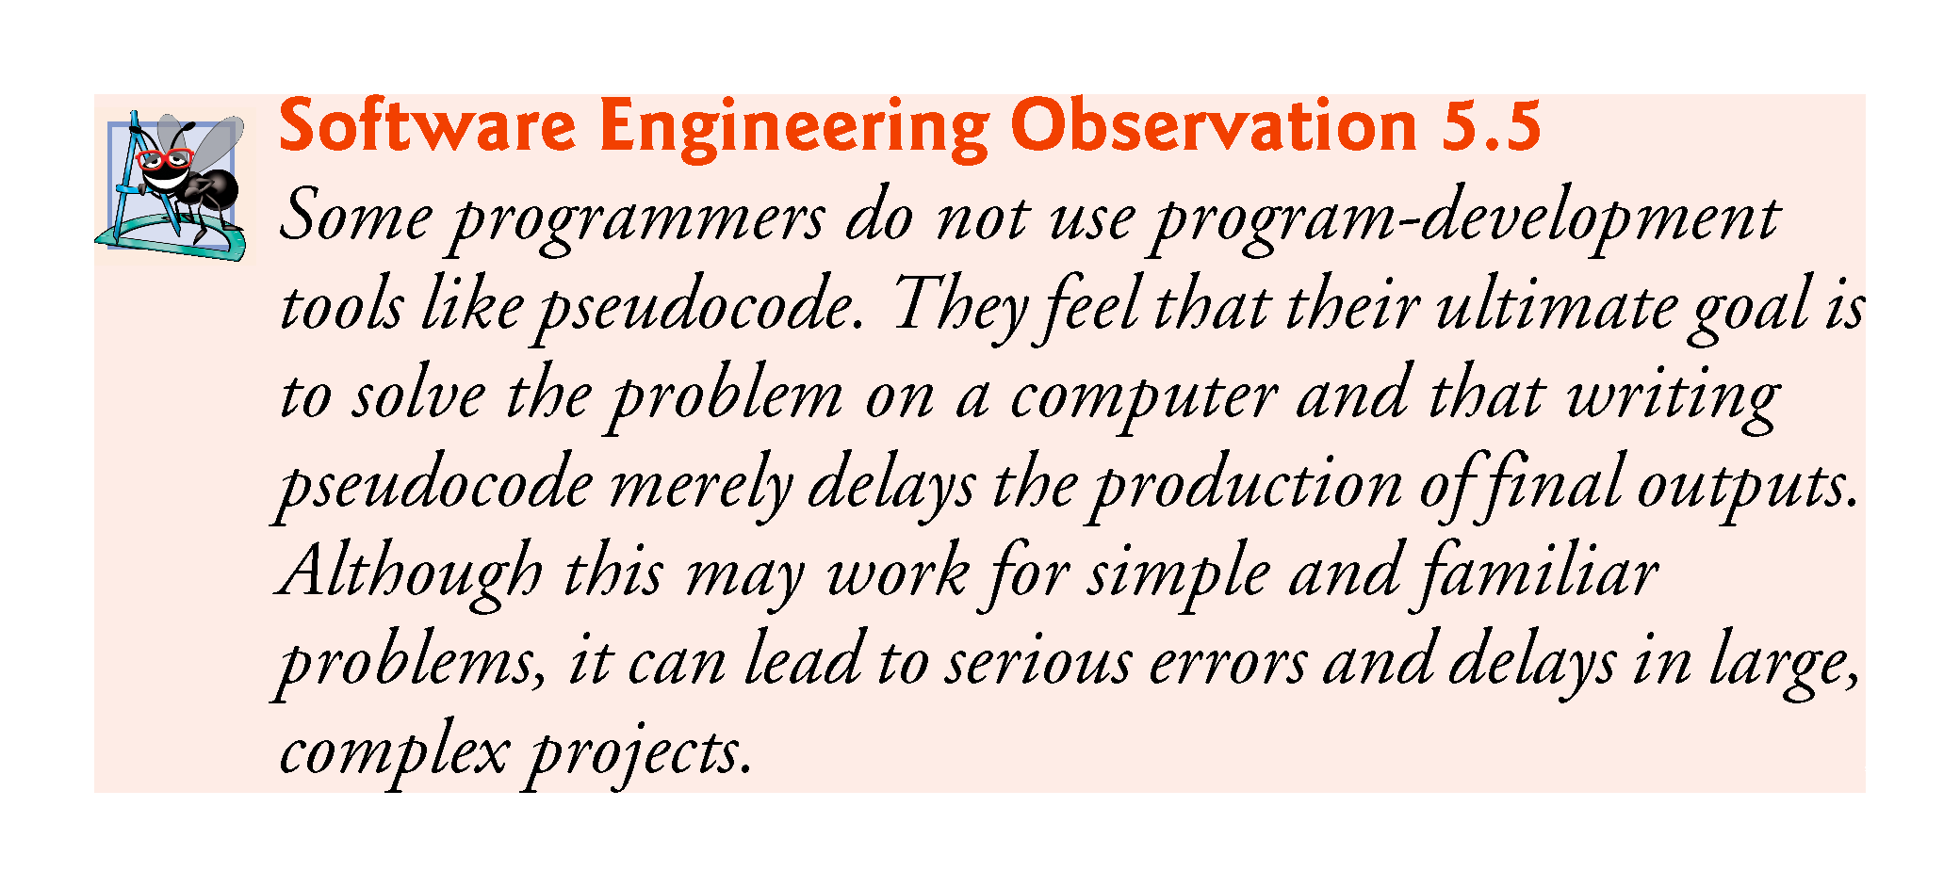

Slide 73
5.10.3 Implementing Sentinel-Controlled Iteration
In Fig. 5.11, method Main implements the pseudocode algorithm of Fig. 5.10.
Although each grade entered by the user is an integer, the averaging calculation is likely to produce a number with a decimal.
The type int cannot represent such a number.
C# provides data types float and double to store floating-point numbers in memory.

Slide 74
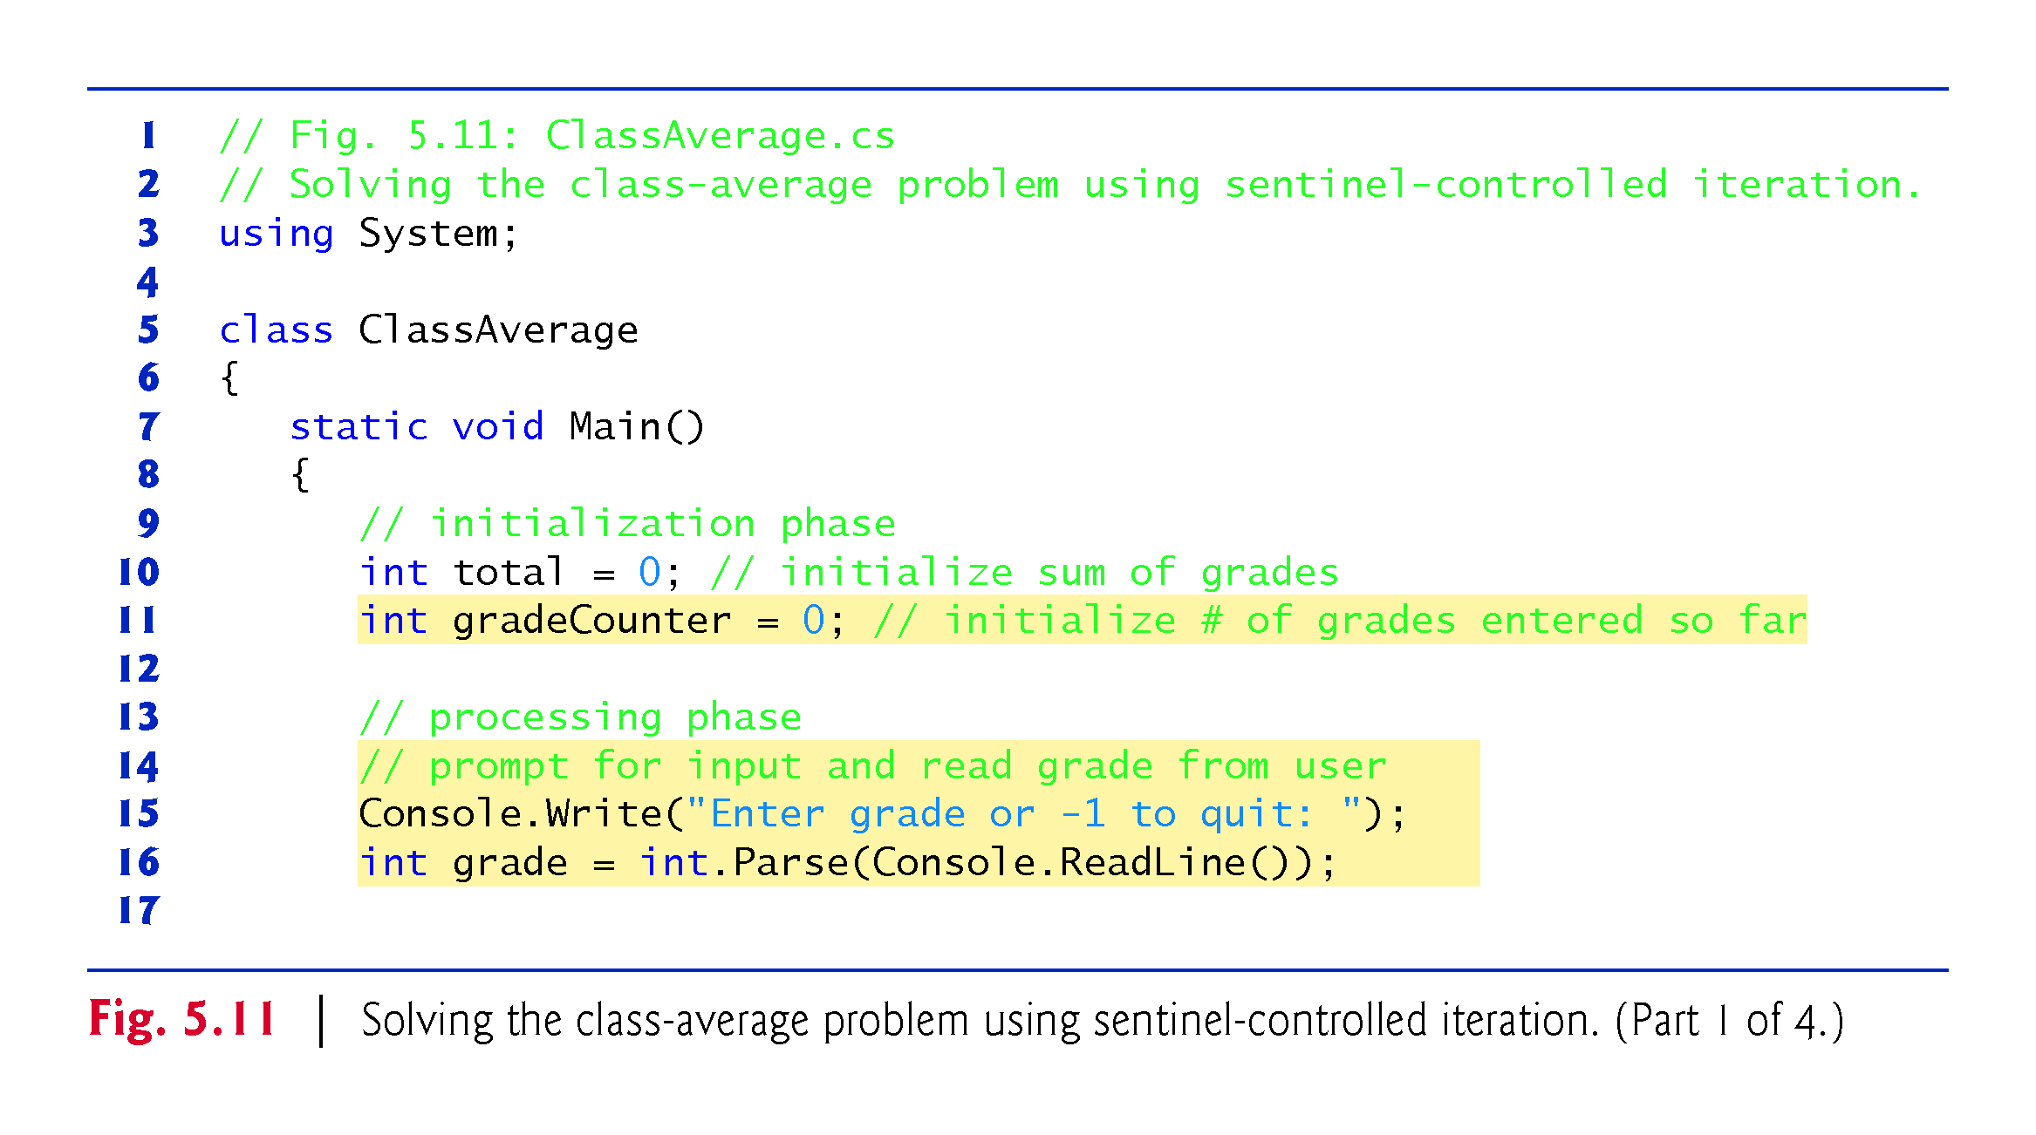

Slide 75
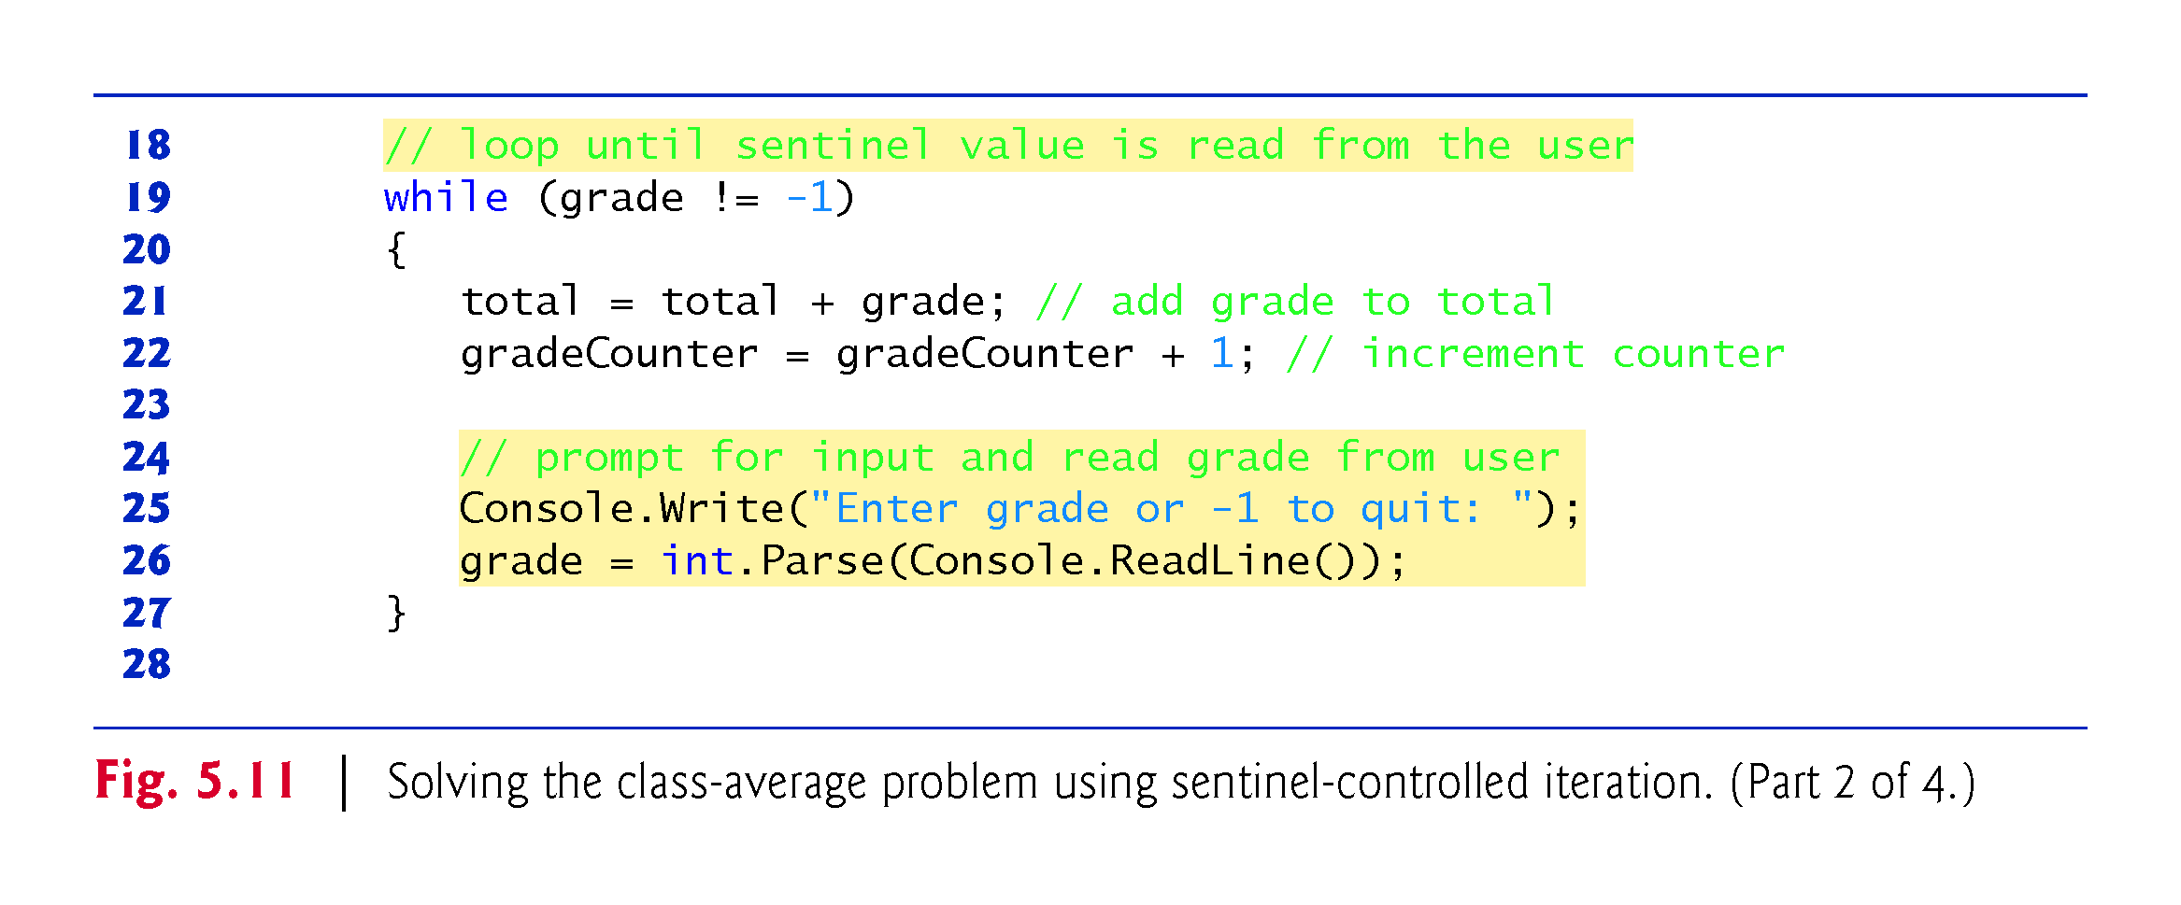

Slide 76
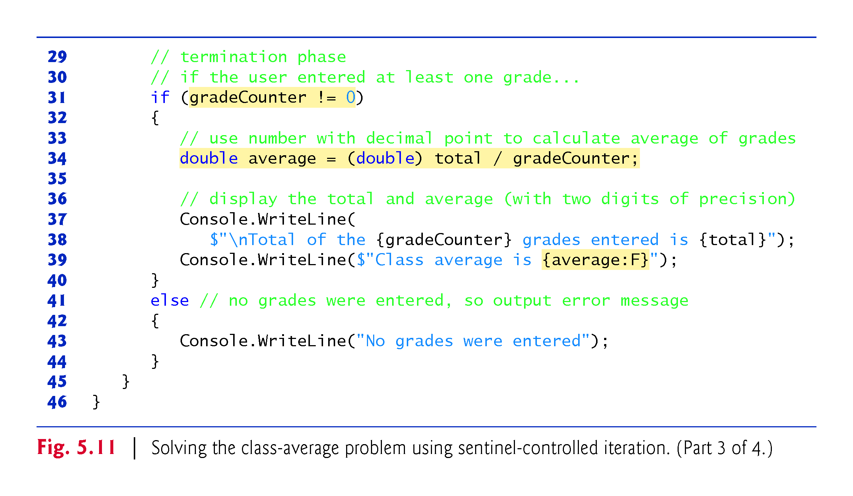

Slide 77
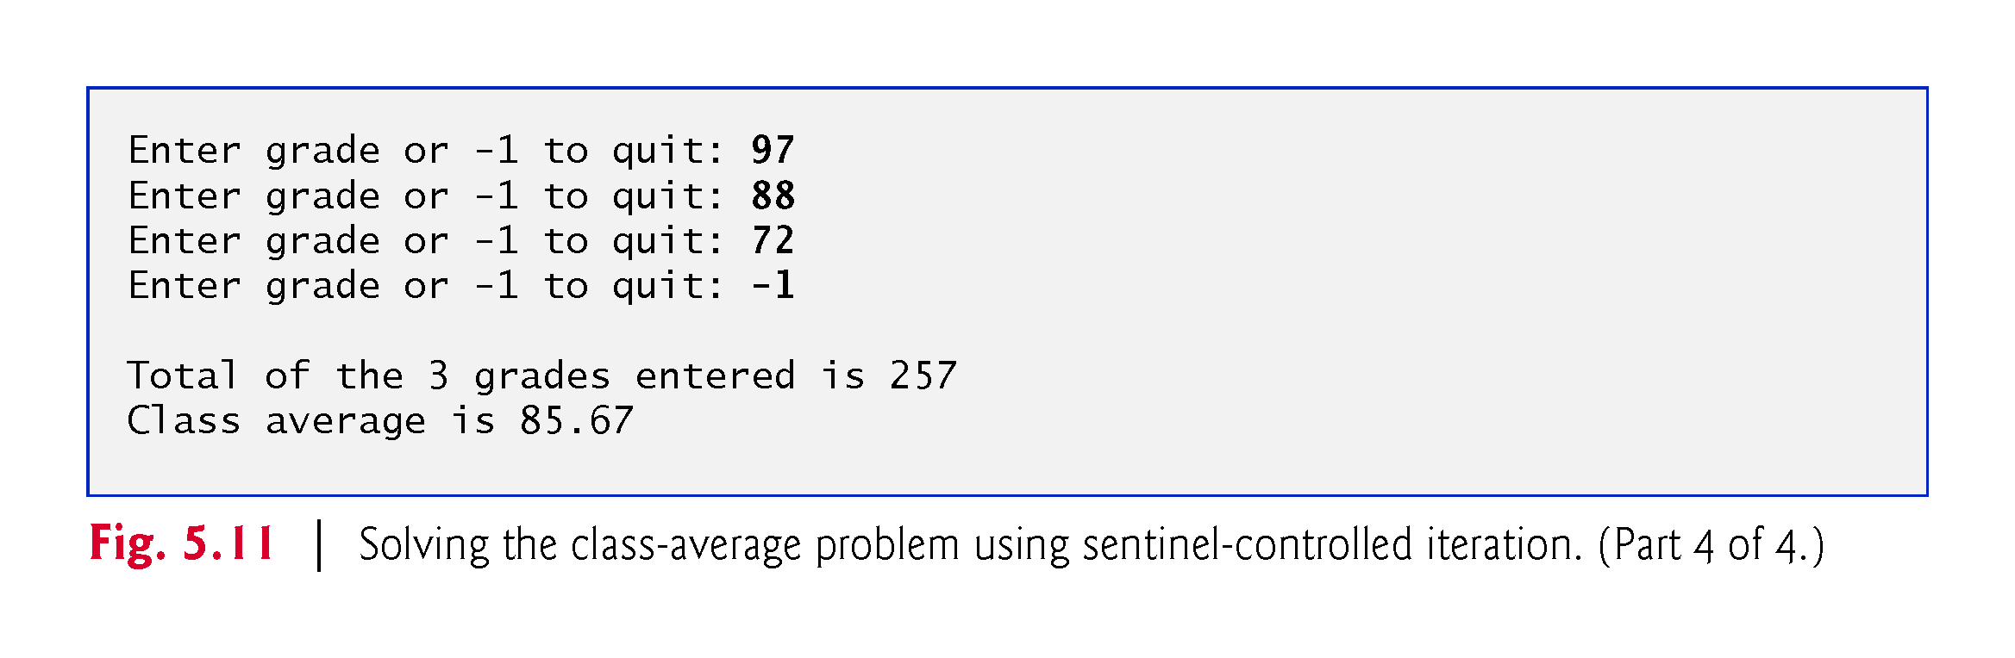

Slide 78
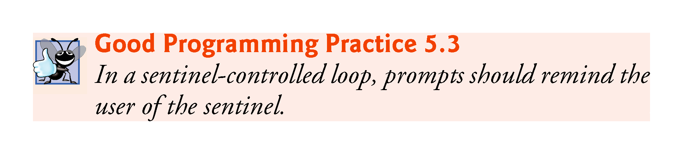

Slide 79
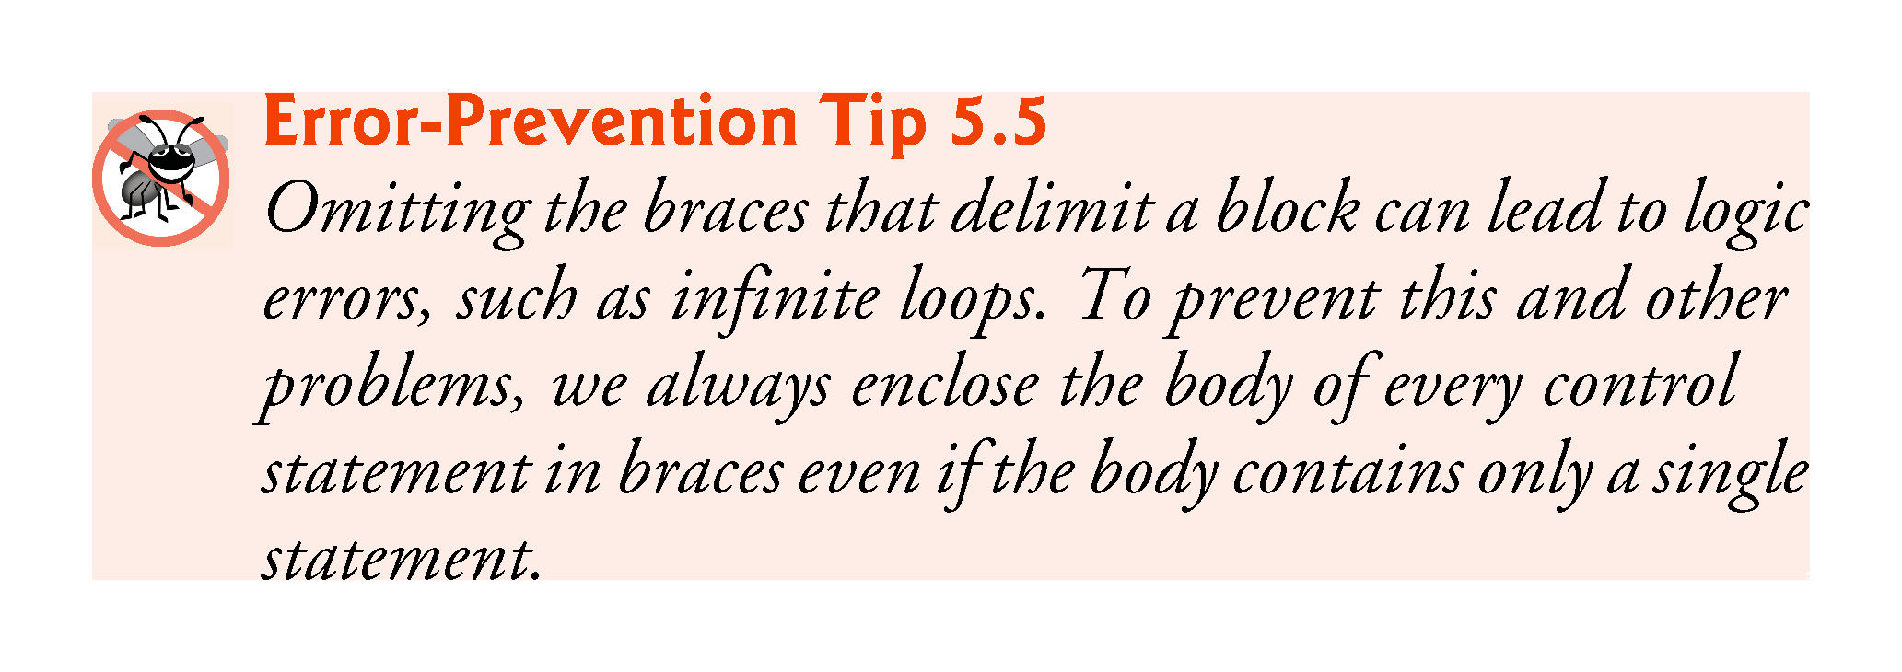

Slide 80
5.10.6 Converting Between Simple Types Explicitly and Implicitly
To perform a floating-point calculation with integer values, we temporarily treat these values as floating-point numbers.
A unary cast operator such as (double) performs explicit conversion.
C# performs an operation called promotion (or implicit conversion) on selected operands for use in the expression.
The cast operator is formed by placing parentheses around the name of a type.
This operator is a unary operator (i.e., an operator that takes only one operand).
Cast operators have the second highest precedence.

Slide 81
5.10.7 Formatting Floating-Point Numbers
Line 39
  Console.WriteLine($"Class average is {average:F}");
outputs the class average.
The format specifier F in the interpolation expression
  {average:F}
typically formats average’s value with two digits to the right of the decimal point
  the Windows culture settings on the user’s machine determine the actual format, including the digits to the right of the decimal point, whether commas or periods are used for separating thousands, millions, etc.

Slide 82
5.11 Formulating Algorithms: Nested Control Statements
We’ve seen that control statements can be stacked on top of one another (in sequence).
In this case study, we examine the only other struc-tured way control statements can be connected, namely, by nesting one control statement within another.

Slide 83
5.11.1 Formulating Algorithms: Nested Control Statements
A college offers a course that prepares students for the state licensing exam for real estate brokers. Last year, 10 of the students who completed this course took the exam. The college wants to know how well its students did on the exam. You’ve been asked to write an app to summarize the results. You’ve been given a list of these 10 students. Next to each name is written a 1 if the student passed the exam or a 2 if the student failed.

Slide 84
5.11.1 Formulating Algorithms: Nested Control Statements
Your app should analyze the results of the exam as follows:
Input each test result (i.e., a 1 or a 2). Display the message “Enter result” on the screen each time the app requests another test result.
Count the number of test results of each type.
Display a summary of the test results indicating the number of students who passed and the number who failed.
If more than eight students passed the exam, display the message “Bonus to instructor!”

Slide 85
5.11.1 Formulating Algorithms: Nested Control Statements
After reading the problem statement, we make the following observations:
  The app must process test results for 10 students. A counter-controlled loop can be used because the number of test results is known in advance.
  Each test result has a numeric value—either a 1 or a 2. Each time the app reads a test result, the app must determine whether the number is a 1 or a 2. We test for a 1 in our algorithm. If the number is not a 1, we assume that it’s a 2.
  Two counters are used to keep track of the exam results—one to count the number of students who passed the exam and one to count the number of students who failed the exam.
  After the app has processed all the results, it must determine whether more than eight students passed the exam.

Slide 86
5.11.2 Top-Down, Stepwise Refinement: Pseudocode Representation of the Top
Proceed with top-down, stepwise refinement:
  analyze exam results and decide whether the instructor should receive a bonus

Slide 87
5.11.3 Top-Down, Stepwise Refinement: First Refinement
Proceed with top-down, stepwise refinement:
  analyze exam results and decide whether the instructor should receive a bonus
Our first refinement is
  initialize variables
  input the 10 exam results, and count passes and failures
  display a summary of the exam results and decide whether the instructor should receive a bonus

Slide 88
5.11.4 Top-Down, Stepwise Refinement: Second Refinement
initialize variables
The preceding pseudocode statement can be refined as follows:
  initialize passes to zero
  initialize failures to zero
  initialize student counter to one

Slide 89
5.11.4 Top-Down, Stepwise Refinement: Second Refinement
input the 10 exam results, and count passes and failures
A nested double-selection statement will determine whether each exam result is a pass or a failure:
  while student counter is less than or equal to 10
  prompt the user to enter the next exam result
  input the next exam result
  if the student passed
  add one to passes
  else
  add one to failures
  add one to student counter

Slide 90
5.11.4 Top-Down, Stepwise Refinement: Second Refinement
display a summary of the exam results and decide whether the instructor should receive a bonus
can be refined as follows:
  display the number of passes
  display the number of failures
  if more than eight students passed
  display “Bonus to Instructor!”

Slide 91
5.11.5 Complete Second Refinement of the Pseudocode
The complete second refinement of the pseudocode appears in Fig. 5.12.

Slide 92
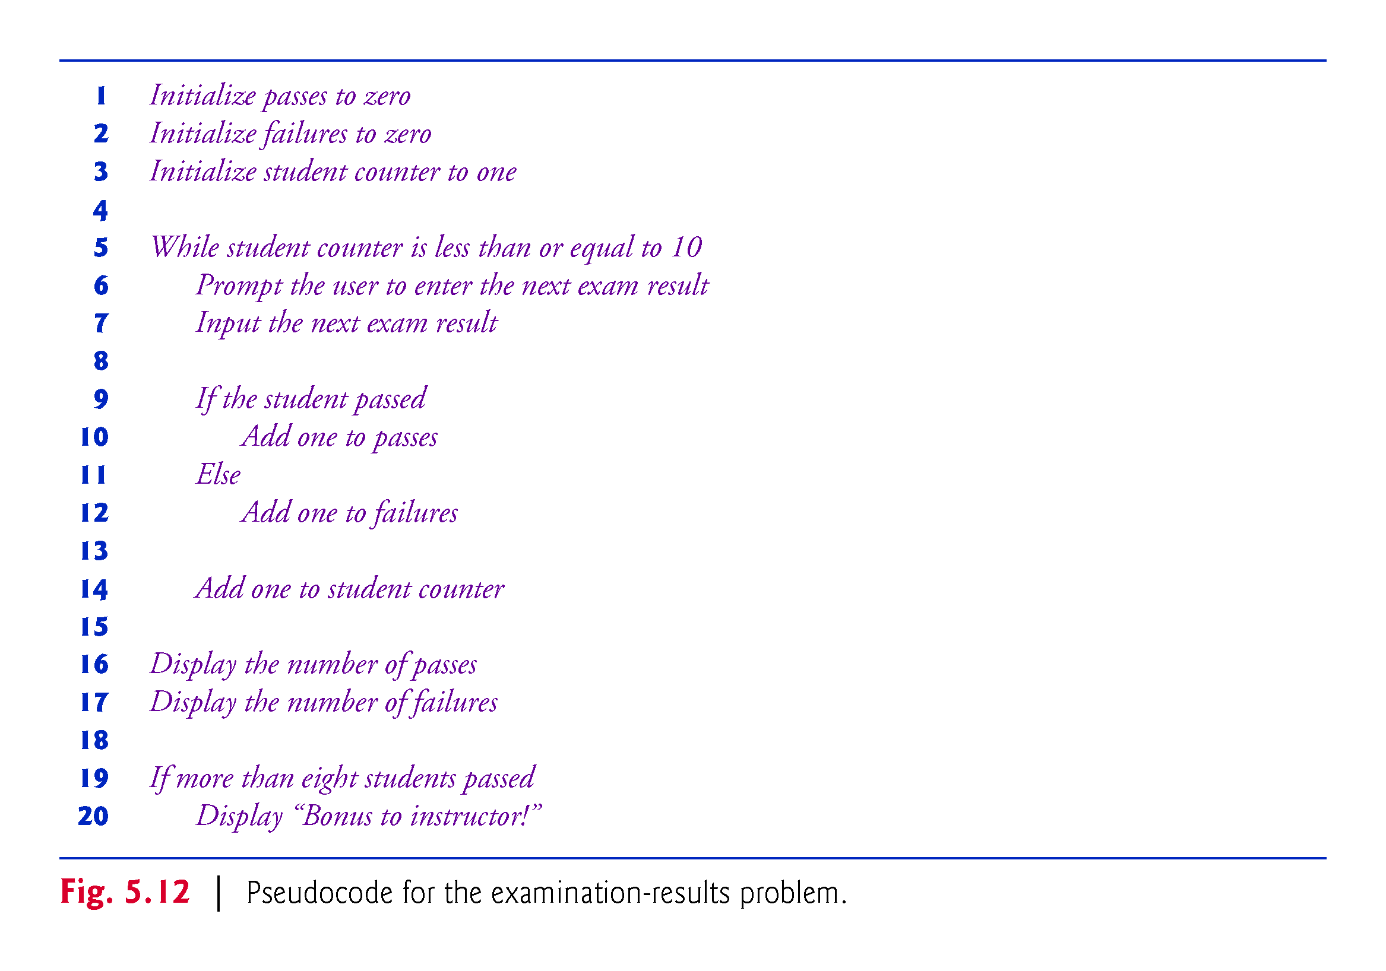

Slide 93
5.11.6 App That Implements the Pseudocode Algorithm
The program that implements the algorithm is shown in Fig. 5.13.

Slide 94
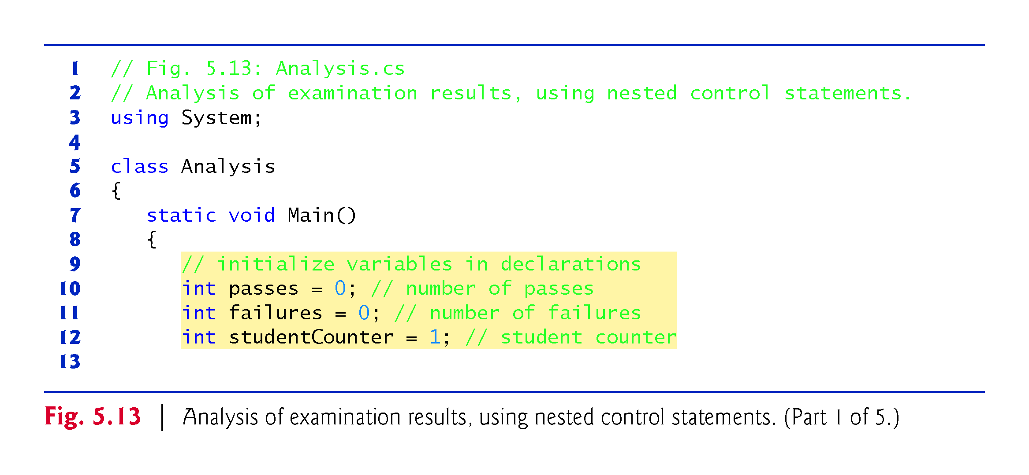

Slide 95
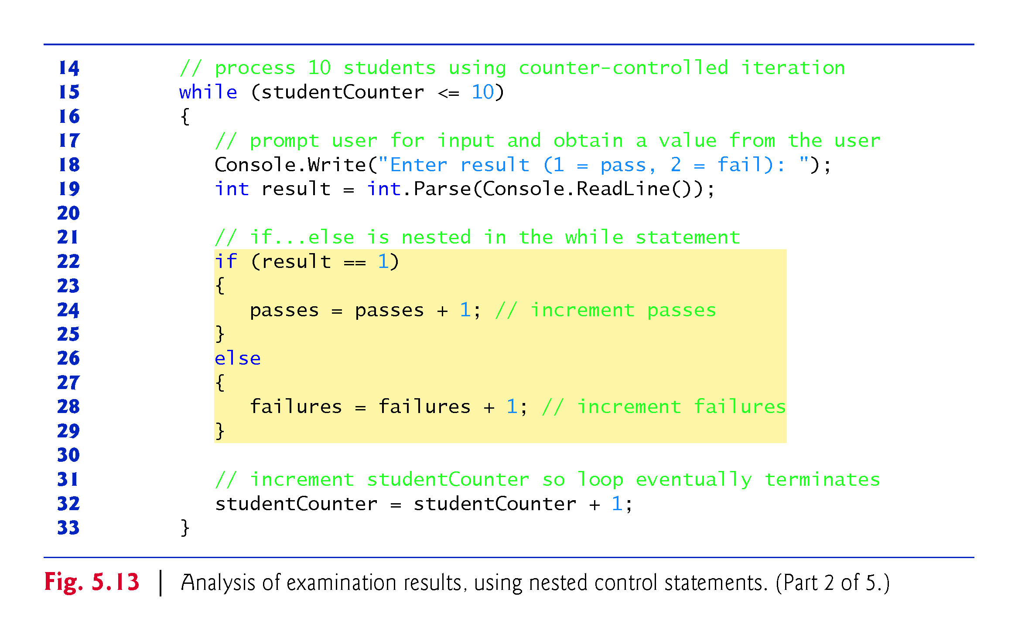

Slide 96
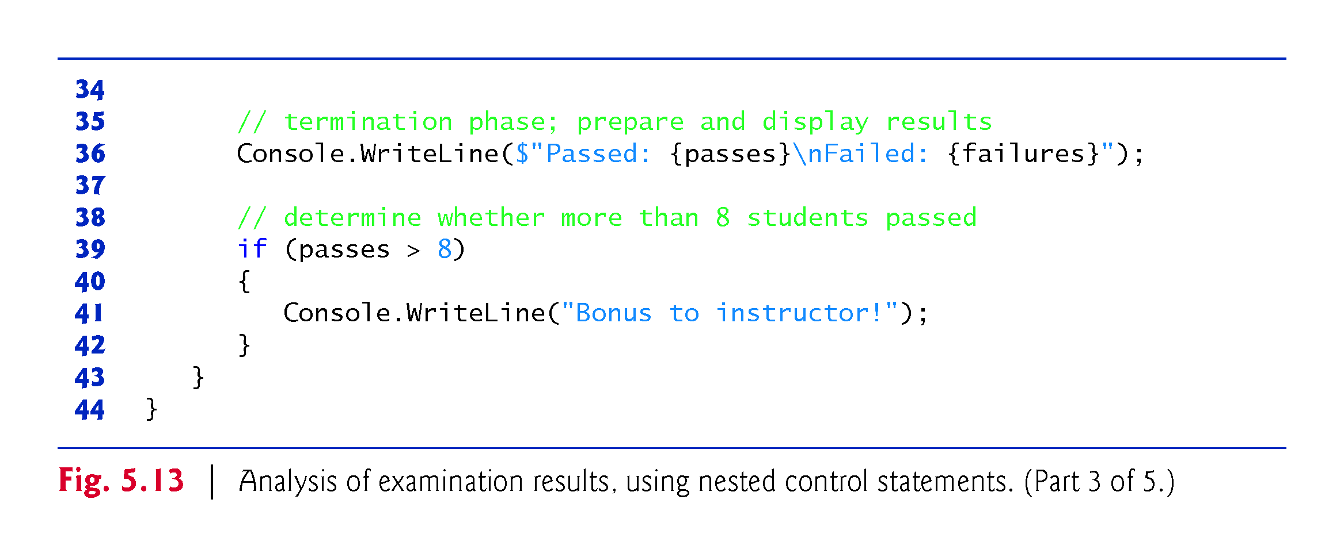

Slide 97
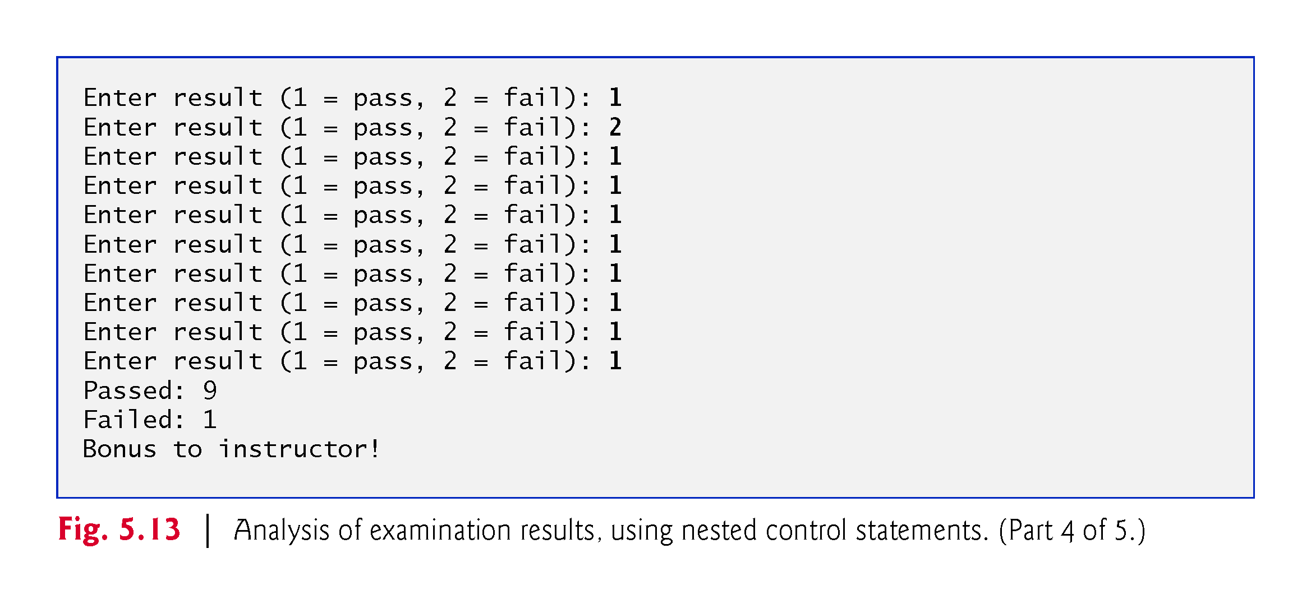

Slide 98
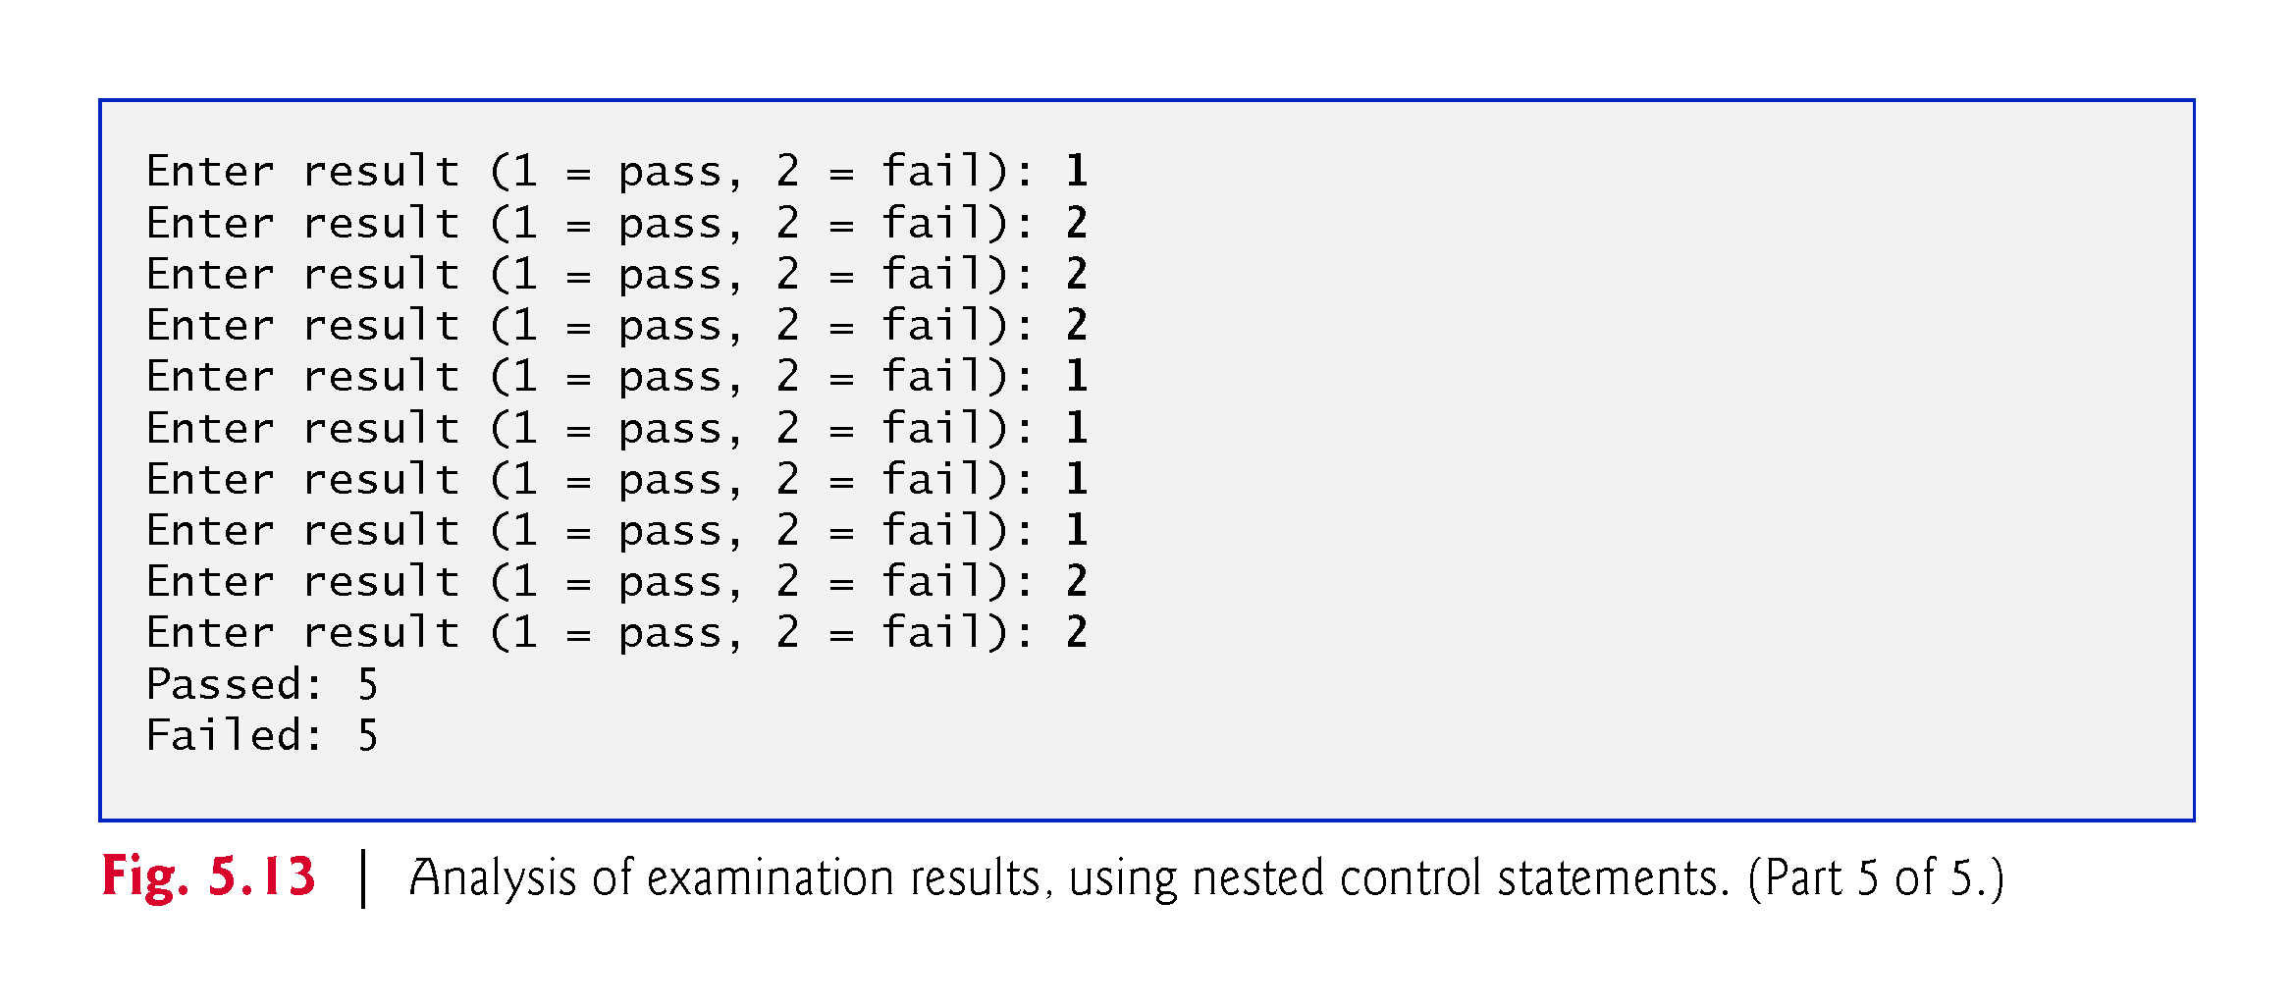

Slide 99
5.12 Compound Assignment Operators
C# provides several compound assignment operators
For example, you can abbreviate the statement
c = c + 3;
with the addition compound assignment operator, +=, as
c += 3;

Slide 100
5.12 Compound Assignment Operators (Cont..)
Figure 5.14 shows the arithmetic compound assignment operators, sample expressions using the operators and explanations of what the operators do.

Slide 101
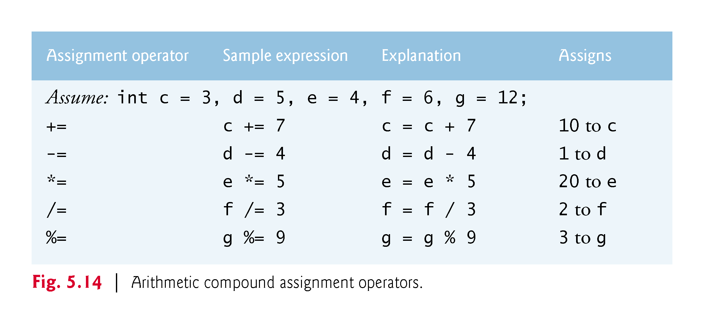

Slide 102
5.13 Increment and Decrement Operators
C# provides operators for adding or subtracting 1 from a numeric variable (Fig. 5.15).
  The unary increment operator, ++
  The unary decrement operator, --.

Slide 103
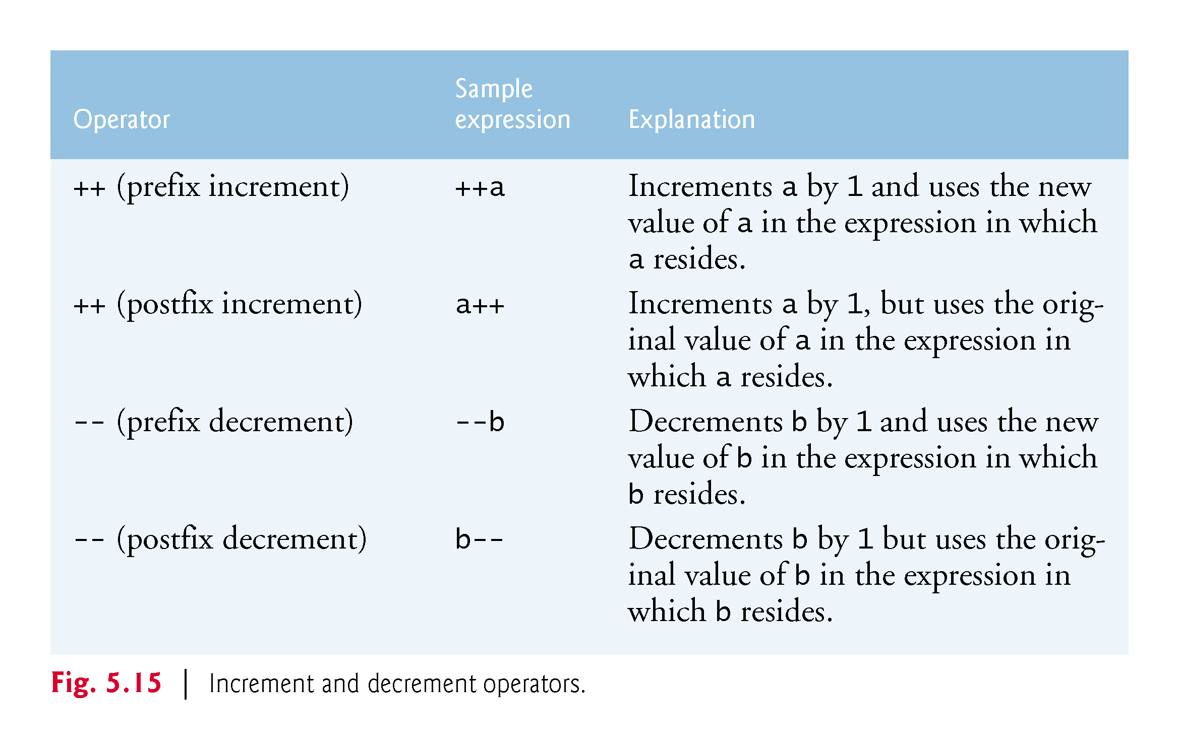

Slide 104
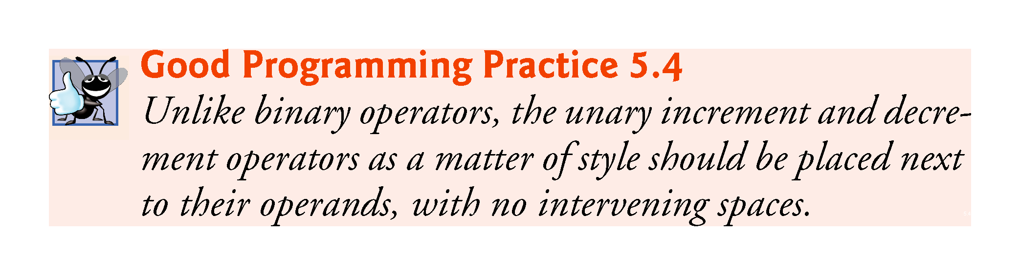

Slide 105
5.13.1 Prefix Increment vs. Postfix Increment
Figure 5.16 demonstrates the difference between the prefix increment and postfix increment versions of the ++ increment operator.

Slide 106
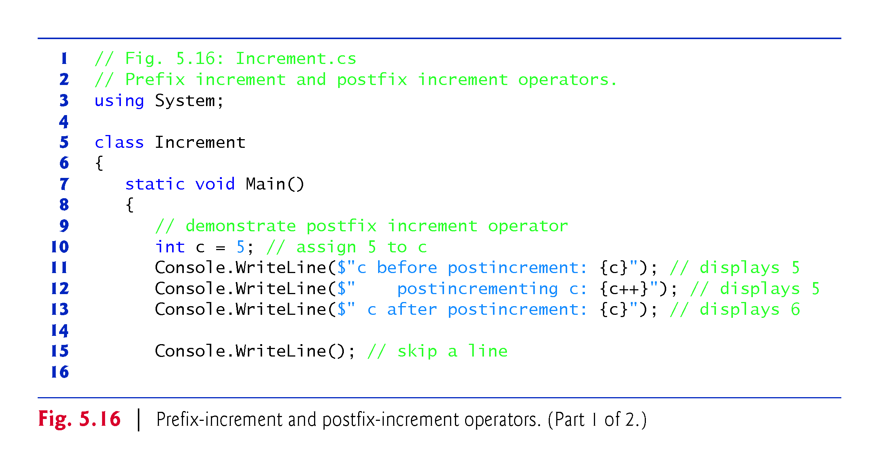

Slide 107


Slide 108
5.13.2 Simplifying Increment Statements
passes = passes + 1;
failures = failures + 1;
studentCounter = studentCounter + 1;
can be written more concisely with compound assignment operators:
passes += 1;
failures += 1;
studentCounter += 1;

Slide 109
5.13.2 Simplifying Increment Statements
This is even more precise with prefix increment operators:
++passes;
++failures;
++studentCounter;
Or with postfix increment operators:
passes++;
failures++;
studentCounter++;

Slide 110


Slide 111
5.13.3 Operator Precedence and Associativity
Figure 5.17 shows the precedence and associativity of the operators we’ve introduced to this point.

Slide 112


Slide 113
5.14 Simple Types
The table in Appendix B, Simple Types, lists the 13 simple types in C#.
C# requires all variables to have a type.
Instance variables of types char, byte, sbyte, short, ushort, int, uint, long, ulong, float, double, and decimal are all given the value 0 by default.
Instance variables of type bool are given the value false by default.
Reference-type instance variables are initialized by default to the value null.

